Slide 1
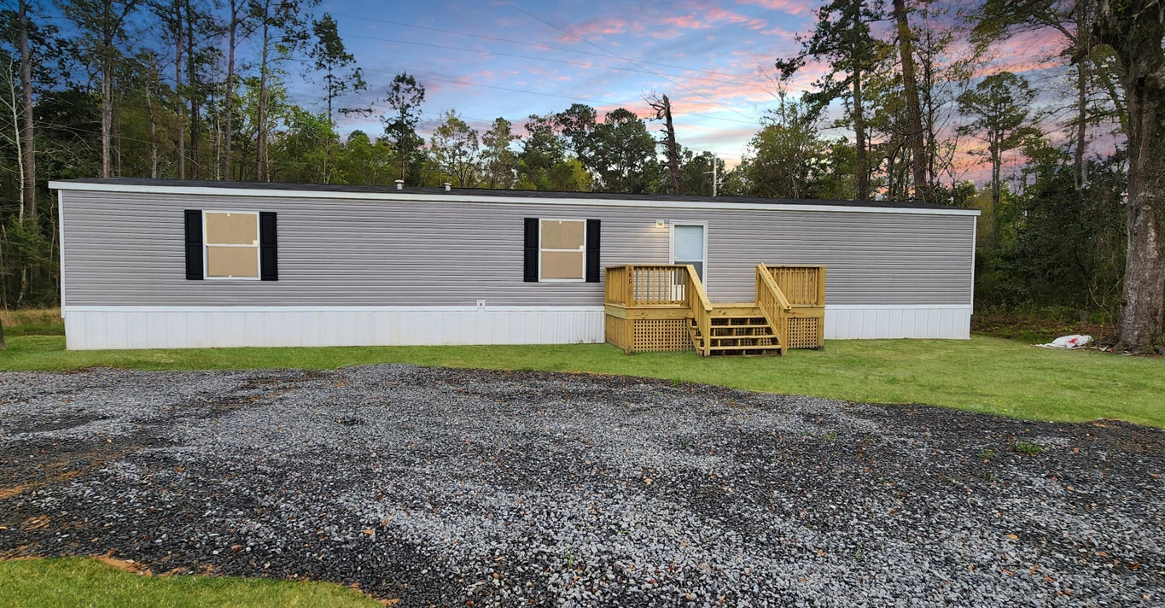
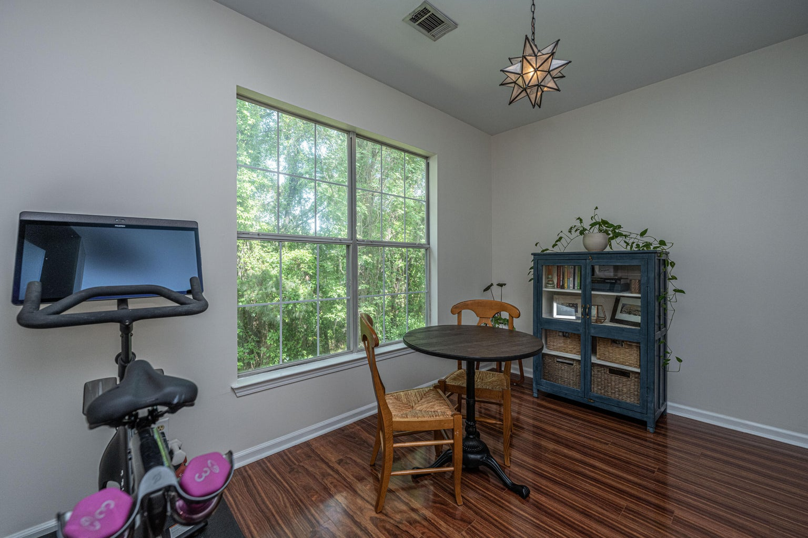
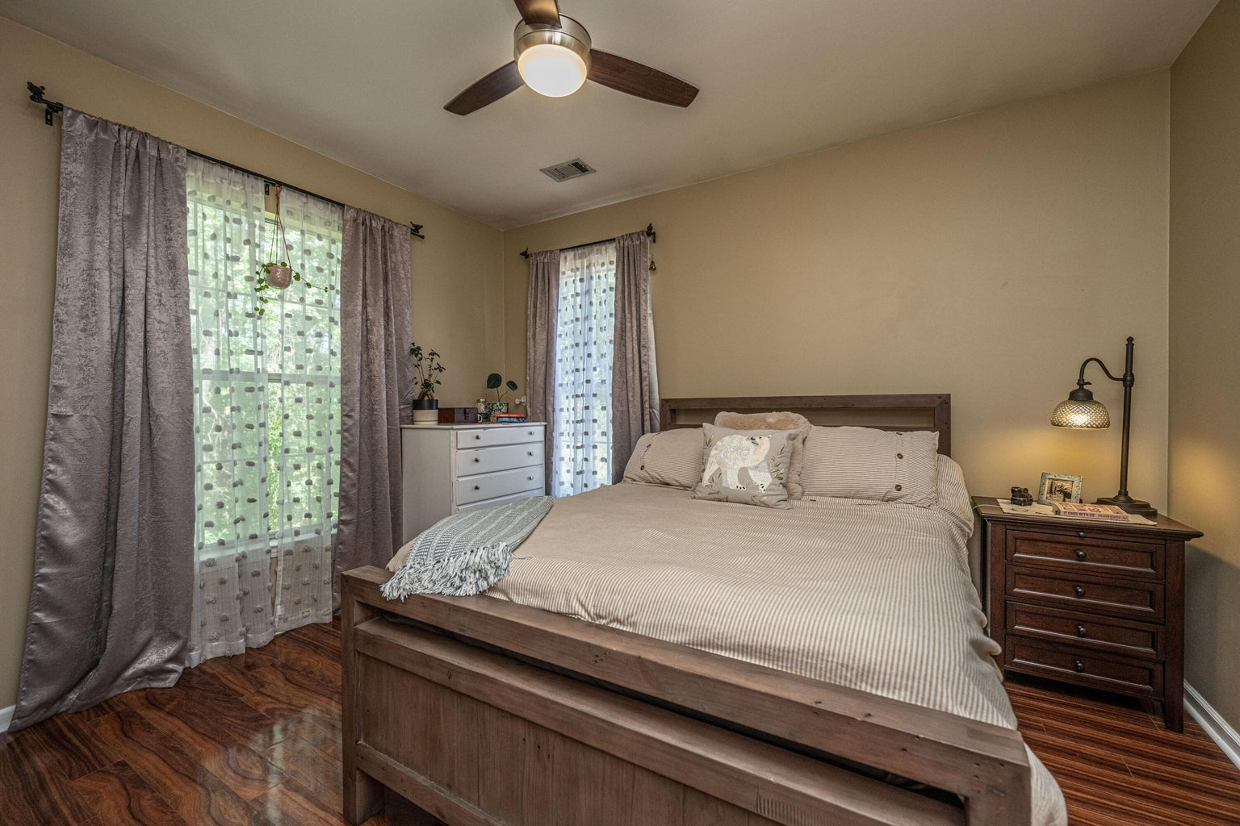
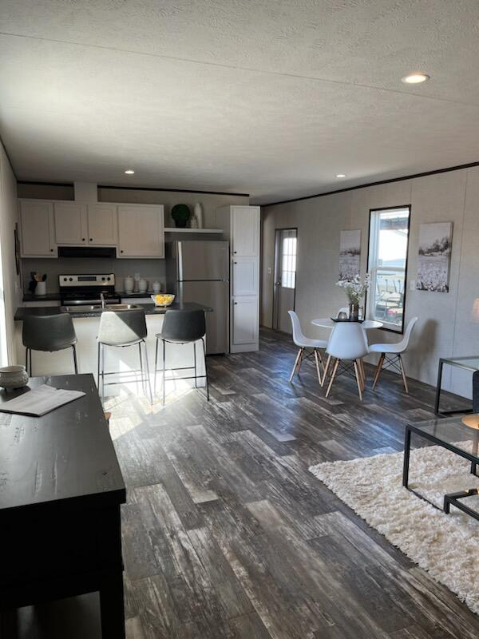
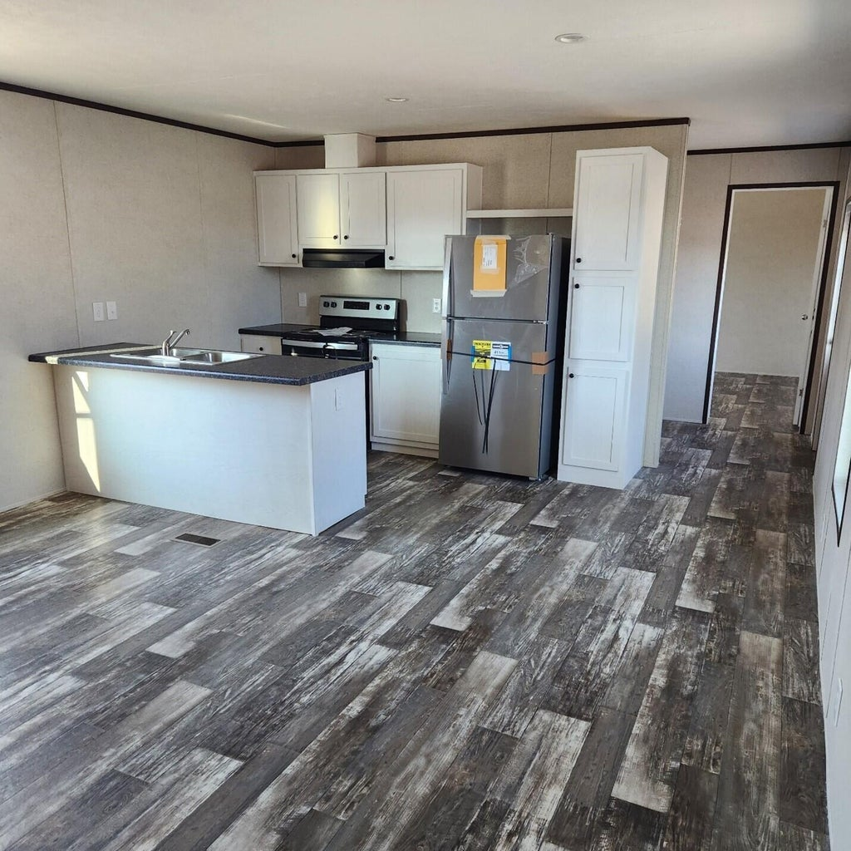
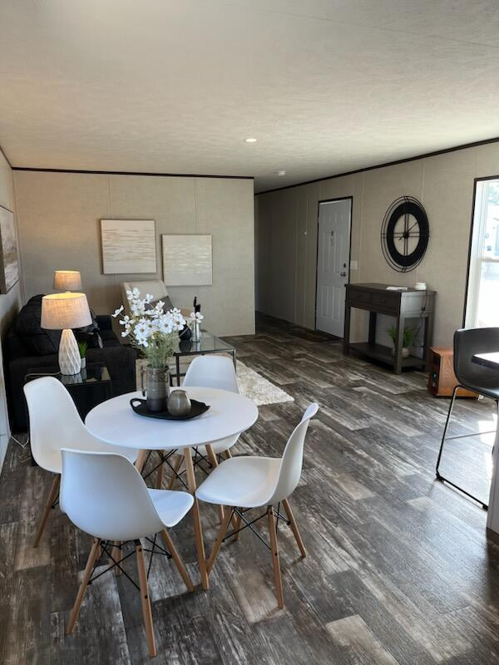
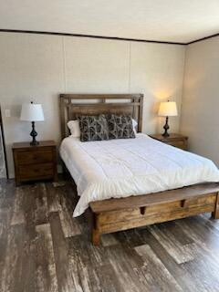
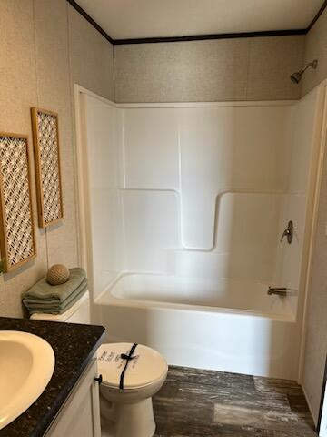



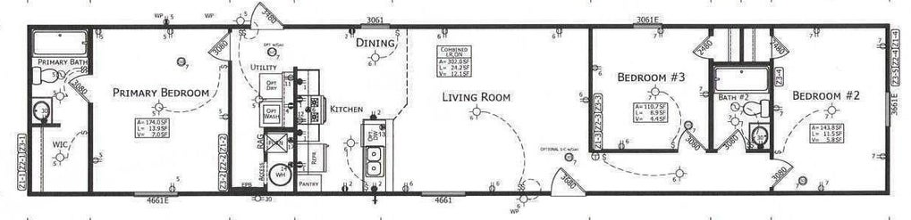


NEW HOME UNDER 200K
Custom 5br, 4.5ba 4700 Sqft Of Flex Space
10’ Smooth Ceiling
Heart Pine Flooring
Master Bedroom Suite On First Level
Second Master On Upper Level
Two Dens With Gas Fireplaces
Formal Dining Room
Gourmet Kitchen With Second Den/Warming Room And Breakfast Room
Walk-in Pantry
Large Bonus/Game Room Above Oversized Two Car Garage
Screen Porch & Outdoor Firepit
Large Pond Lot With Mature Trees And Irrigation System
3 Separate AC Units
Gas Hot Water Heater
New 35-year Roof
Private Gated Community With Community Pool, Clubhouse, Boat Launch And Dock
680 Barracada Road
Walterboro, SC 29488 | MLS# 24008148 | $190,000
Welcome to this brand new home in Walterboro! This 3 bed/2 bath homes sits on a 1/2 acre providing plenty of space to enjoy the outdoors. The open floor plan has natural light, amble cabinet and countertop space for entertaining. The home has a fantastic front deck. The home is minutes to shopping, downtown Walterboro, I-95 and Summerville.
4
3
1,844
Telecia Bilton 843-412-3586
tmbilton@rogcoastal.com
Realty ONE Group Coastal
1510 Trolley Rd
Summerville, SC 29485

