Slide 1
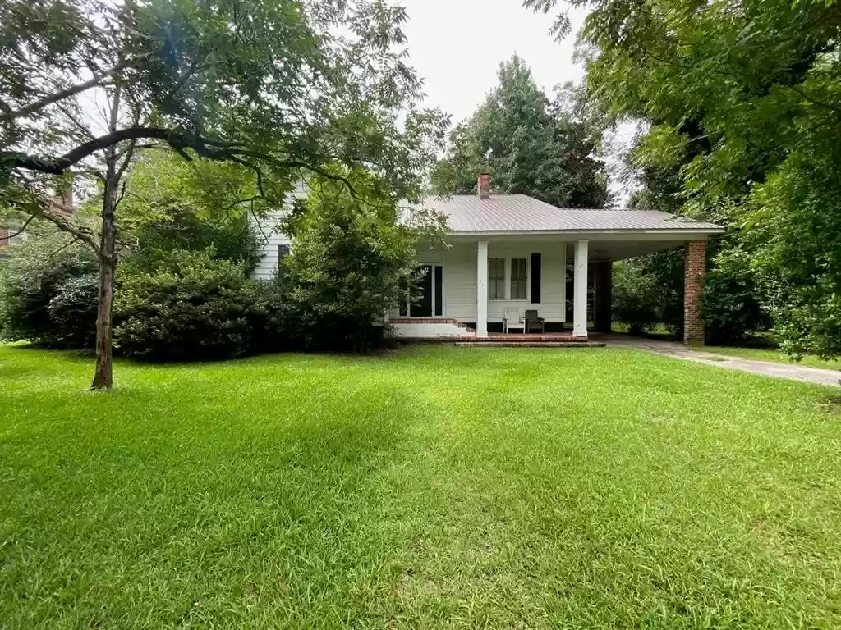
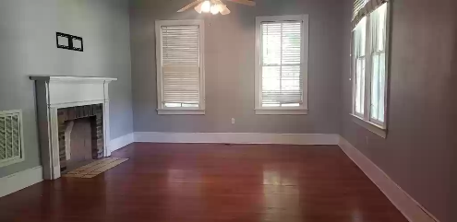
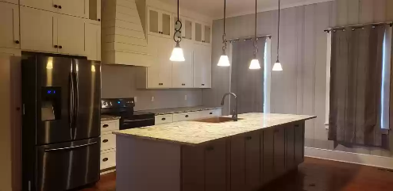
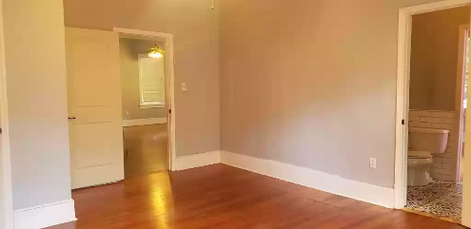
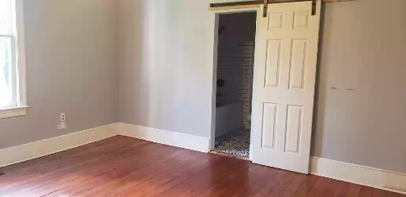

Charmingly Southern
680 Hampton St
Elloree, SC 29047 ~ MLS# 152070 ~ $358,000
In town Elloree Home. Updated home only 1 hour to Columbia and Charleston. Small town living on a large town lot. Slow down and relax here. The home offers updated baths and custom built kitchen. Granite counter tops.
Lake Homes Realty, LLC
Elloree, SC 29047
www.SCLakeLife.com
Kristie Anderson
(803) 387-9459
kristie@sclakelife.com

