Slide 1
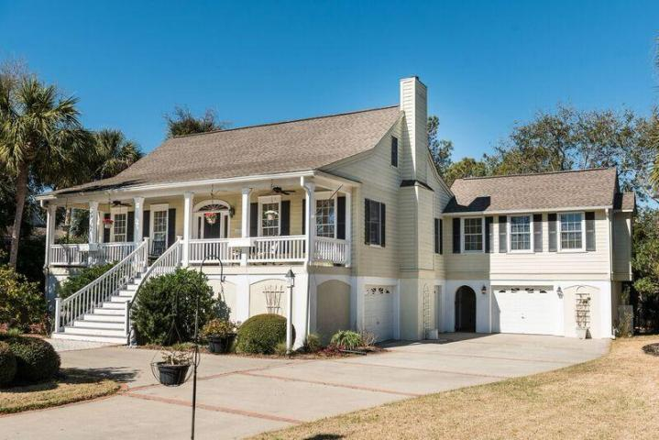
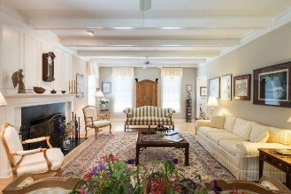
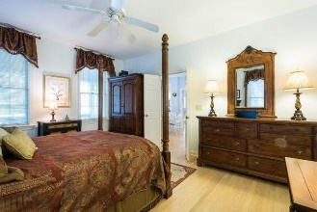
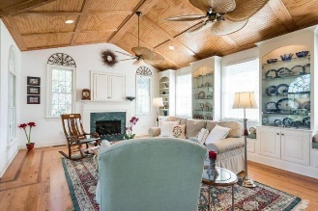
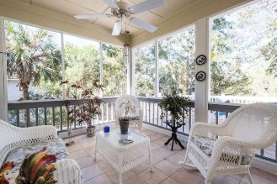
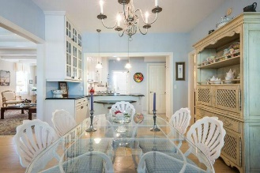
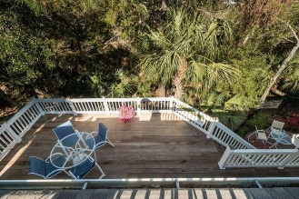
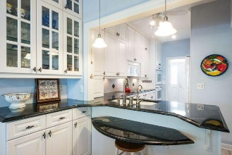
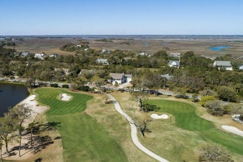


6819 Back Bay Drive Wild Dunes ~ Isle of Palms MLS# 17007240 ~ $850,000
Just Reduced $785,000!
Huge Price Reduction!
Beautiful IOP home for $850,000!
Enjoy golf course views from the expansive front porch and wildlife in the wooded marshland from the rear screen porch, roof balcony, and sprawling main-floor deck. This charming home has multiple spaces for outdoor living and the floor plan has a great flow. It is the perfect home for entertaining and large family gatherings. The master suite is downstairs; it's master bathroom and walk-in closet were renovated in 2016. There are hardwood floors throughout, with the exception of tile in the bathrooms and kitchen. The kitchen has a large breakfast area with a bay window which provides wonderful wooded views and natural light. In 2004, major renovations and additions were completed. The kitchen was totally renovated, as well as a screened and tiled porch, the entry stairway, landscaping and irrigation system, and new driveway with decorative stamped accents. Additions included the great room with large Palladium windows, a fireplace, beautiful stained-wood cathedral ceiling, built-in cabinetry and window seats, a large formal dining room, a second-floor roof deck, internal stairs to the garage; fenced-in brick patio, and the enclosure of all three garage bays under the house. There is ample space measuring 24.1 x 10.4 in the garage that would be perfect storage for a boat of this size. Wild Dunes resort provides a lifestyle that is unsurpassed! The pristine beauty of the golf courses, tennis courts, swimming pools, biking and walking trails make living at the beach the best it can be!
Mac Jenkinson
M (843) 224-0210
mac@carolinaone.com
Beth Moore
M (843) 532-4892
bmoore@carolinaone.com
www.jenkinsonandmoore.com
Jenkinson & Moore, LLC | Carolina One Real Estate | 1503 Palm Blvd | Isle of Palms, SC 29451-2280

