Slide 1
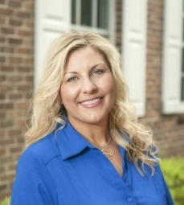
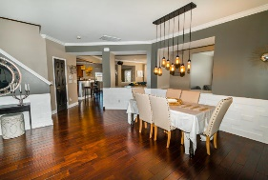
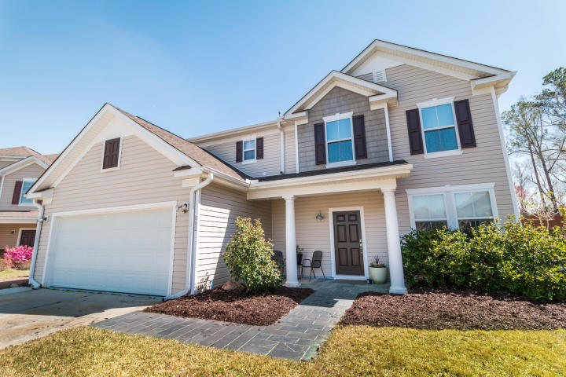
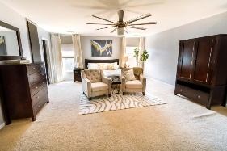
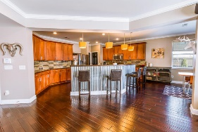
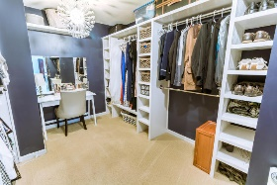
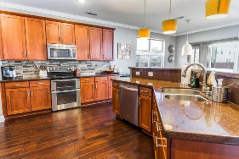
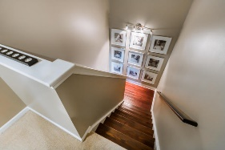
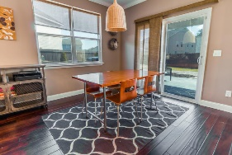
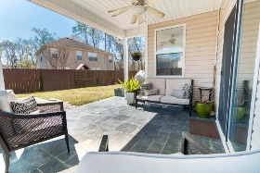

Exceptional Value for this Upgraded Home
Reba Cole
M (843) 819-7322
rcole@century21properties.com www.century21properties.com
682 Grassy Hill Rd | Blackberry Creek | Summerville | MLS# 16007160 | $279,100
Only 5 minutes from I-26. Closer to Downtown Summerville than you think. This impeccably maintained home has been upgraded to better than new status! The current owners have added designer touches throughout. From the slate walkway to the custom raised panel Wainscoting in the Dining/Formal living room to the glamorous walk-in dressing area in the Master Suite, the current owners have thought of everything. Upon entering the home, you will be greeted by gleaming hand-scraped hardwood floors and 9-foot ceilings. The spacious, open floor plan easily flows from room to room. The modern gourmet kitchen is replete with Silestone countertops, imported Australian glass backsplash, under mount lighting, extra power outlets, built-in wine rack, large serving island and upgraded 39" cabinets. The matching stainless steel appliances (refrigerator, double oven, smooth cooktop, built-in microwave, and dishwasher) all convey with sale. The large room off of the family room can be used for a 5th bedroom/playroom/office or study. The closets and shelves in this room also convey. Upstairs you will find 4 over-sized rooms each with large walk-in closets. The Master Suite features a dream dressing walk-in closet. The bathroom has been upgraded top to bottom with a custom 2 person shower, a 2 large linen closets and a private water closet. The fully fenced backyard has a large slate patio, fresh sod, pavers and a nice 8x12 storage building that also conveys with the sale. There is plenty of storage throughout the home and in the garage a ladder has been added to access even more storage. The 2 car garage has added storage, plenty of power outlets and an epoxy floor covering. This well-appointed home is nestled in a cul-de-sac in the peaceful Blackberry Creek Subdivision. Best of all it is located in the highly sought after, award winning Dorchester II School District. Be prepared to fall in love with this home.
Century 21 Properties Plus | 3301 Salterbeck St Suite 100 | Mt. Pleasant, SC 29466

