Slide 1



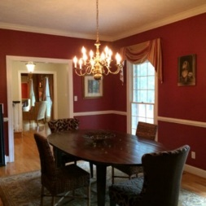
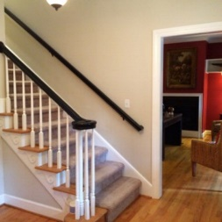
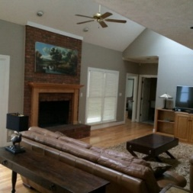
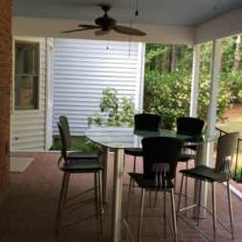
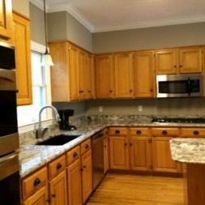
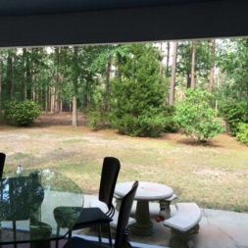
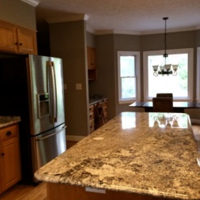
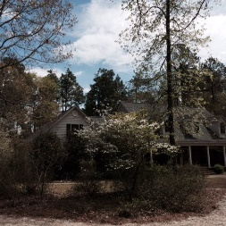


682 Pintail Drive
Aiken, SC 29803
MLS# 90580 / $525,000
Exceptional custom built home on apx. 10 acres with 5 acres cleared to park like setting. High ceilings, beautiful hardwood flooring and open floor plan plus large master suite and guest room on main level add to the interesting design of this wonderful country home. There are 3 bedrooms upstairs plus a well designed bonus room with back stairs leading to the spacious kitchen w/ Gas cooktop, Stainless steel appliances, Dual ovens, granite countertops and large island perfect for entertaining. Home has dual geo-thermal (water source) heat pumps. Great layout and a pleasure to show.
Valli Catchpole
803.617.8540 / valli1@me.com
Property Consultants of the South, 1429 Lyon Dr SE, Aiken, SC 29801 / www.FineSouthernLiving.com

