Slide 1
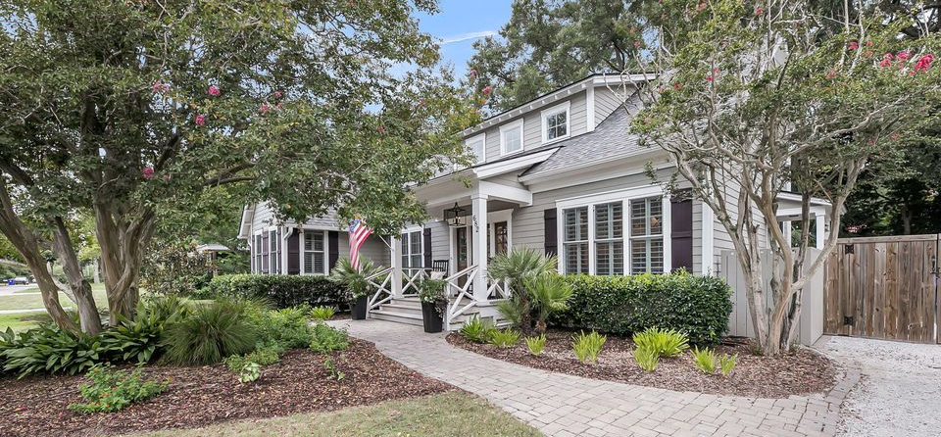

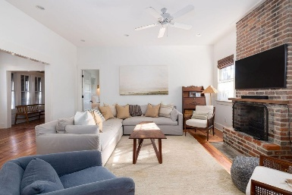
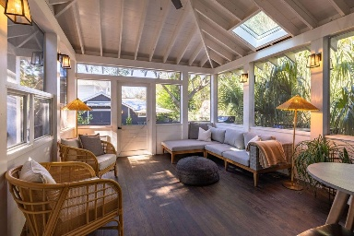
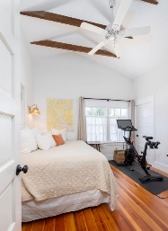
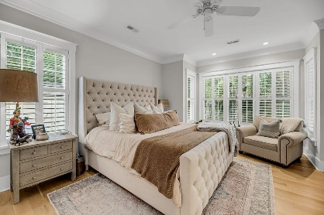
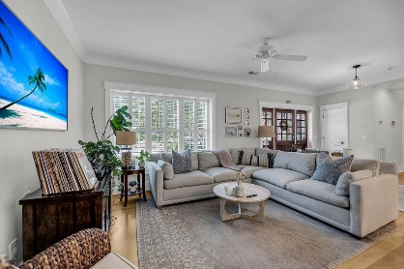
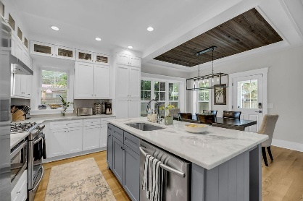
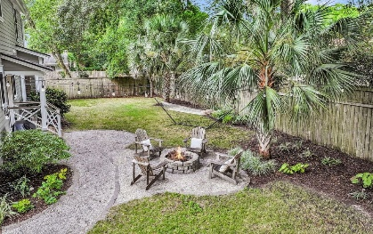

Old Village 2.5% BAC + $5K Bonus with Ratified Contract by EOD Monday
682 Adluh Street
Old Mt Pleasant | Mount Pleasant, SC 29464 | MLS# 25020257 | $1,950,000
Welcome to 682 Adluh Street! This beautiful home was built in 2019 and the attention to detail is apparent as you move through the home. The entrance of the home makes a statement with a sizable Ipe front porch and the custom mahogany front door. Entering through the front door, you're immediately met with the gorgeous open floor plan of the living room, dining room, and kitchen. Large windows encircle the living & entertaining space filling the rooms with natural light. The kitchen features a substantial gas stove and range hood, marble countertops, subway-tiled backsplash, and a kitchen island big enough to seat a few friends or family members to eat. Don't miss the one-of-a-kind cypress wooden ceiling in the dining room - it's truly picturesque!
The first floor also features the primary suite with the ideal walk-in closet, dual vanity, and steam shower, a second bedroom/office, full bathroom, and spacious laundry/utility room hidden behind a barn door. The expansive hallway features a cathedral ceiling and custom shiplap. Up the stairs, there is an additional primary suite with multiple closets, a fourth bedroom, storage closets with attic access, a built-in desk space, and a large lofted living area.
The home is perfectly situated on almost a quarter of an acre, underneath a canopy of historic oak trees and crepe myrtles. Relax in the serene & fully fenced-in backyard enjoying the unbeatable weather of the Lowcountry. Located in the idyllic neighborhood of Old Mt Pleasant, you are just 10 minutes to Downtown Charleston and 5 minutes to the beaches of Sullivans Island. Don't forget to take a walk or quick bike ride to the shops & restaurants of the Old Village or catch the sunset at the Pitt Street Bridge!
VIRTUAL TOUR
Greg Gelber
843-494-2354
greg.gelber@agentownedrealty.com
Kelly Snyder
843-457-5951
kelly.snyder@agentownedrealty.com
AgentOwned Charleston Group | 902 Savannah Hwy | Charleston, SC 29407-7802

