Slide 1
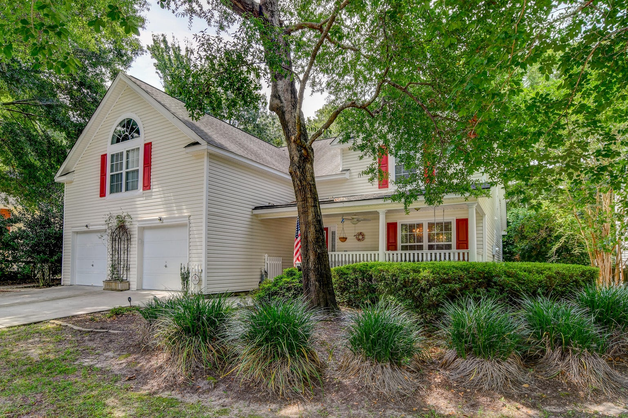

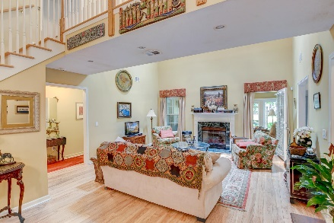
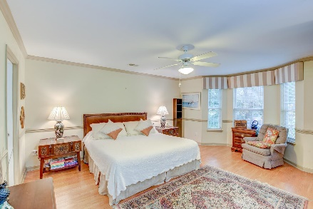
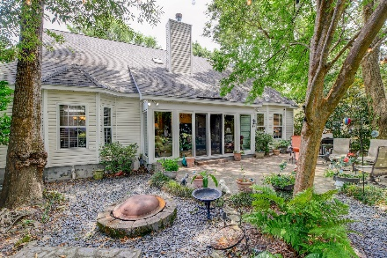
OPEN HOUSE
SATURDAY 12-3
Open House Saturday 12-3
Don’t Miss This One!
682 Majestic Oaks Drive
Seaside Plantation | Charleston, SC 29412 | MLS# 23014787 | $759,000
Welcome to this stunning custom 5-bedroom, 5-bathroom single owner home nestled in the beautiful Majestic Oaks community in Seaside Plantation. As you step inside, you'll be greeted by a spacious living room featuring a cozy gas logs fireplace and a vaulted ceiling. To the left, a staircase leads to a unique catwalk overlooking the living room, creating a sense of openness and elegance. On the right, you'll discover a generously-sized formal dining room, perfect for entertaining guests. A convenient powder room is located in the hallway. The large kitchen boasts an abundance of cabinets and gleaming stainless steel appliances, making it a dream for any home chef. Enjoy casual meals in the eat-in kitchen area.
The owner's suite is located downstairs and offers a luxurious retreat with a spacious bathroom featuring a whirlpool tub, a separate shower, and a sizable walk-in closet. On the opposite side of the home, two bedrooms share a convenient Jack-and-Jill style full bathroom. There is also another owner's suite with its own full bathroom and a large closet. All bedrooms are equipped with ceiling fans for added comfort and ventilation. Additionally, there is a bedroom with a closet and a half bathroom located above the garage.
An office space is connected to the fifth bedroom, providing a designated area for work or study. The heated and cooled sunroom offers a delightful space to relax and enjoy picturesque views of the lake. Step outside to the landscaped backyard, complete with a large brick patio overlooking lake with fountain, perfect for outdoor gatherings. The neighborhood amenities include a dock and boat ramp for those who enjoy water activities.
This property is located 1.6 miles from Publix Super Market at Riverland, 5.4 miles from Folly Beach, 9 miles from historic downtown Charleston, and 16.8 miles from Charleston International Airport. This home offers ample space, luxurious features, and a serene lakeside setting. Don't miss the opportunity to make it your own!
Book your showing today!
Jeremiah Brown jbrown@mattoneillteam.com 803-730-1715

