Slide 1
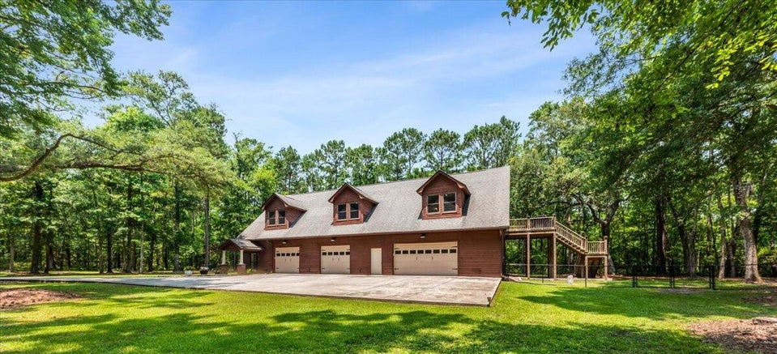
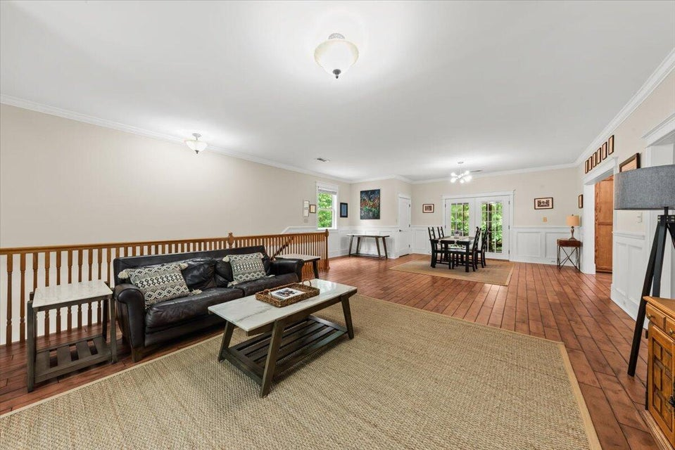
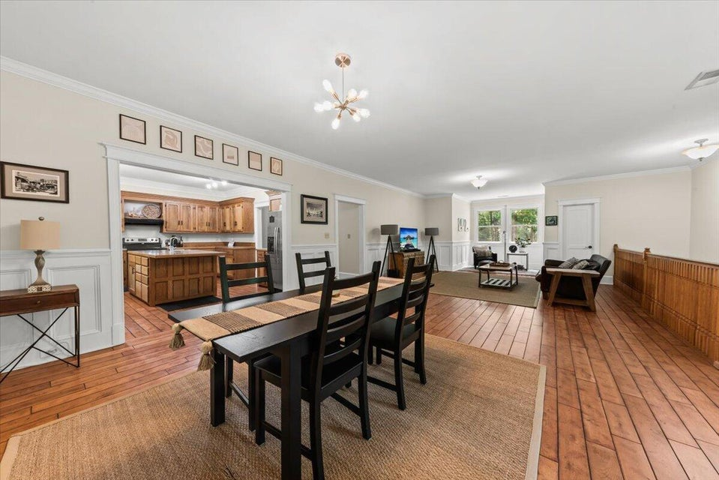
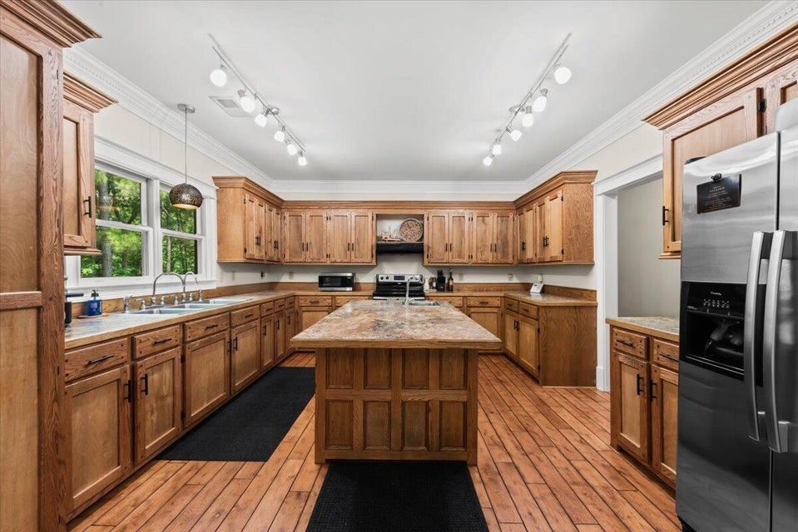
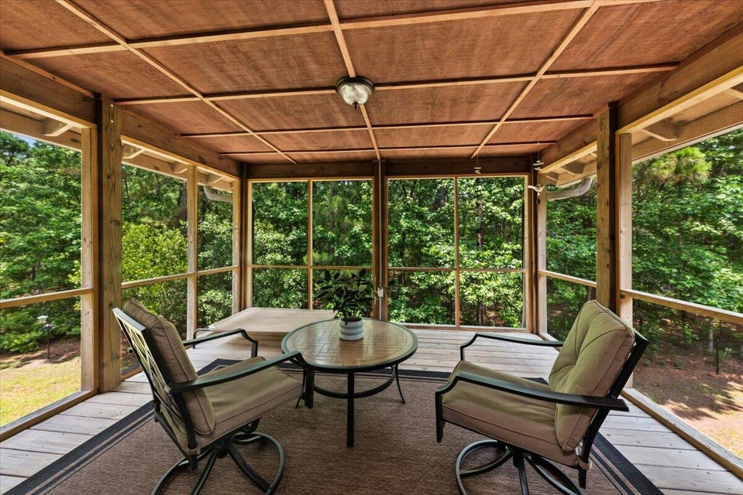
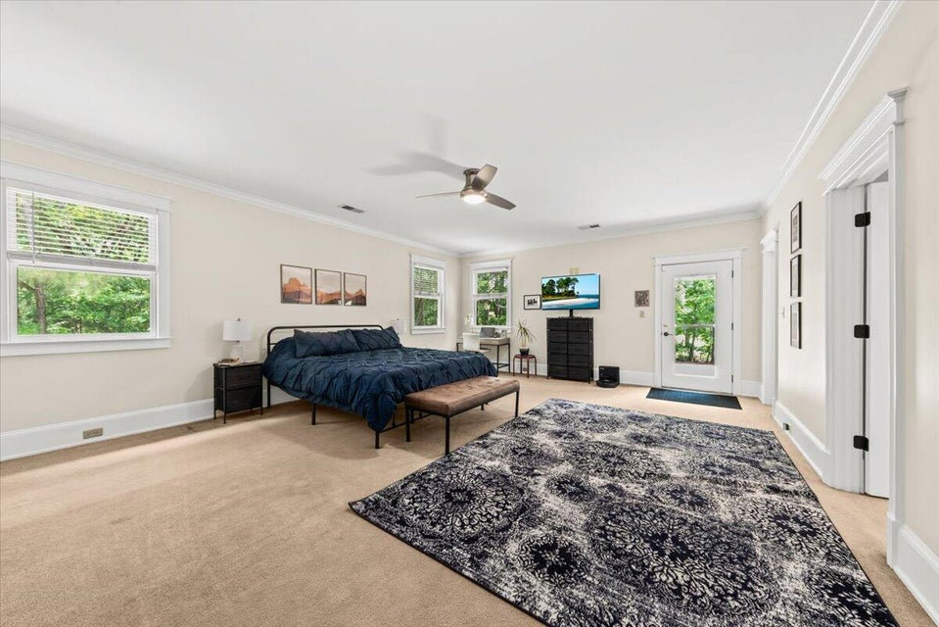
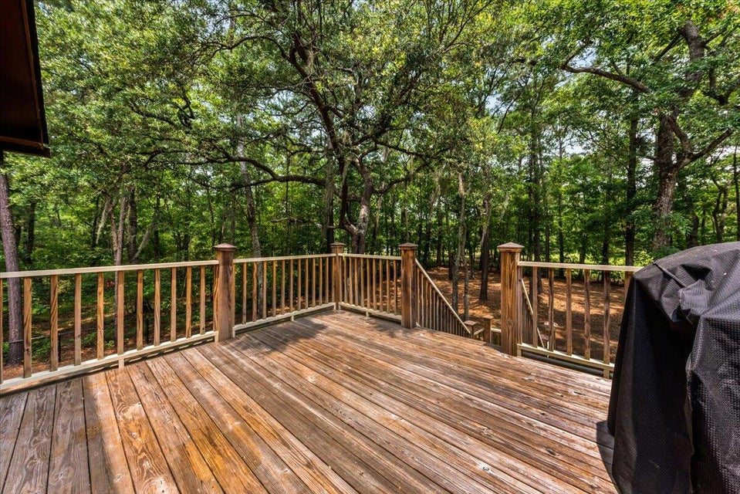
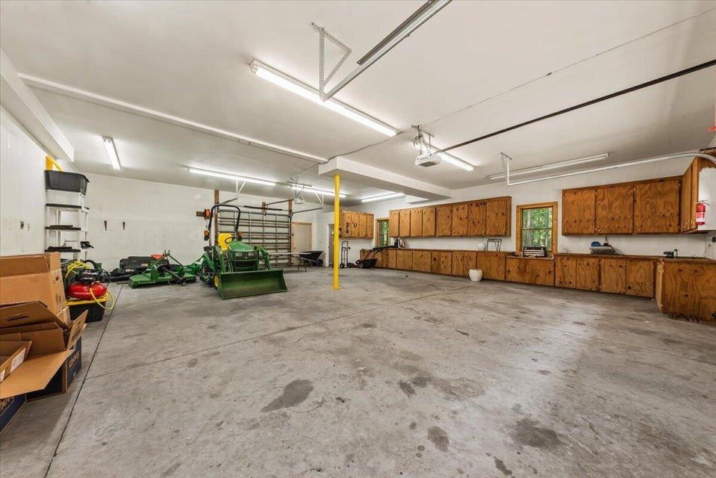
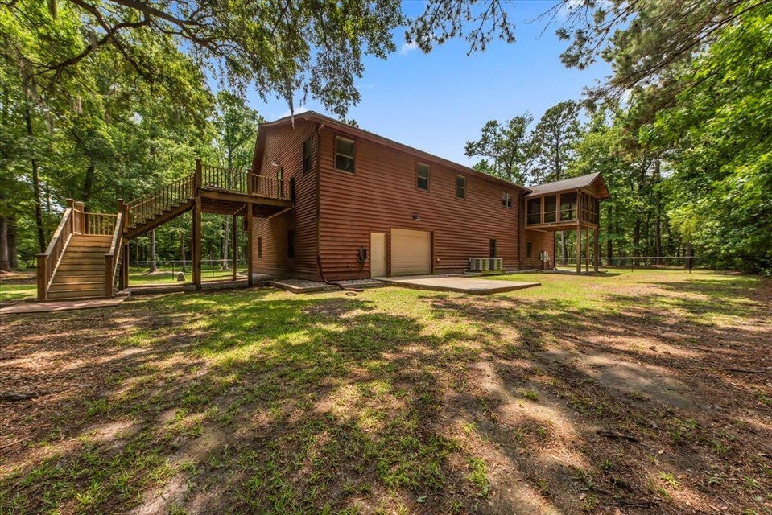

COUNTRY LIVING AT ITS FINEST!
6840 Early Jersey Road
QUIGLEY FARMS · MEGGETT, SC 29449 · MLS# 25015756 · $765,000
Welcome to 6840 Early Jersey Road, a serene retreat nestled in the quiet town of Meggett, just 30 minutes from the heart of downtown Charleston. Set on 6.5 pristine acres, this peaceful property offers the ultimate privacy, space and natural beauty. Surrounded by mature trees and open skies, the landscape provides a calming backdrop for everyday life. Whether you're enjoying coffee on the private deck off the primary bedroom, relaxing on the screened-in porch, or exploring nature in your expansive yard, you'll find peace and seclusion in every corner of this Lowcountry haven. The home features a spacious open floor plan, large kitchen, 10 ft ceilings, and a screened-in porch conveniently located just off the kitchen—perfect for indoor-outdoor gatherings.
When it's time to unwind or get creative, the downstairs area is a hobbyist's dream, featuring a four-car garage and a generous workshop space ready for your next project.
If you're looking for quiet country living with easy access to Charleston, 6840 Early Jersey Road delivers the best of both worlds.
Deck replaced in 2021, new well in 2020 and new HVAC 2023
Robyn Lane
843-222-5599
robynlane01@icloud.com
Bobby Shealy
843-442-7373
bobby@shealyrealestate.com
bobbyshealy.erawilderrealty.com
ERA Wilder Realty
1282 State Rd
Summerville, SC 29486

