Slide 1
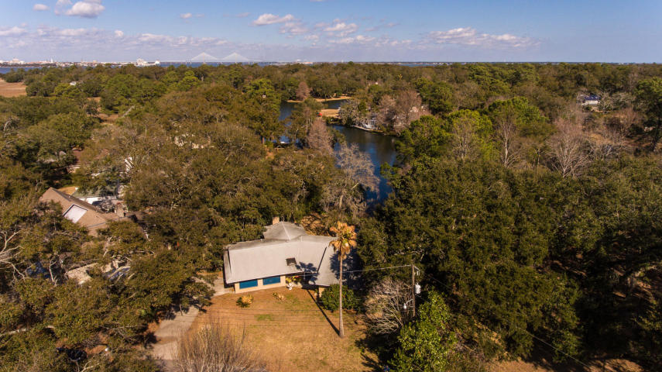
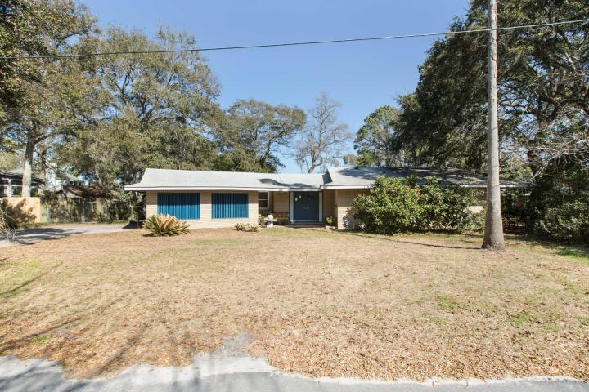
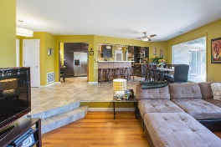
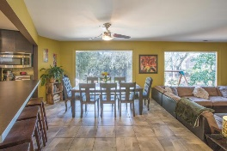
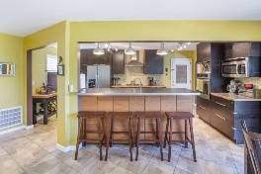
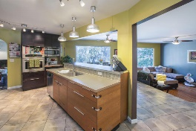
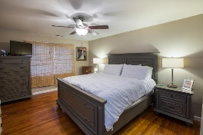
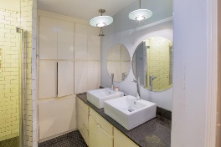
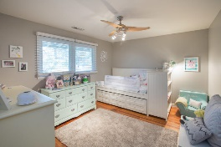
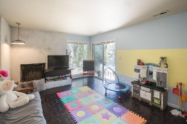
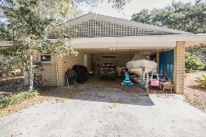
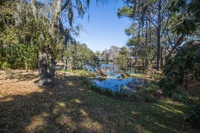
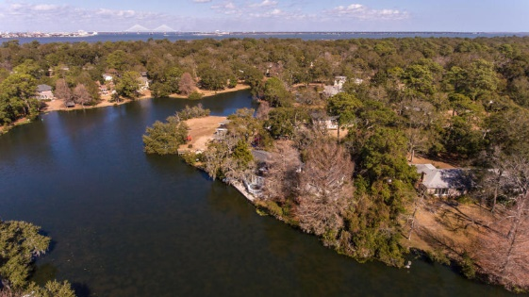

Open House Saturday
February 24th from 1-4
688 Ayers Drive
Clearview ~ Charleston, SC 29412
MLS# 18003443 ~ $499,900
Beautiful Ranch Home on Lake Edmonds with an open floor plan. As you walk-into this home, you will be greeted by a wall of windows that boast a view of the lake and the wildlife that adorns the lake. The home sits on a private lagoon and wooded lot with controlled bamboo. The sleek and modern kitchen has built in oven and gas cooktop with plenty of counter space and storage areas along with an eat in area. The Kitchen overlooks the main living area that has a step down entrance. The Master bedroom has its own en suite bathroom and large walk in closest. The other two bedrooms share a bathroom with a jetted tub and shower combination. The bonus room located off the kitchen has a wood burning fireplace and may be used as a play/media/office space. The backyard has a fire pit and offers beautiful views of the lake. You can launch your Canoe or Kayak from the backyard. The home also has access to a Well that can be used to maintain your lawn and shrubbery in the hot summer months. The house is also wired for the use with Generator if needed. The carport is spacious with storage room in the attic. Clearview has close access to the charming Sunrise Park (can use your golf cart to drive to the beach) and/or use the pier to fish. Great schools as well as the new Pinckney Park with sidewalks to the Park. Residents of Clearview may also apply for membership at the James Island Yacht Club.
Deborah Meuli
(843) 822-0133
dmeuli@comcast.net
Wendy Deitsch
(843) 270-0433
wendy@lifetreeliving.com
LifeTree Real Estate, LLC | 3094 Hwy 17 North | Mt. Pleasant, SC 29466 | www.lifetreerealestate.com

