Slide 1
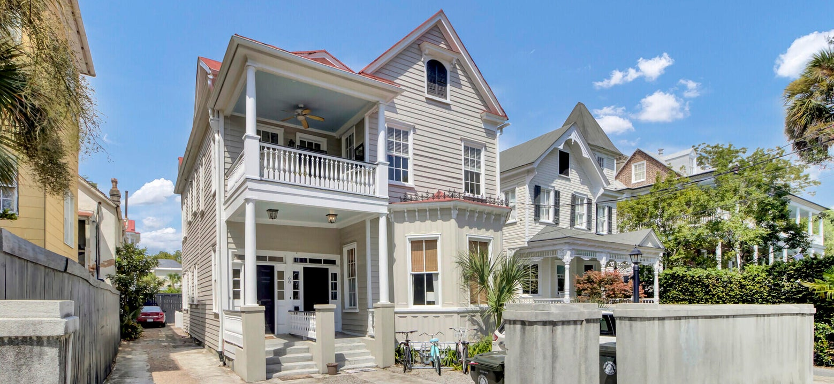
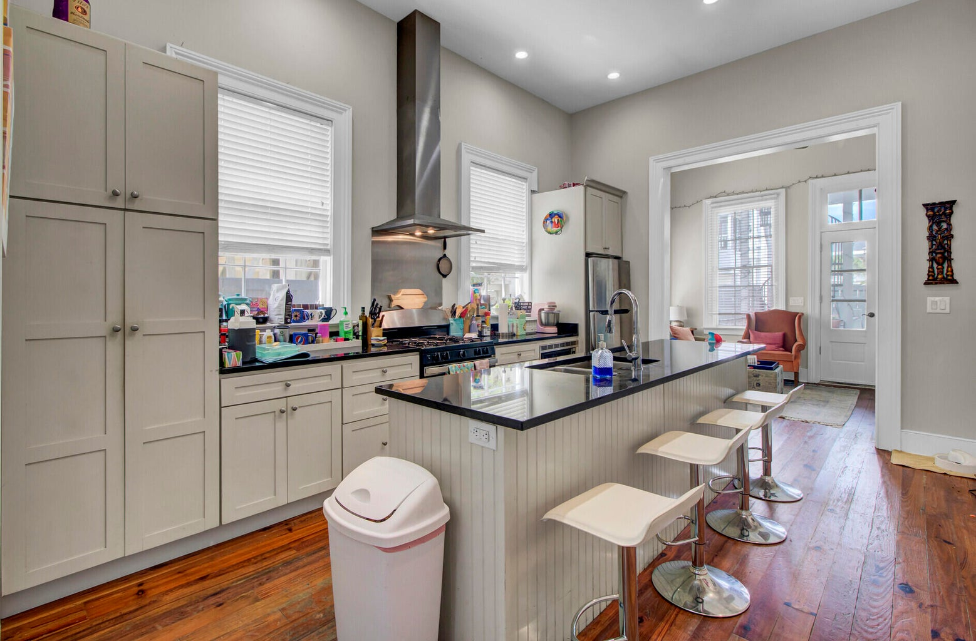
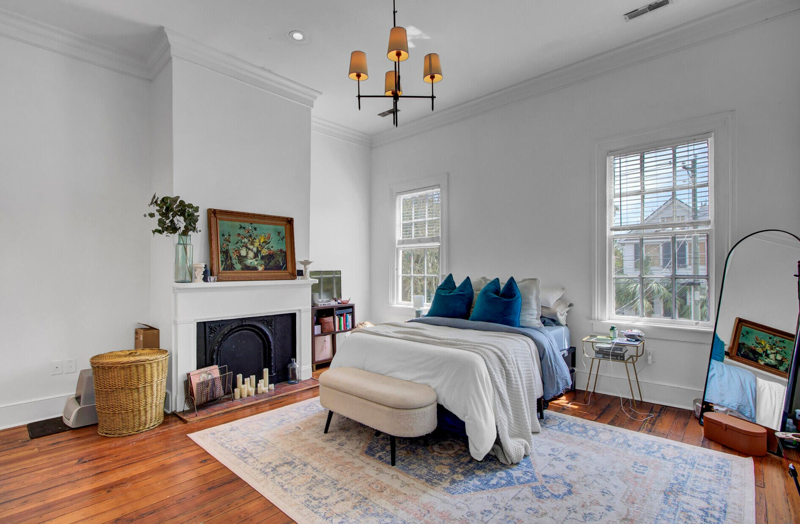
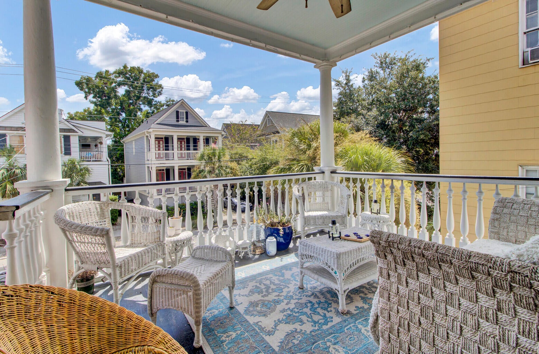
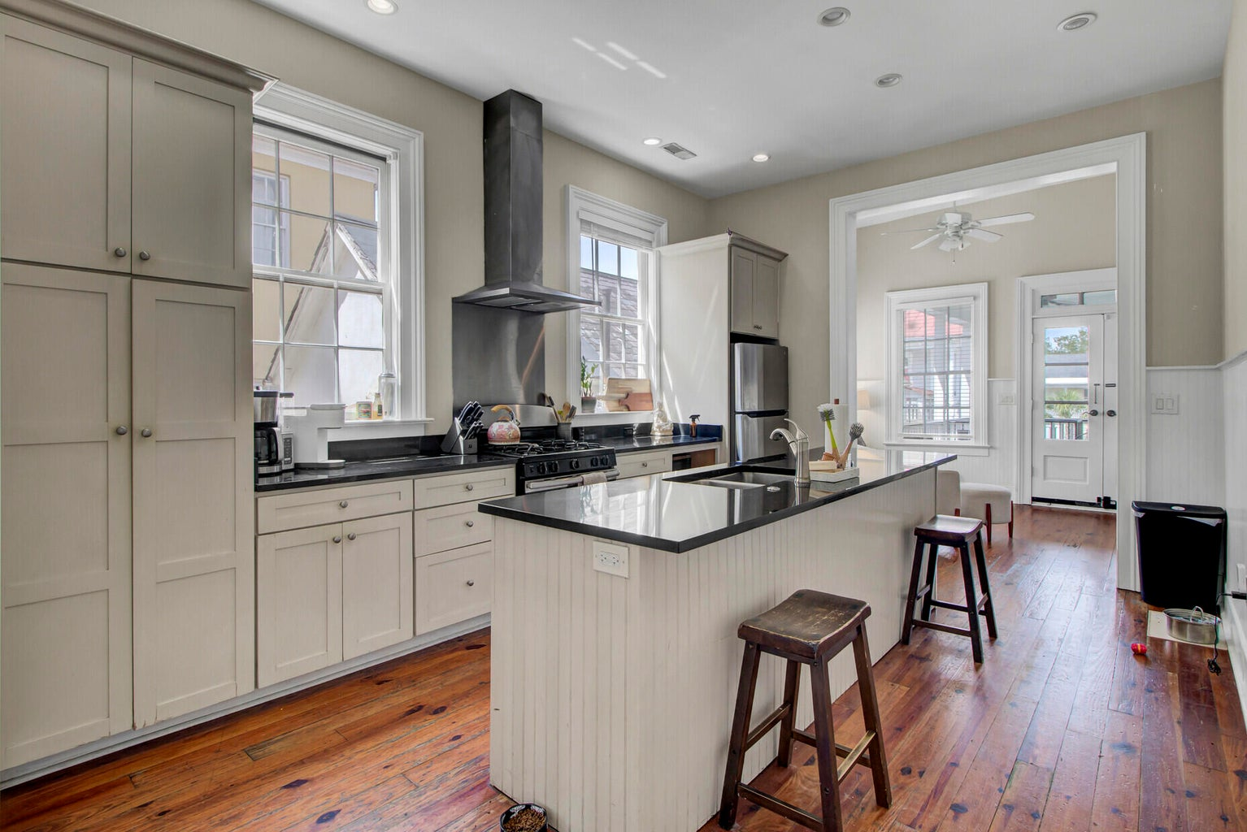
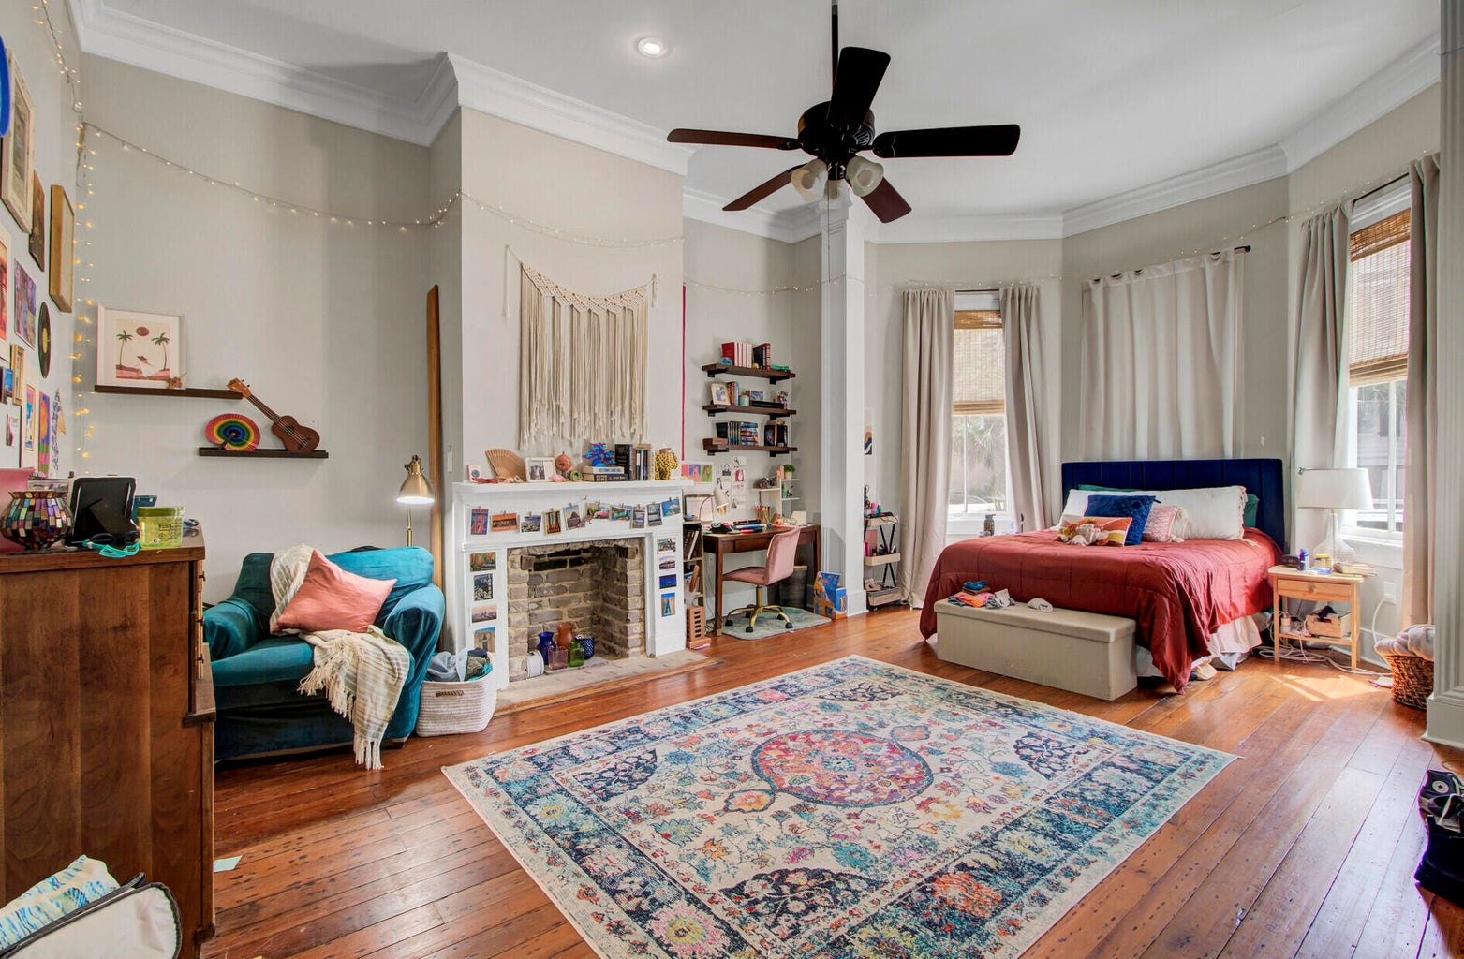
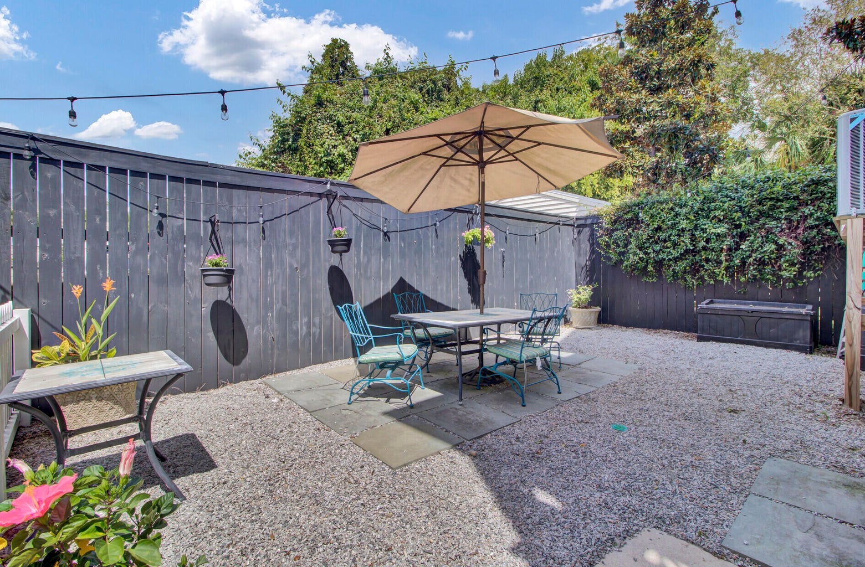


CALLING ALL INVESTORS!
Downtown Charleston Opportunity
68 Vanderhorst Street A & B
Radcliffeborough | MLS# 23021036 | $1,850,000
6 Bedrooms | 4 Full+2 Half Baths | 3,390sf
LOCATION! Steps away to MUSC, CofC, and King Street, this 2 unit property is a Tenant and Landlord's dream! This charming property is Currently Tenant occupied and has OFF STREET PARKING! Each unit has 3 bedrooms/2 full baths and a powder room. No need for tenants to lug dirty laundry as each unit has a washer and dryer. Property offers several outdoor spaces, including a spacious backyard and three balconies/porches. Outdoor areas enhance this property's appeal and functionality. Layout is great for generating rental income and ideal for multiple tenants. Property boasts a blend of historic charm and modern amenities. Features include heart pine floors, original mantels, and fireplaces in the bedrooms, which add character and warmth to the space. Clawfoot tubs adds a touch of vintage elegance. High ceilings (12 feet) contribute to a spacious and open feel. Attractive investment opportunity, particularly for those looking to generate rental income in desirable downtown Charleston. Its combination of historical charm and modern amenities is likely to appeal to both tenants and potential buyers. Make your appointment today!!
Take a Virtual Tour!
Tracy Arnett
843-973-2314
tracyarnett5@gmail.com
ERA Wilder Realty Inc
103 Church St
Mt. Pleasant, SC 29464

