Slide 1
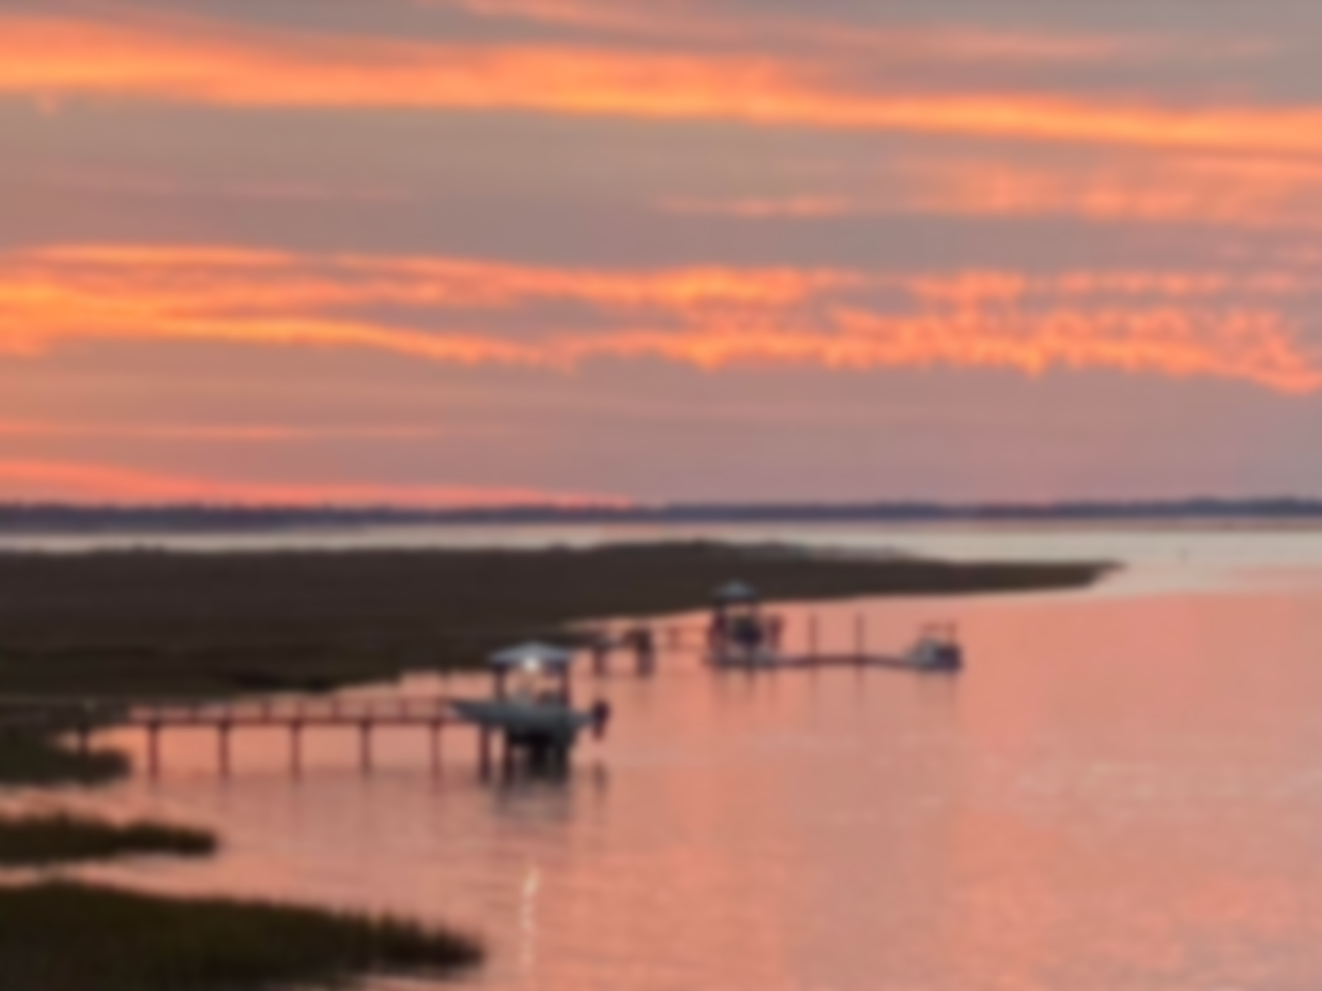
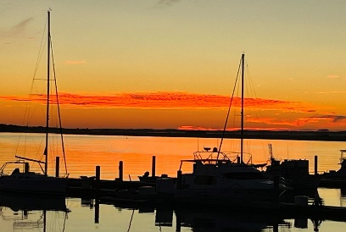
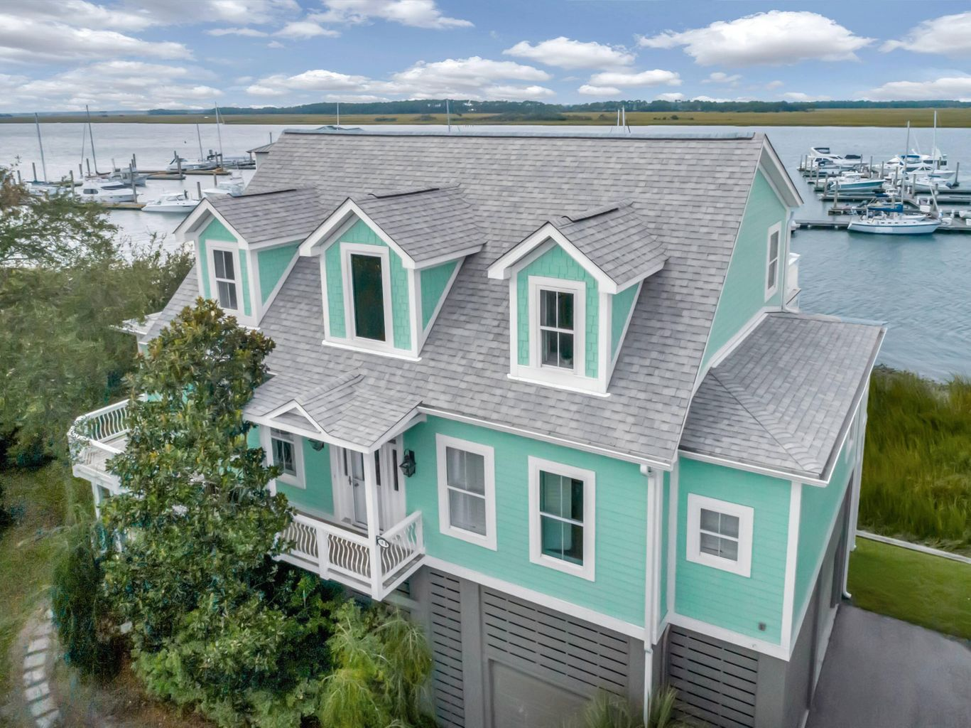
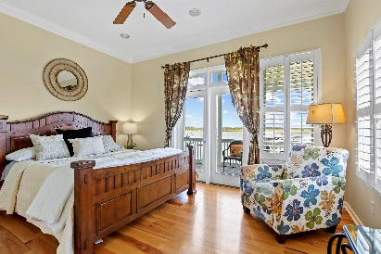
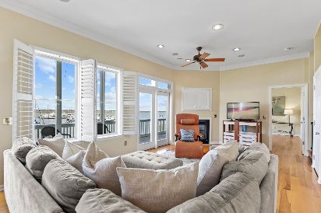
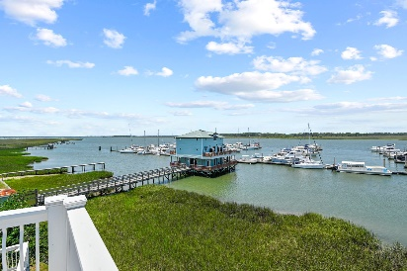
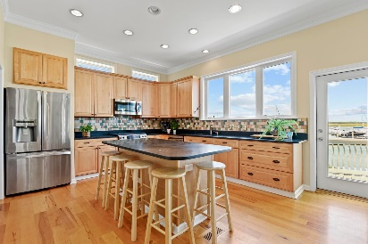
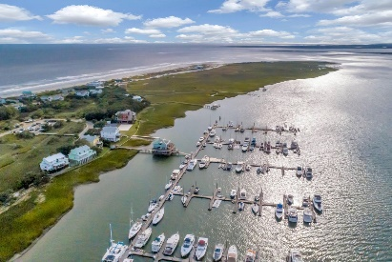



Open House Sunday November 27th from 2 - 4
Reduced!
68 W 9th Street B
Folly Beach, SC 29439 · $1,995,000
Don’t miss this beautiful, elevated home on the FOLLY RIVER with a 20’x40’ BOAT SLIP! You cannot beat the views from this home. From Kiawah to Mt Pleasant, you will see beautiful marshes and wildlife, gorgeous sunsets, and panoramic views all the way to the Ravenel Bridge. This home has a welcoming, open floor plan with a generous back porch extending along the entire backside of the home. The family room, overlooking the river and marina, has a wall of windows allowing beautiful natural light. Hardwood floors cover the entire home, except for the bathrooms which have tile. The kitchen is spacious with lots of cabinets and an island perfect for entertaining. Adjacent to the kitchen is the large laundry room with more cabinets adding to the abundant storage options. Downstairs, the main bedroom also has access to the back porch through French doors and includes a large ensuite bath with garden tub and separate shower, plus a walk-in closet. Upstairs you’ll find two more bedrooms, one being a second main bedroom option with private bath, and a spacious guest bathroom. The upstairs loft area with built-in shelving is perfect for an office or kids play space. This could also be a 4th bedroom option. The best part though is the 2nd floor patio accessible from both the loft and right-side bedroom. From here you’ll sunbathe, watch the river and wildlife activity, and enjoy a glass of wine watching those amazing sunsets! Finally, don’t forget the huge garage area perfect for storing all your beach toys! There is also an outdoor shower. The owners have recently painted the exterior and installed a new roof.
Stephanie Howard
843-224-5912
stephanie@stephanie-howard.com
www.findyourcharleston.com
Elaine Brabham and Associates
1890 Sam Rittenberg Blvd. #217 · Charleston, SC 29407

