Slide 1
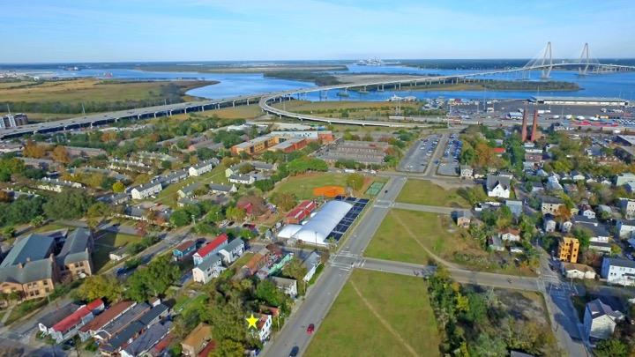
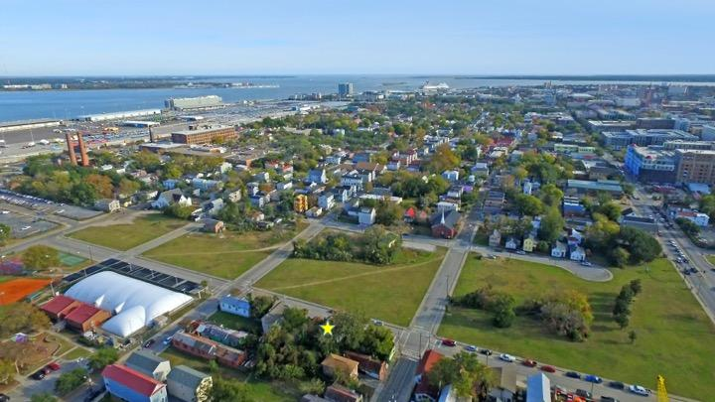
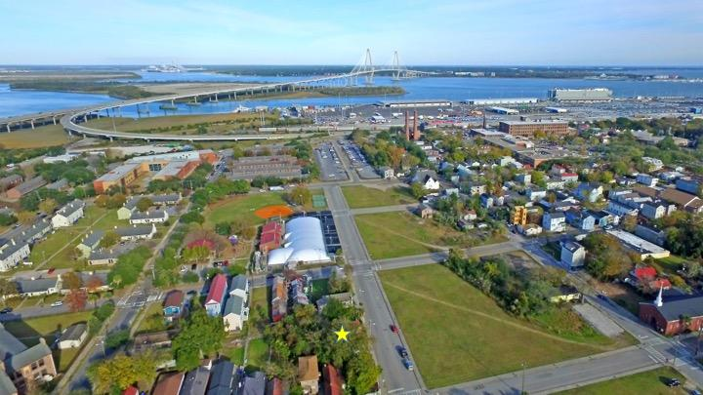
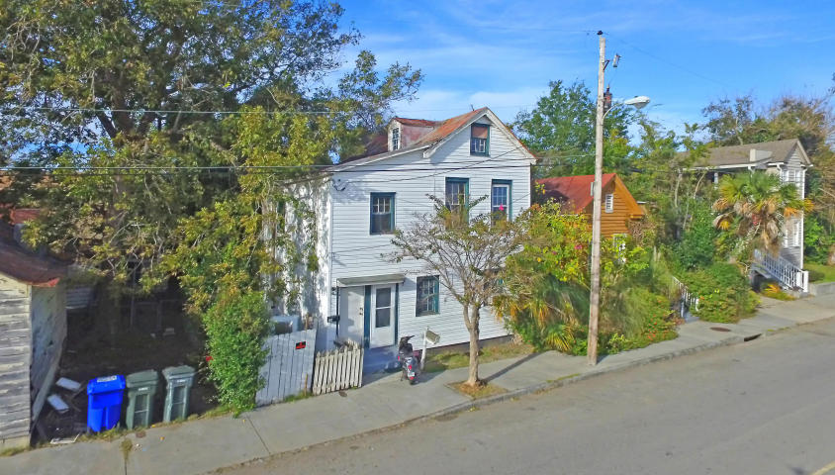
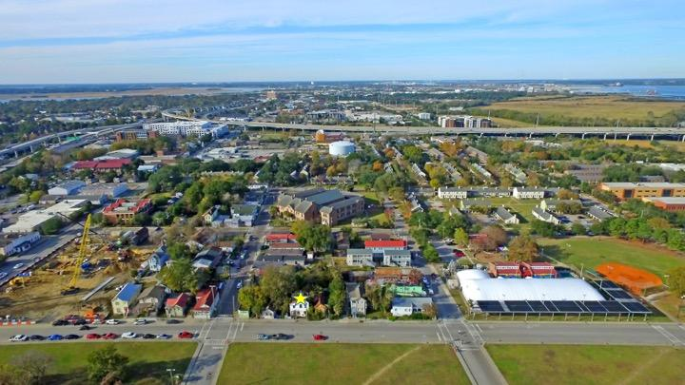
Great Downtown Investment Opportunity
Price Reduced!
68 Lee Street
Charleston, SC 29403 ~ MLS# 17031634 ~ $425,000
GREAT INVESTMENT OPPORTUNITY IN DOWNTOWN AREA OF CHARLESTON SLATED FOR FUTURE GROWTH. Development plans for the nearby blocks include a hotel, student residence, college community center, and a park. This two-unit property could be rented or removed for future development! From just outside this two-unit property you can see the iconic Ravenel Bridge! Historic downtown offers so much in terms of shopping, dining, nightlife, sightseeing and of course, the gorgeous water views from the peninsula. With extremely easy access to I-26, you can be on your way to anywhere in the Lowcountry in no time including beautiful beaches and Mount Pleasant. Don't miss out on this investment property in one of the country's most desirable cities!
Additional features include:
Unit A on the top floor includes 3 bedrooms and 1 bathroom
Unit B on the bottom floor includes 2 bedrooms and 1 bathroom
UNIT B CAN ONLY BE VIEWED ON SECOND SHOWINGS!
Thank you for showing!
Paige Rhodes 843-830-3281
paige@mattoneillteam.com
Lisa Quick 843-452-6688
lisa@mattoneillteam.com

