Slide 1
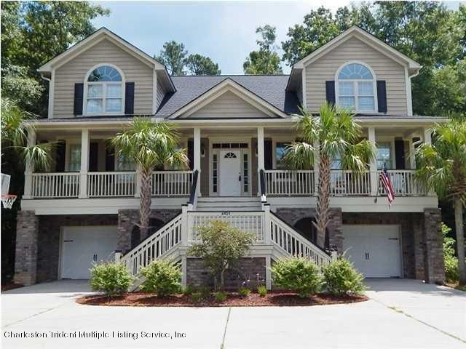
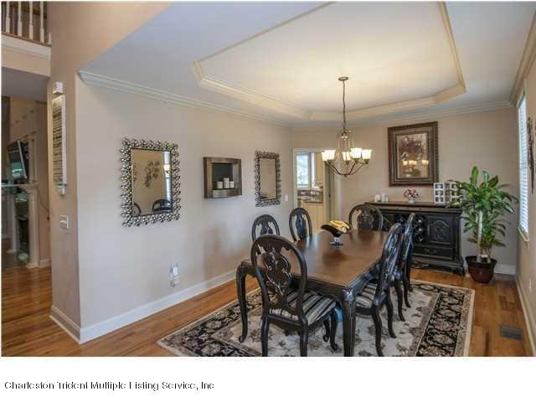
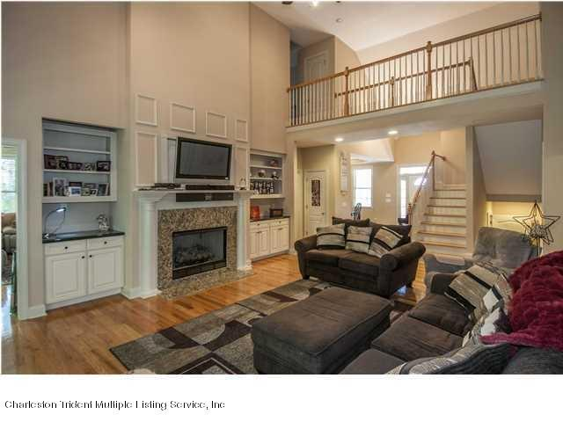
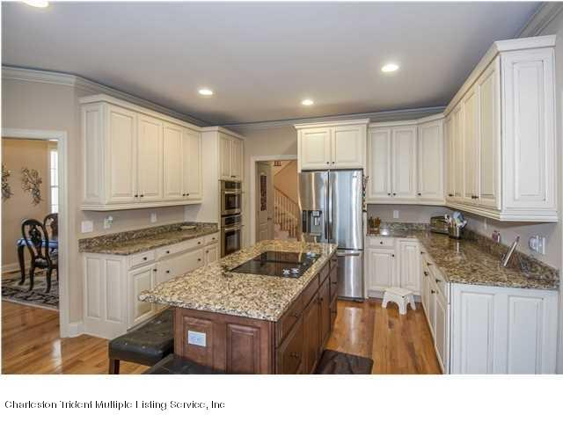
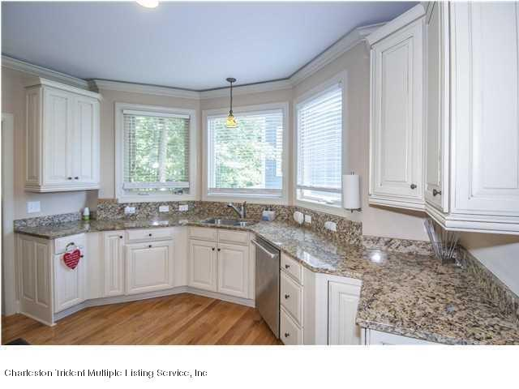
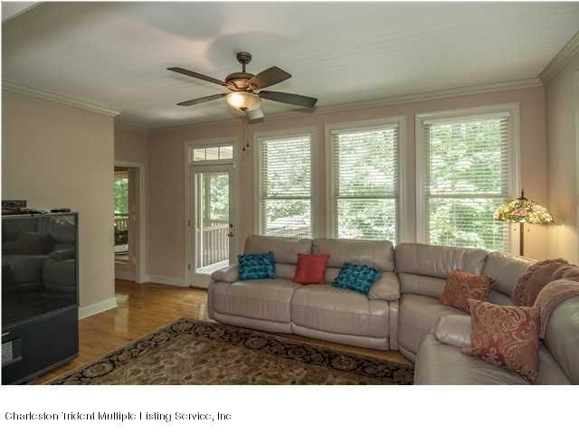
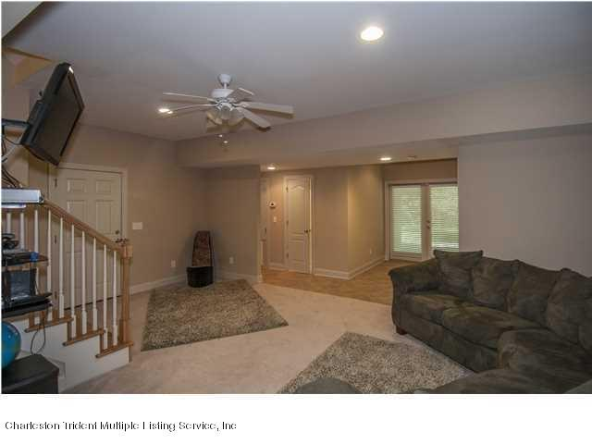
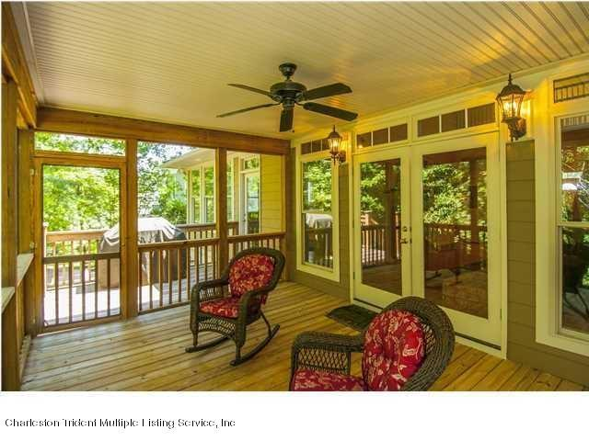
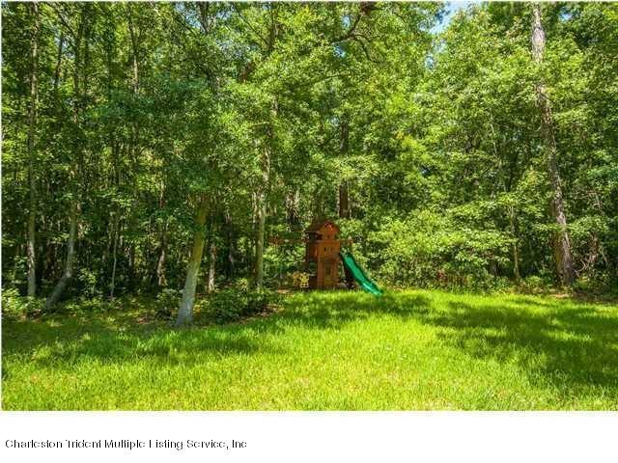
FOR SALE...LEASE/PURCHASE...LEASE
4758 SF | 6 BR | 4.5 BA | MOTHER-N-LAW SUITE
PURCHASE $549,000 | LEASE $2,500/MONTH
Formal Dining Area
Living Room
Custom Kitchen
Granite Countertops
6925 Tanner Hall Boulevard – Hanahan, SC
Sale MLS# 14027324 | Lease MLS# 14027335
Additional Living Area
Mother-in-Law Suite
Rear Porch & Deck
Wooded Rear Yard
LOCATION...LOCATION...LOCATION...Your new home is only 7 minutes to the I-526 (3.3 Miles)...12 minutes to Boeing or Tanger Outlet Mall...And about 20 minutes to the ocean and downtown Charleston! The home is located in the Tanner Hall Subsection of Tanner Plantation which is the most upscale area of Tanner Plantation with homes that have sold for close to $1,000,000. This small upscale community has a boat dock, boat ramp with access to the Cooper River where you can reach downtown Charleston, a large swimming pool, tennis courts and even a club house for your private events. If you are not familiar with the town of Hanahan it's a little known gem that has a great school system. Within Tanner Plantation (Just a short bike ride from your new home) is a neighborhood shopping center that has a BI-LO grocery store, 4 restaurants, a tanning/massage salon, Animal Clinic, Dentist, Orthodontist, 24 Hour Health Club and other shops and services. A very special feature of this home is a completely separate mother-in-law living area on the ground level with kitchen, 2 bedrooms, den, bath, plus glass sliding doors to the rear yard...Truly a separate living area!!! The main floor has a large master suite including a large walk-in closet with custom shelving. The kitchen has everything you would expect in a custom built home including granite countertops, stainless steel appliances and lots of custom cabinets. This is a must see home that offers the best value anywhere in the Charleston area for a high end custom home. This home is also available for a Lease/Purchase...move in now and purchase in the future...Call Listing Agent for details.
Rick Willis
843-327-3017
rwillisteam@gmail.com
The Group, LLC

