Slide 1
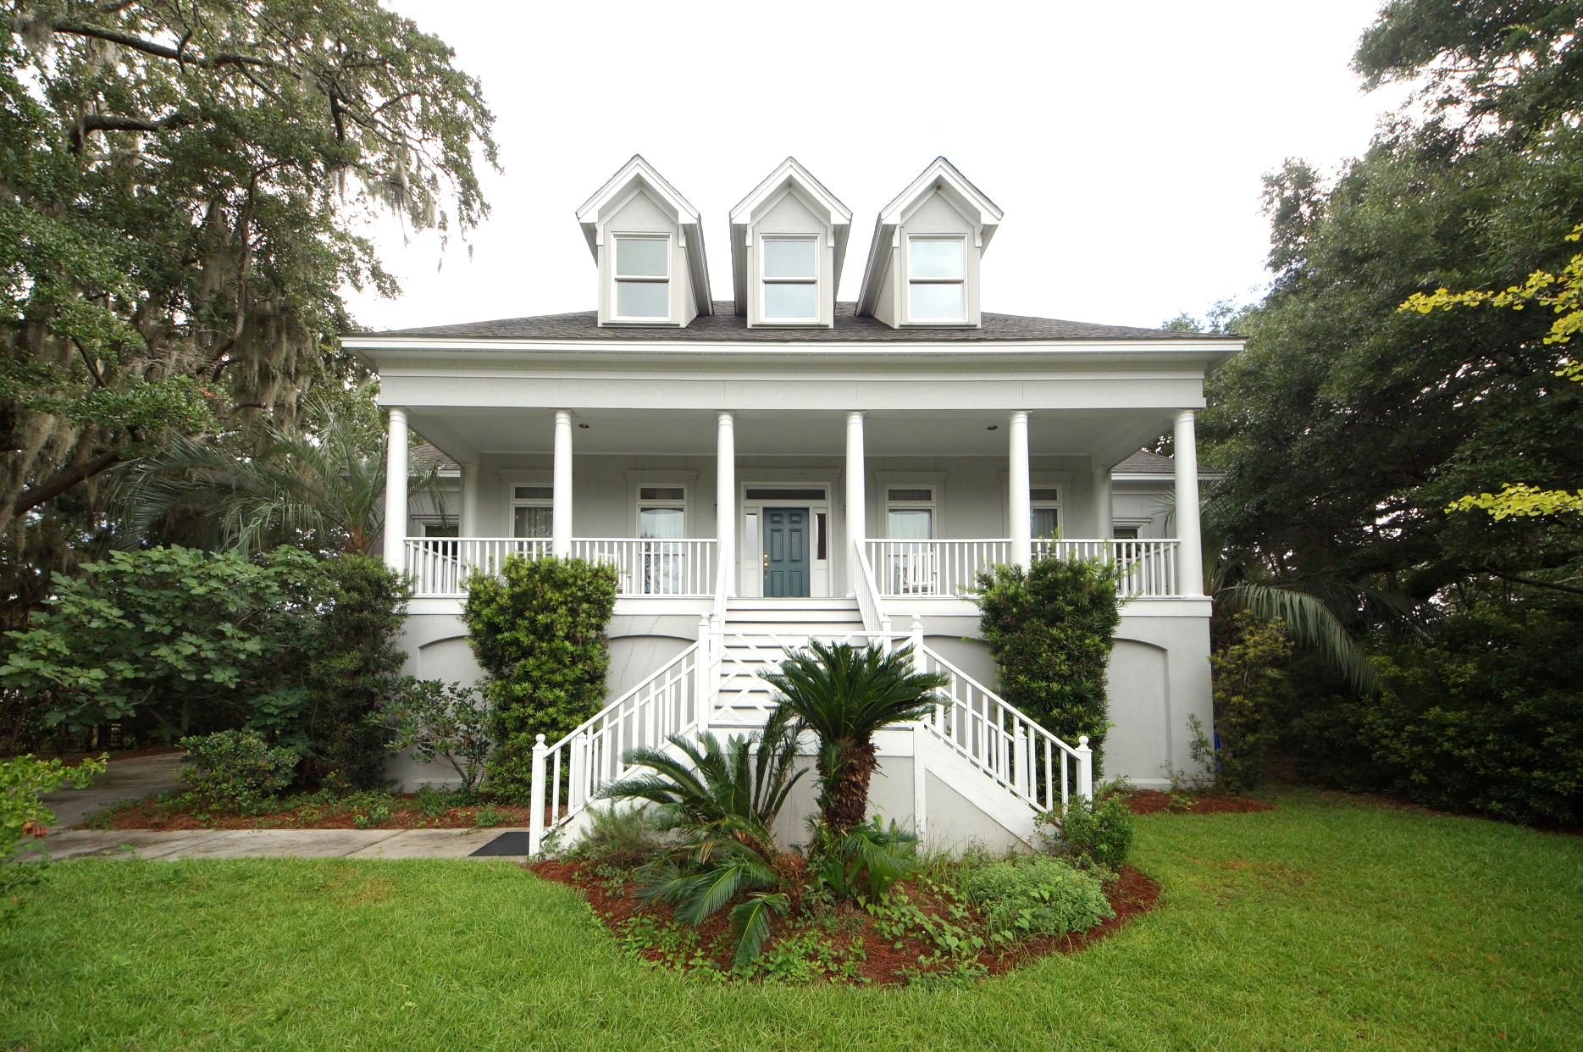
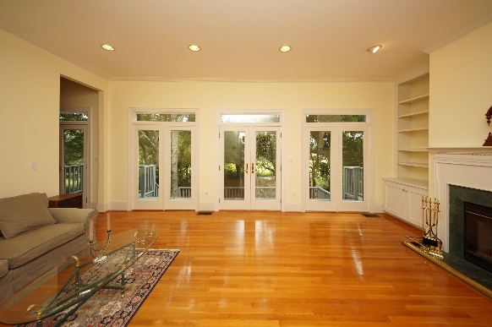
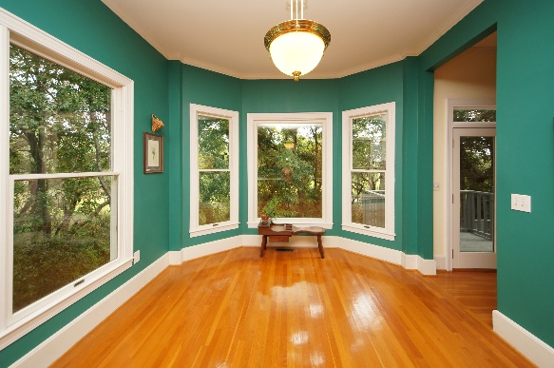
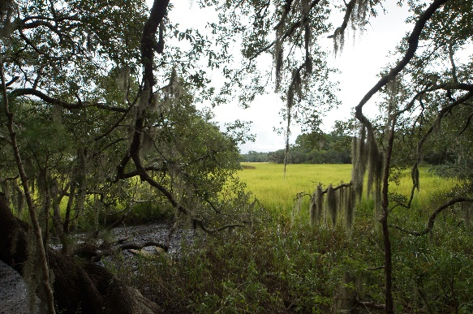


Open House Thursday Sept 20th 12-1:30
693 Whispering Marsh Drive ~ Stiles Point Plantation ~ Charleston
MLS# 18024303 ~ $885,000
Take a look at this Gorgeous custom built Plantation Style home with Marsh Views of Compass Point in desirable Stiles Point Plantation. Just minutes away from downtown Charleston, MUSC and all area hospitals. Located in one of the best school districts in Charleston, this beautiful executive family home is located on a quiet cul-de-sac near the community tennis courts and playground. This is the first time this home has been on the market and it is teeming with custom finishes, 10 foot ceilings downstairs and hardwood floors in all rooms! Master Bedroom suite is on the first floor. The ground floor garage is huge and could easily house an office or extra playroom w/plenty of parking! Did I mention the 17 ancient live oak trees dripping with Spanish moss surrounding the MarshFront yard?
Handsome Properties, Inc 53 Broad St Charleston, SC 29401
Ellen Leigh Murray
843 813-2006
chaspremierprop@bellsouth.net

