Slide 1
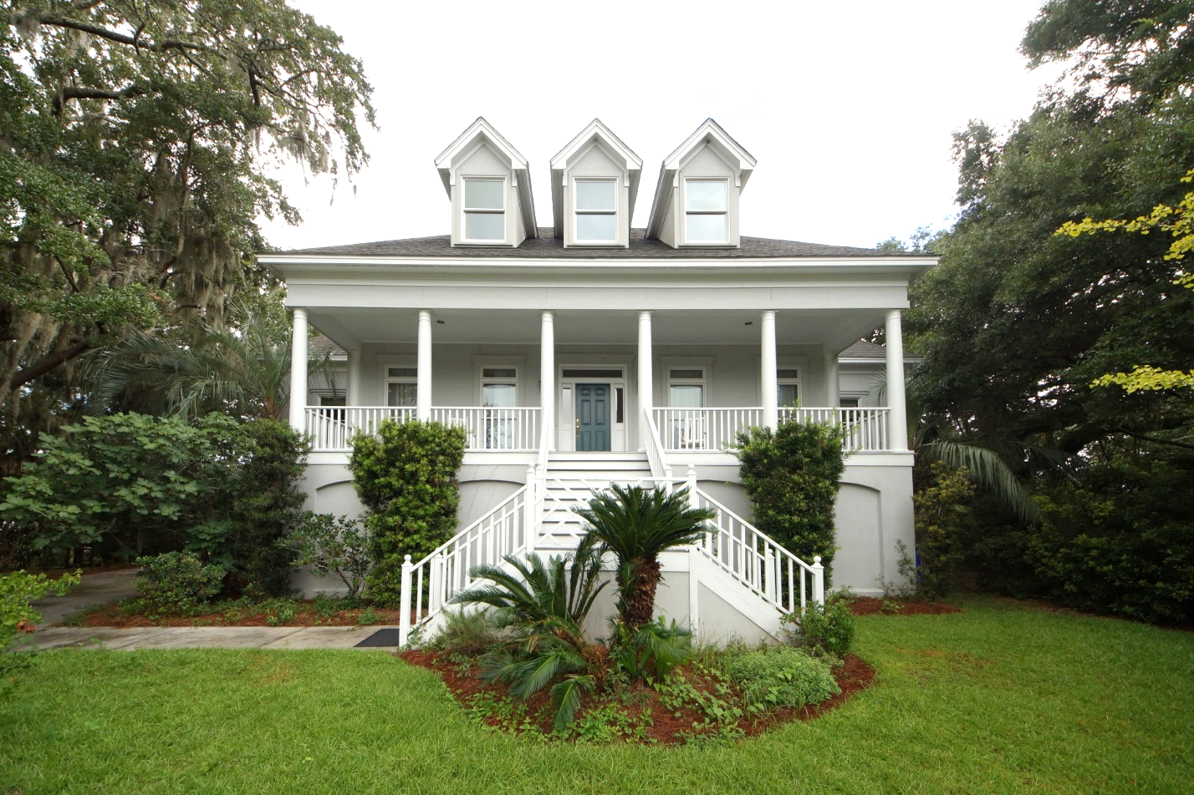
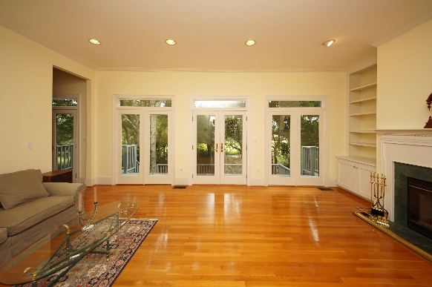
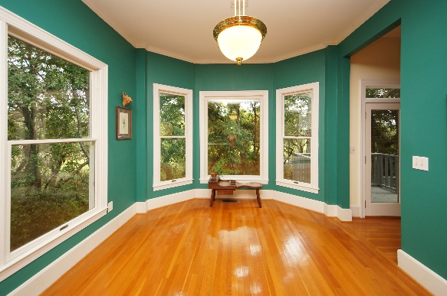
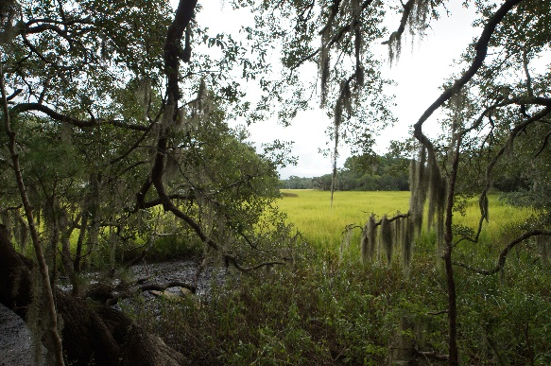


Price Reduction in Stiles Point Plantation!! $799,000 Bring all offers!
693 Whispering Marsh Drive
3400 Square Feet
Marshfront Lot
4 Bedrooms
MLS# 18024303
Handsome Properties, Inc 53 Broad St Charleston, SC 29401
Ellen Leigh Murray
843 813-2006
chaspremierprop@bellsouth.net

