Slide 1
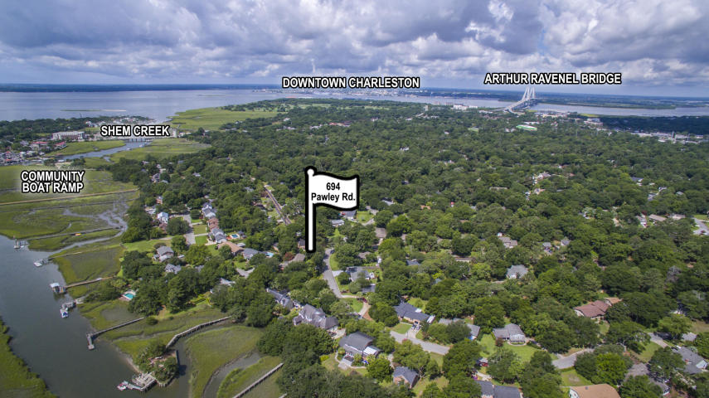
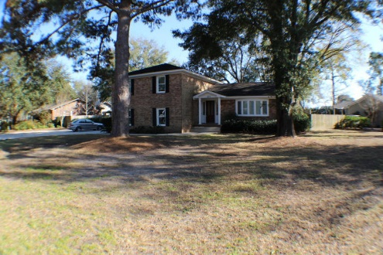
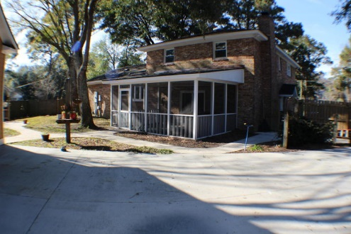
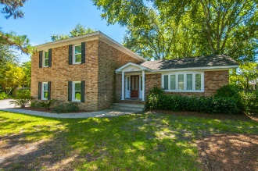
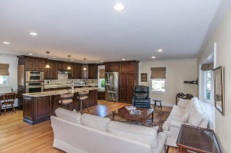
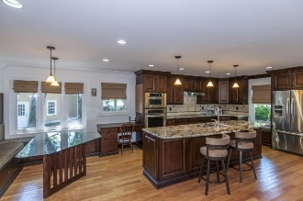
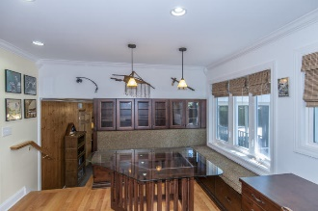
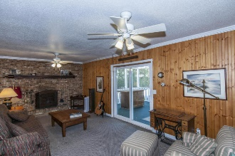
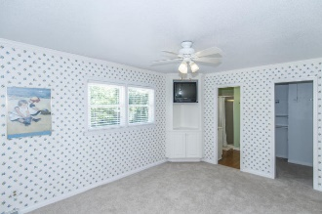
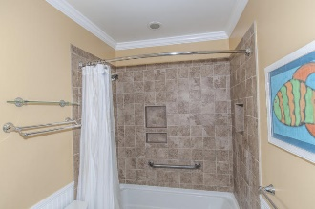
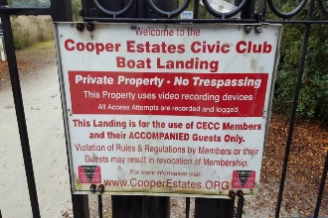


694 Pawley Road Mt Pleasant ~ MLS# 16003883 ~ Reduced to $639,000
Location…Location…Location…
Motivated seller says “bring us an offer!”
This extensively upgraded home is in a GREAT location!
Just minutes form the bridge this Beautiful corner lot has many mature trees. The Roof, windows, HVAC hardwoods, and beautiful custom kitchen with granite are some upgrades. Open floor plan! Living/ Kitchen combo, family room with built ins and a brick fireplace. Large laundry room and half bath. Spacious recreation room with and over sized pantry area also! Rear patio is screened and overlooks a large fenced yard. The cement plank 2 car garage makes a great work shop and has a 600 sqft floored room too. Would be a nice office area? Gated community boat ramp/dock, picnic area and it is on Shem Creek and only $100 per year!
Christopher McCormick
Office - 843-974-6200
Cell - 843-224-3204
cjmccormick@carolinaone.com
Carolina One Real Estate
900 N Main St
Summerville, SC 29483

