Slide 1
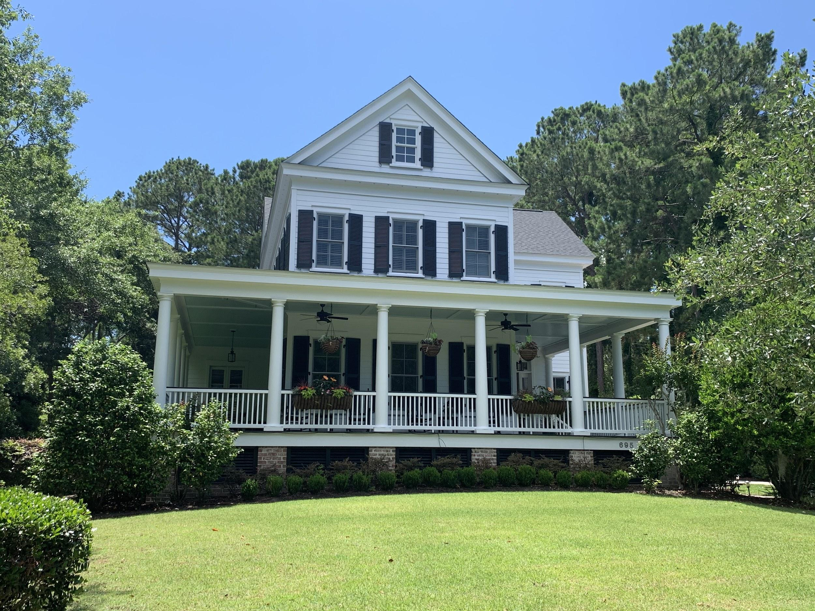
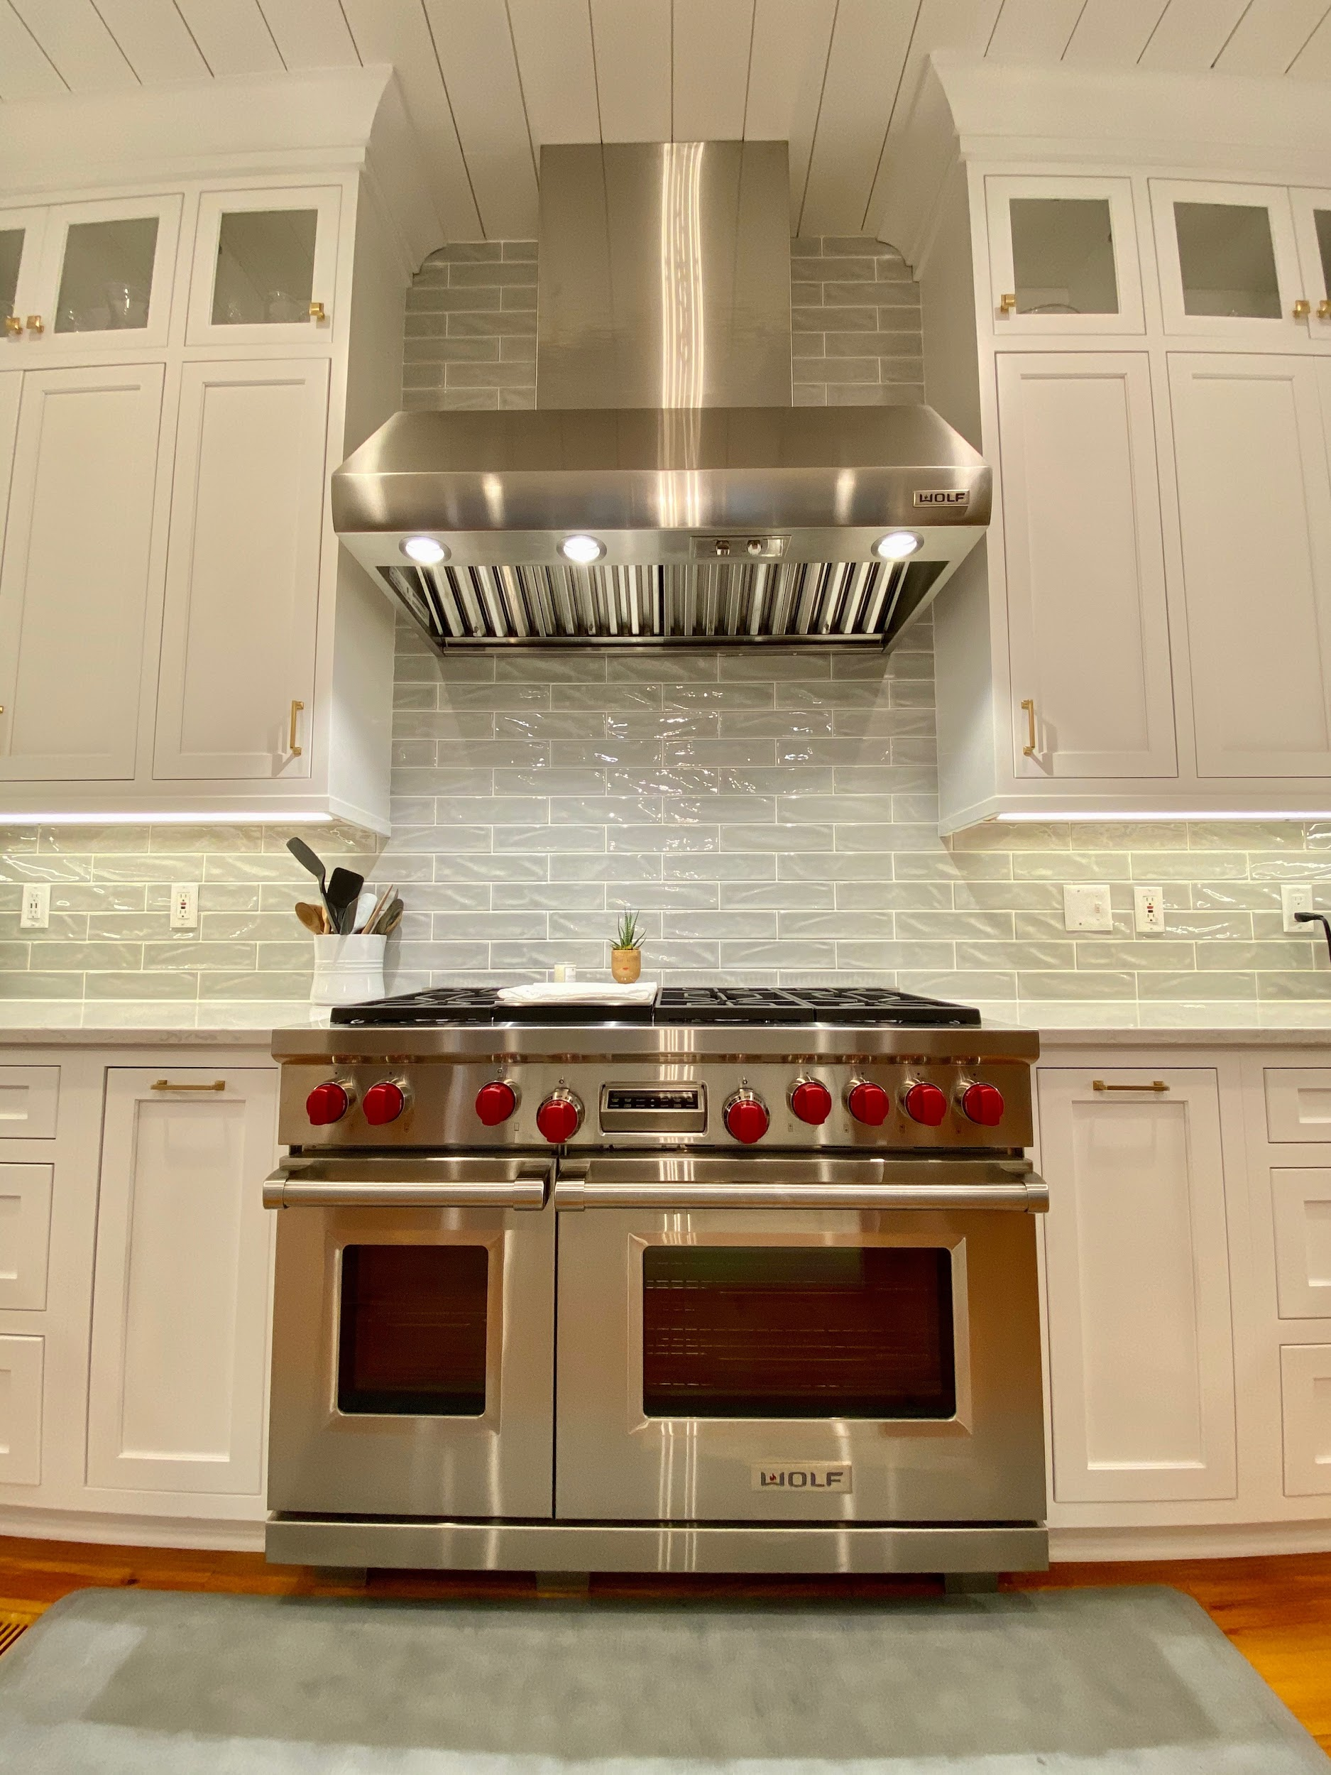
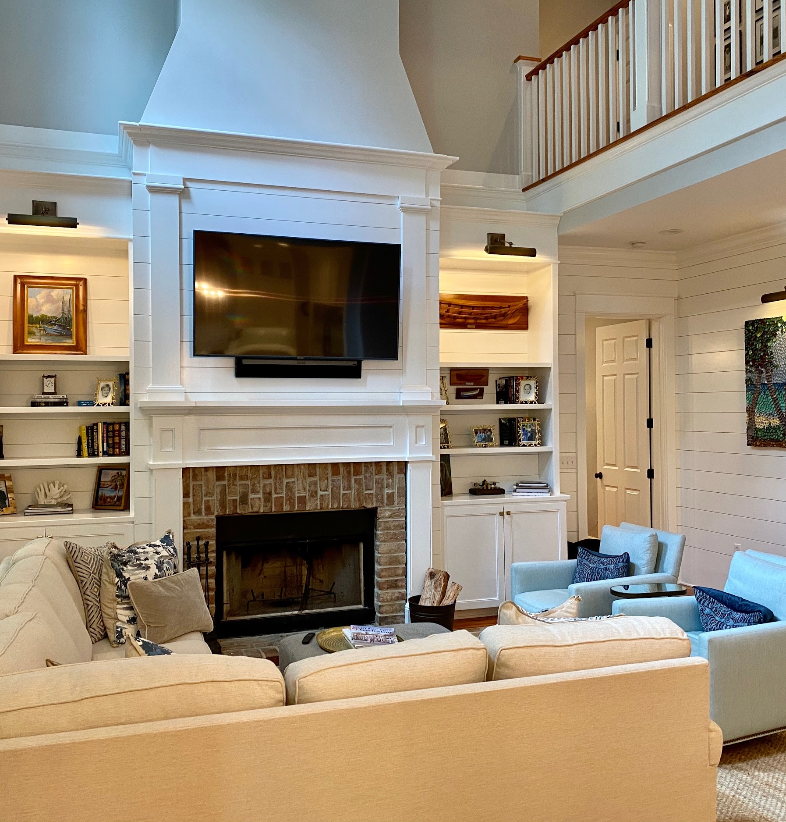
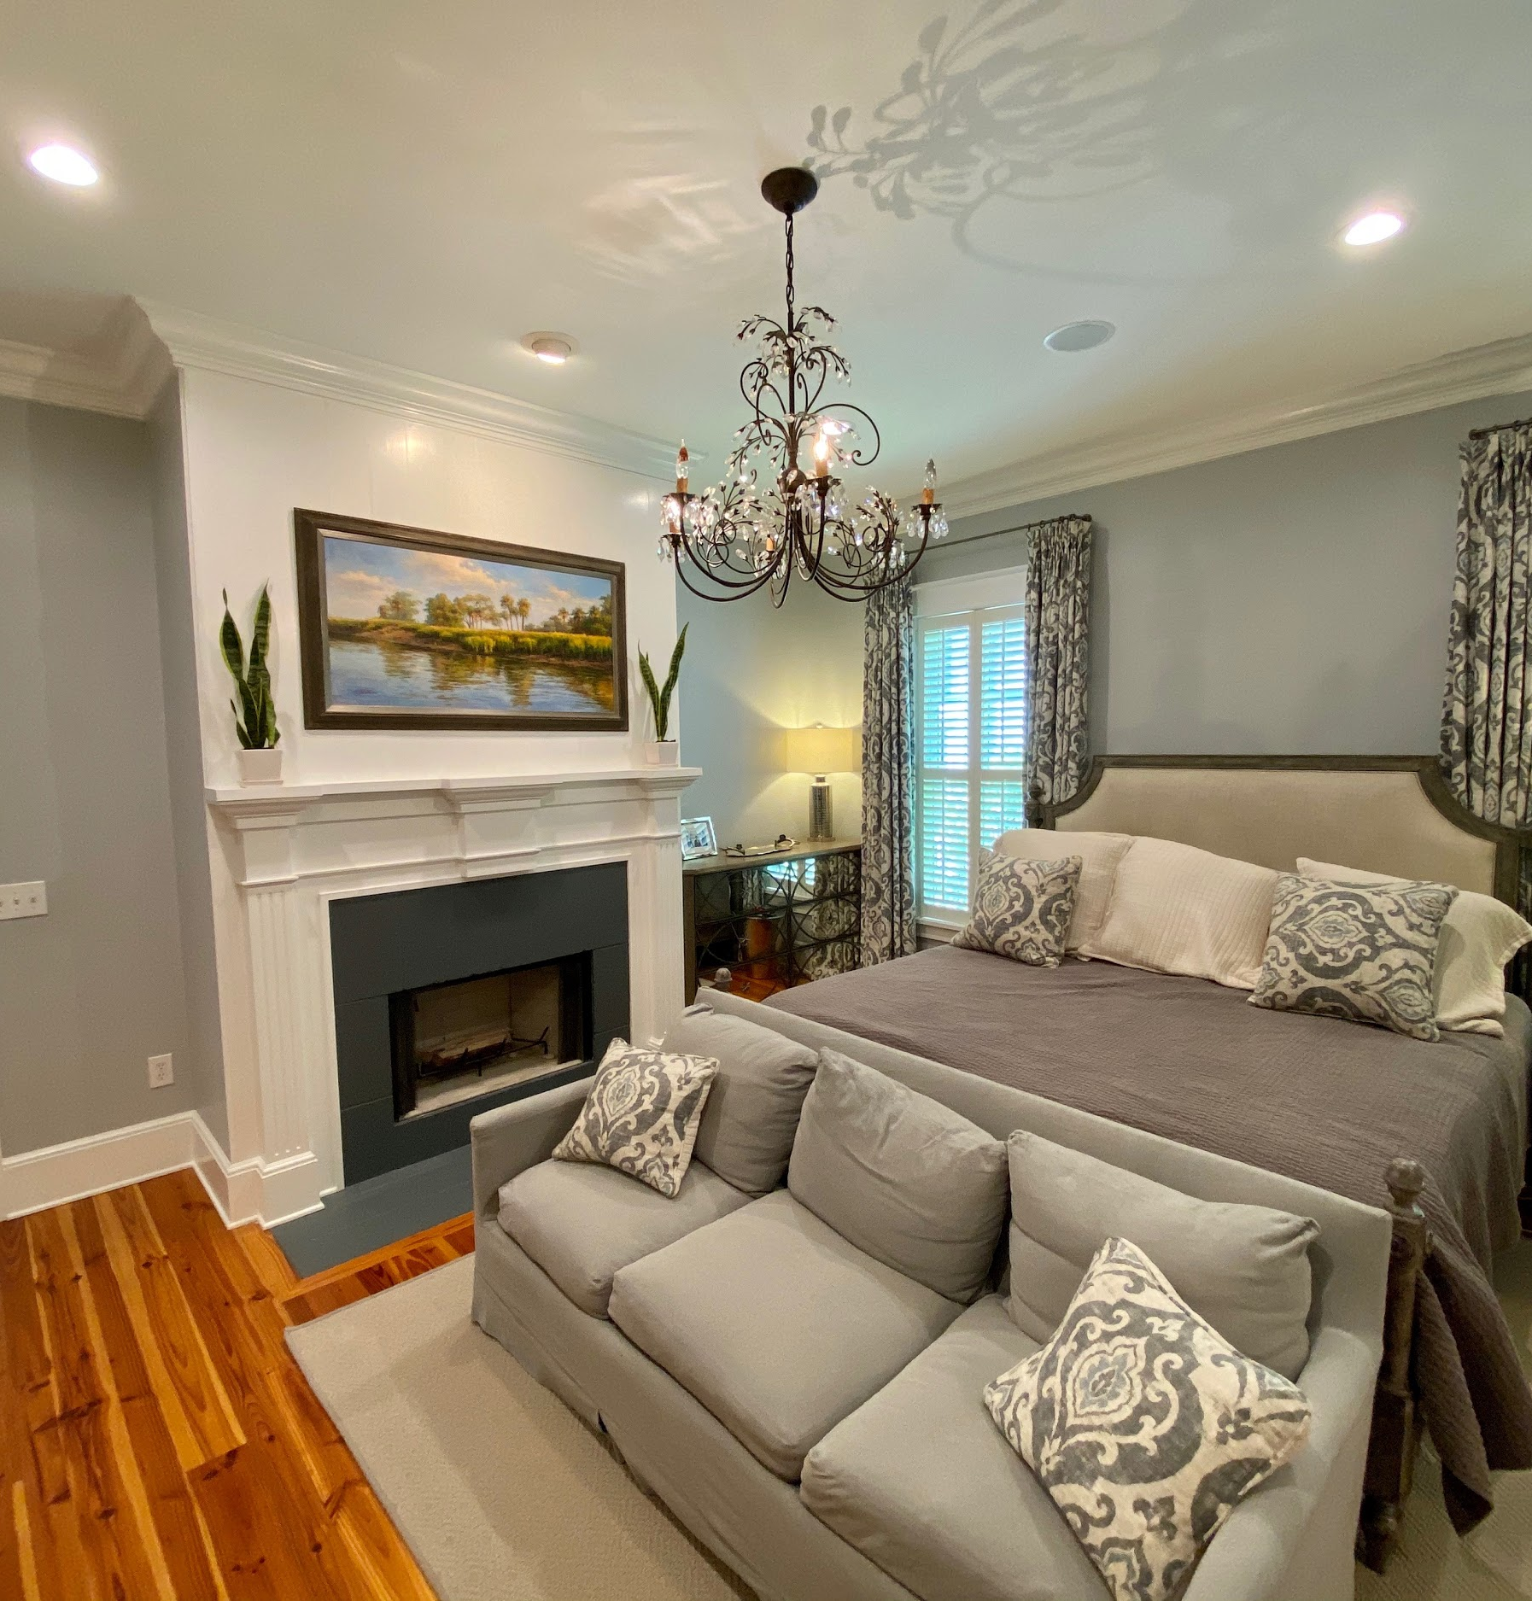
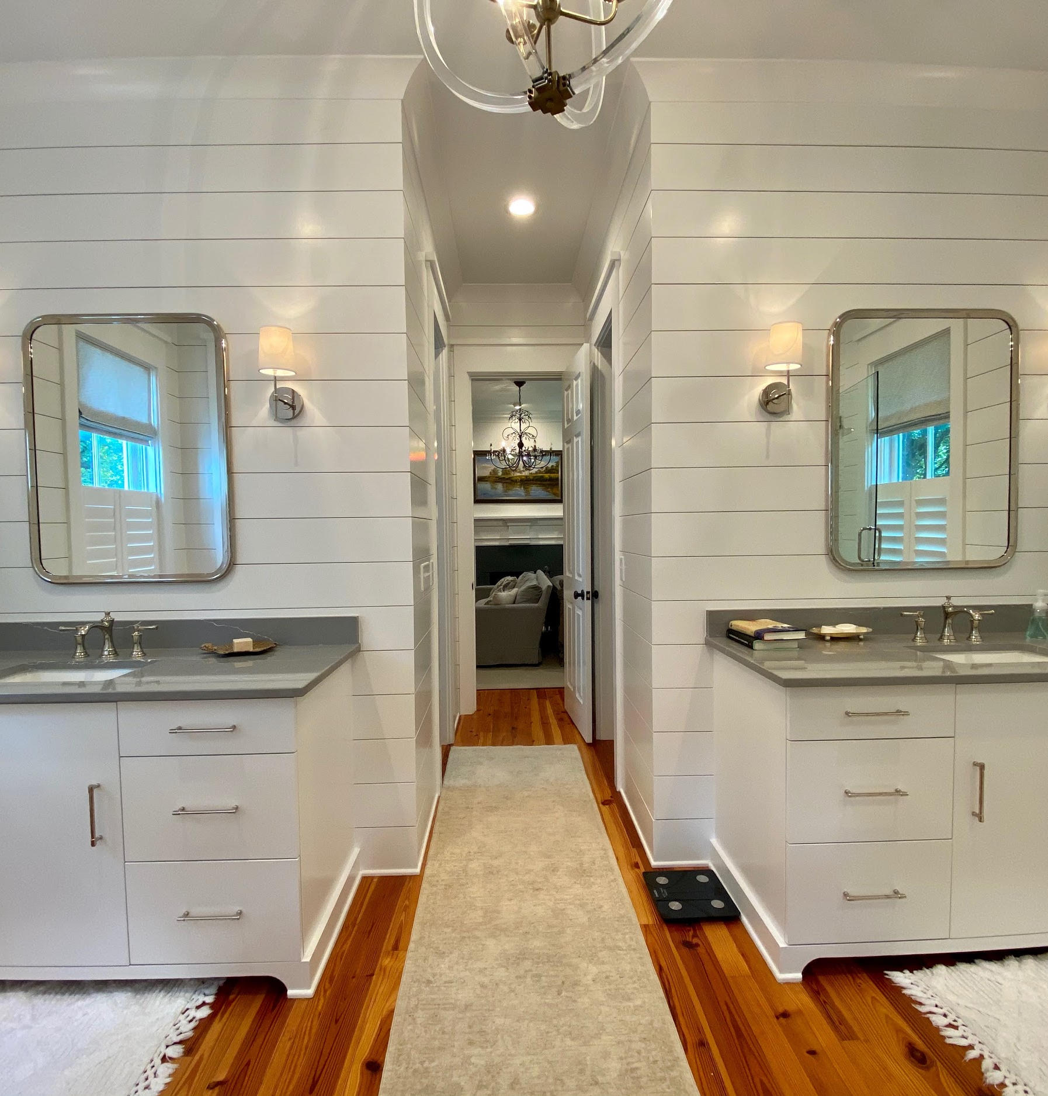
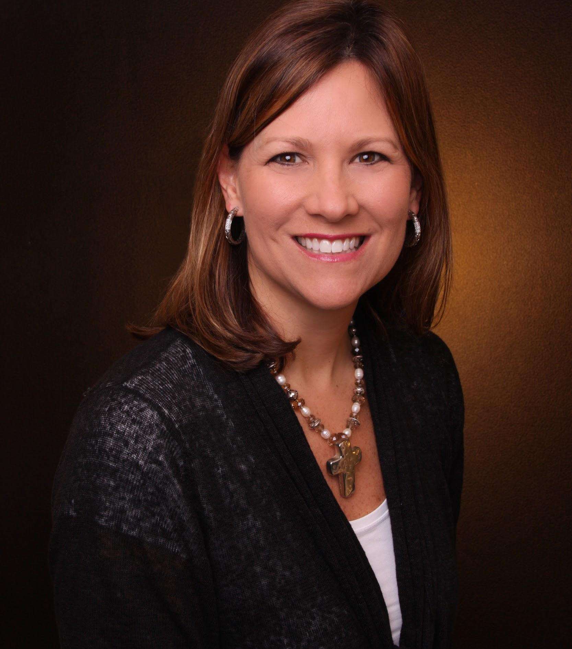
Agent/Public Open House
SUNDAY, AUGUST 2, 2:00 - 4:00
Virtual Tour:
https://www.youtube.com/watch?v=3ggS4ms93Sg
695 Olde Salt Run · Mt. Pleasant, SC
$2,250,000 · 5 Beds · 6 Baths
SUNDAY, AUG. 2 2:00 - 4:00
Kea Whatley
REALTORⓇ
843-408-8704
Kwhatley@AgentOwned.com
AgentOwned.com
Notes:
DO NOT ALTER LAYOUT. YOUR FILE WILL BE RETURNED OR EDITED IF IT IS RECEIVED ALTERED.

