Slide 1
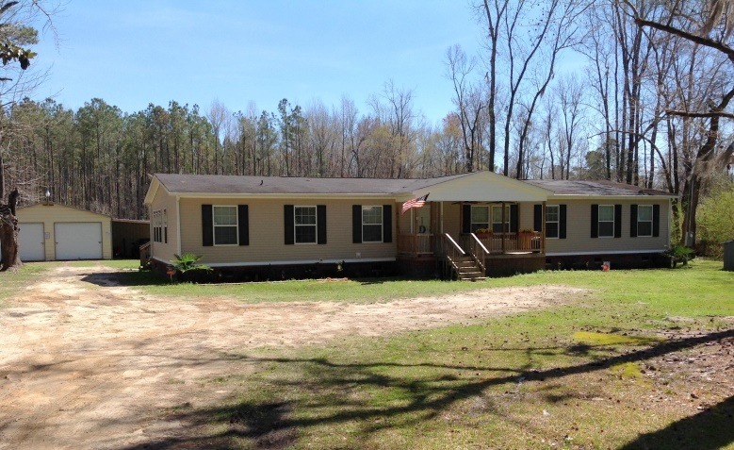
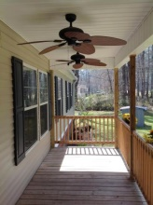
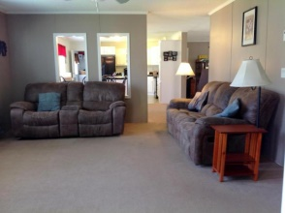
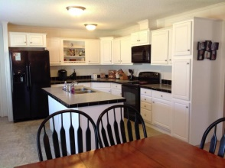
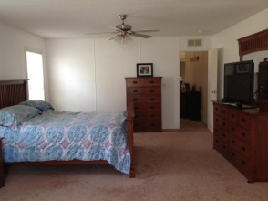
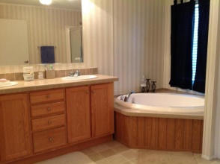
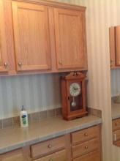
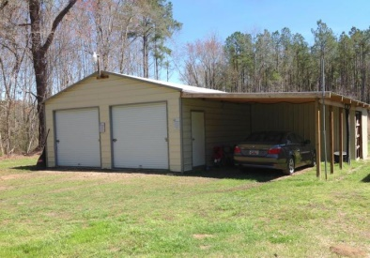
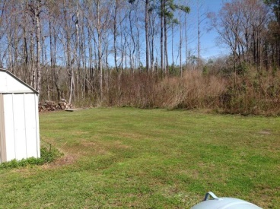
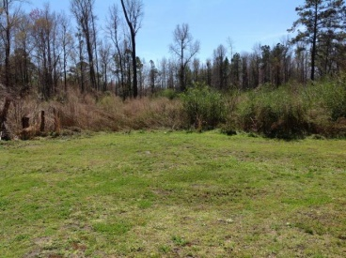
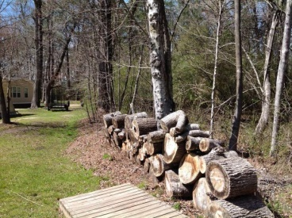

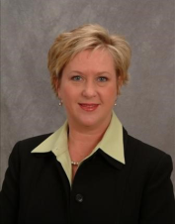

696 Griffith Acres Drive
Cottageville, SC 29435 ▪ MLS# 15006934 ▪ $135,000
3 Bed ▪ 2.5 Bath ▪ 2,432 sf
Open House
Sunday from 1-4
Country living in the quaint little town of Cottageville. This spacious home has a wonderful open floor plan that flows easily from the large living room to the huge kitchen, and family room. Beautiful kitchen with tons of white cabinets, an abundant amount of counter space, black appliances and an island. Kitchen is open to family room - a great space for entertaining. There is another space leading from family room, with French Doors, that would make a fantastic office, kids play room, another sitting area, etc. Large master suite with sitting area, huge master closet with built-in cabinets, and a wonderful master bath with garden tub, separate shower, and dual vanities. Two other bedrooms share the second full bath which is also very large with dual vanities, linen closet, and tub/shower combo. Home has a separate laundry room off of kitchen and a half bath. Ceiling fans in all bedrooms and most living areas. This home boasts a full front porch that also has outdoor ceiling fans. A great place to relax and enjoy the peacefulness of this area. The two car garage has been built within the past 2 years with concrete flooring and electricity. Tons of storage space and another storage building for lawn mower, etc. If you are looking to get out of the city and are looking for a quiet country home at an affordable price - look no further.
Jennifer Nipper, Realtor®
(843) 478-1800 | jen@AgentOwned.com
www.AgentOwned.com
The AgentOwned Realty Co | 824 Johnnie Dodds Blvd | Mt. Pleasant, SC 29464
Real Estate • Mortgage • Insurance

