Slide 1
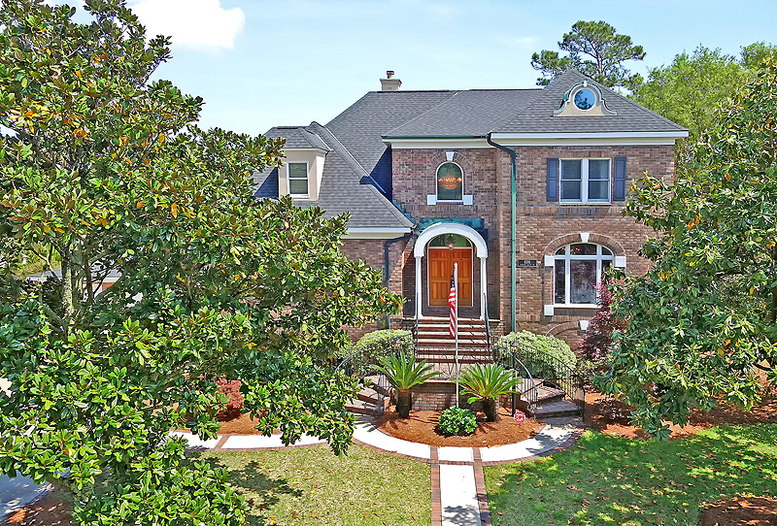
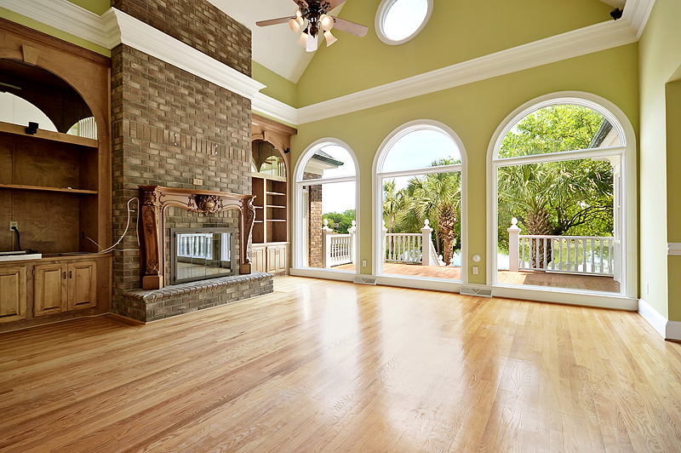
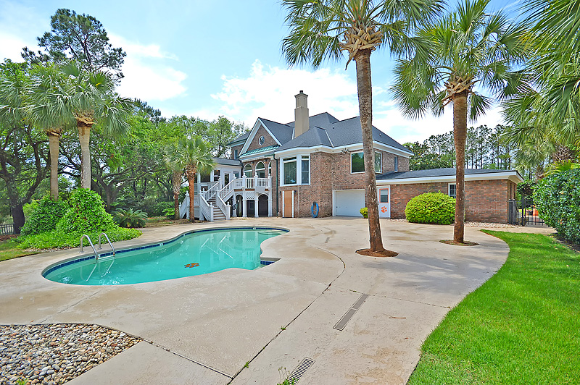
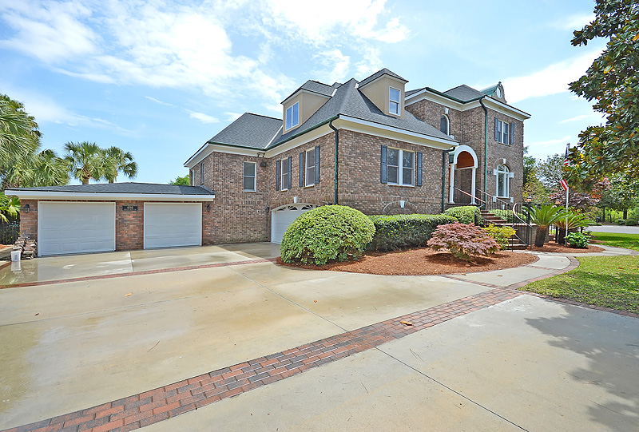
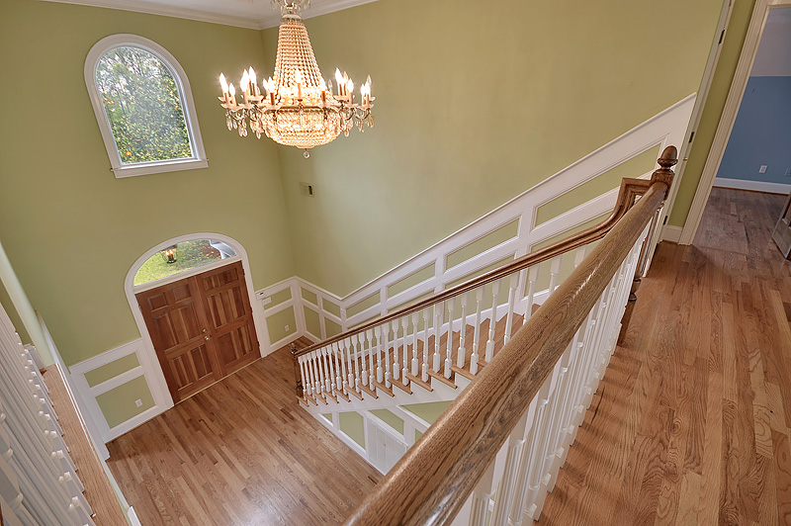
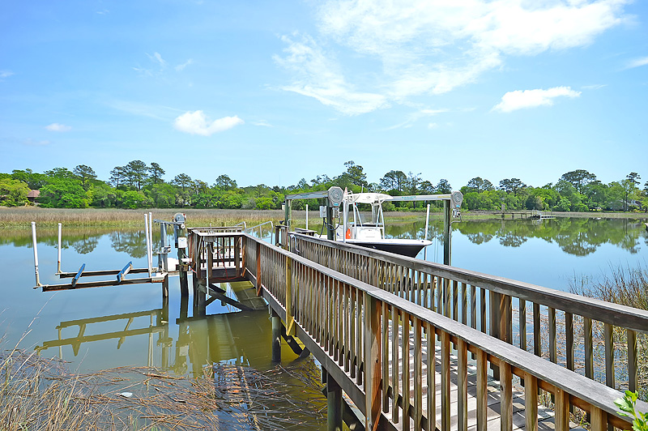
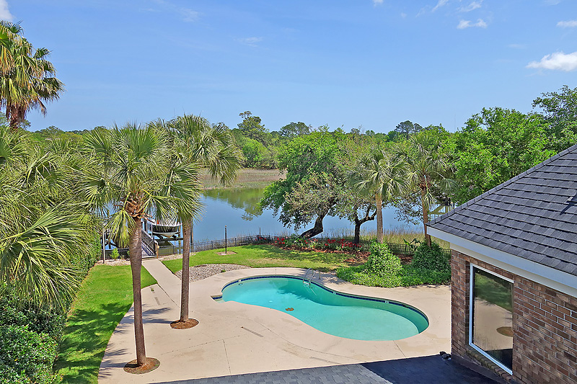
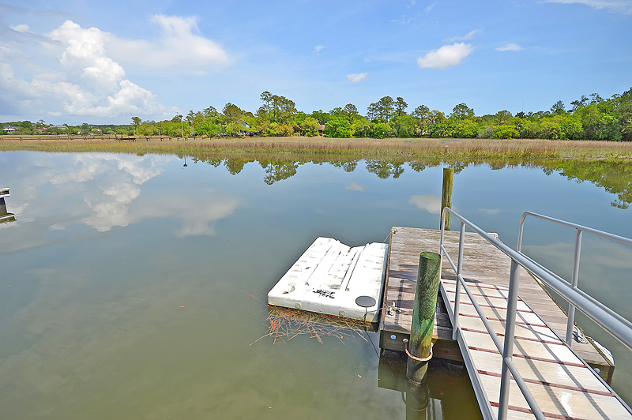


Striking Water-front Home In Sought After Hobcaw Creek Plantation
696 Hobcaw Bluff Drive
Striking water-front home in sought after Hobcaw Creek Plantation with pool and multiple boat lifts, four bedrooms and a large media room. This brick home inspires with its classic architecture and weathered copper accents. Walk up the steps lined with iron rails and into a two story foyer leading to the dining and the two story vaulted great room. The home extenuates the outdoor living potential of a 1/2 acre lot with a large sunroom, deck, beautifully landscaped backyard, salt water pool and dock. Lawn is maintained by a well-fed irrigation system. Home is elevated allowing for an incredible amount of semi-conditioned space on the ground level for storage, exercise equipment and more. Additionally, the home boasts a large and wide driveway/parking area and two large garages fitting 4 cars. HOA includes a boat landing, pool, tennis courts, playground and clubhouse. Home is minutes away from grocery, shopping and dining in Bell Hall.
EASY TO SHOW. MLS#: 17011434
J. Thomas Wingard
cell (843) 385-2494 | office (843) 501-9911
Southeastern Development Associates
192 Slipper Shell Ct Mount Pleasant, SC 29494

