Slide 1
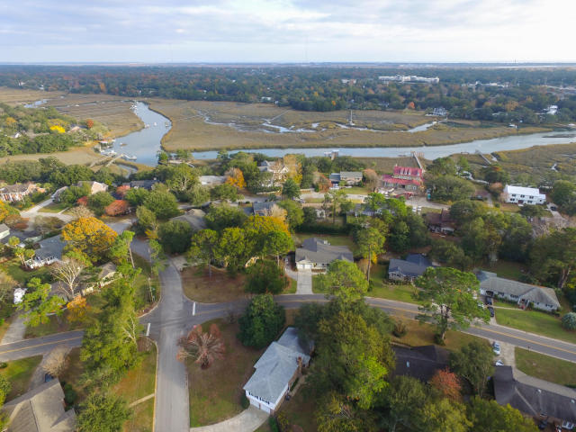
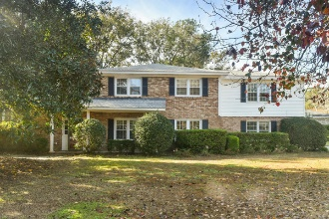
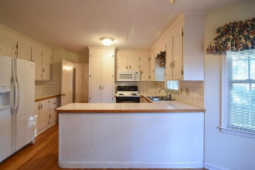
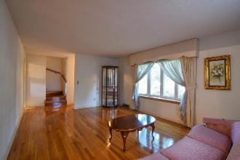
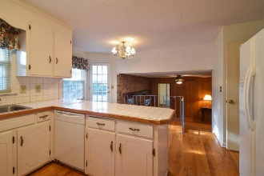
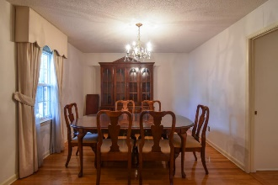
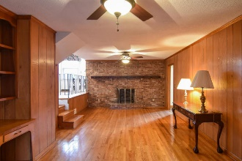
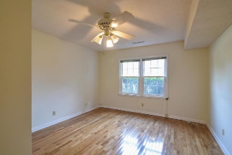
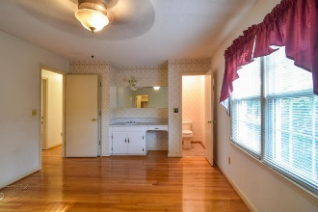
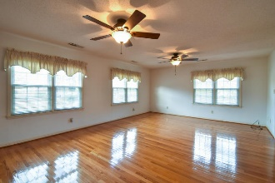
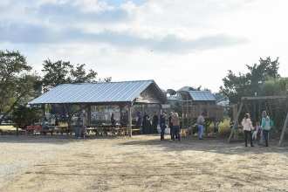
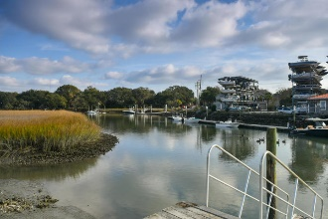


696 Pawley Road
Mount Pleasant, SC 29464 :: MLS# 17032077 :: $595,000
The Only Deep Water Home On Daniel Island
Cooper Estates Open House
Sunday, February 4th ~ 1:30–4pm
Conveniently located in desirable Cooper Estates! This home has so much potential! Nice bedroom and full bath on ground level could be master bedroom or Mother-in-law suite. Beautiful hardwood floors! Large home with fenced in backyard perfect for pets or keeping your boat! Neighborhood has a boat landing and dock that is optional to join. Walk to the new Shem Creek Park or to Shem Creek restaurants! Hop on the Ravenel Bridge and you'll be downtown in 10 minutes! If you've been wanting to live in the Coleman corridor now is your chance to make this home your own!
Helen Hudson
843-991-9875
helen.hudson@carolinaone.com
Carolina One Real Estate
2713 Highway 17 North
Mt. Pleasant, SC 29466

