Slide 1
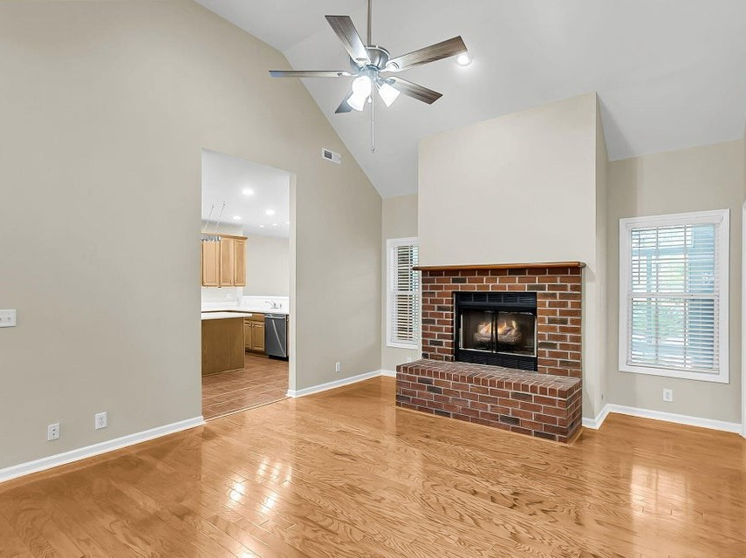
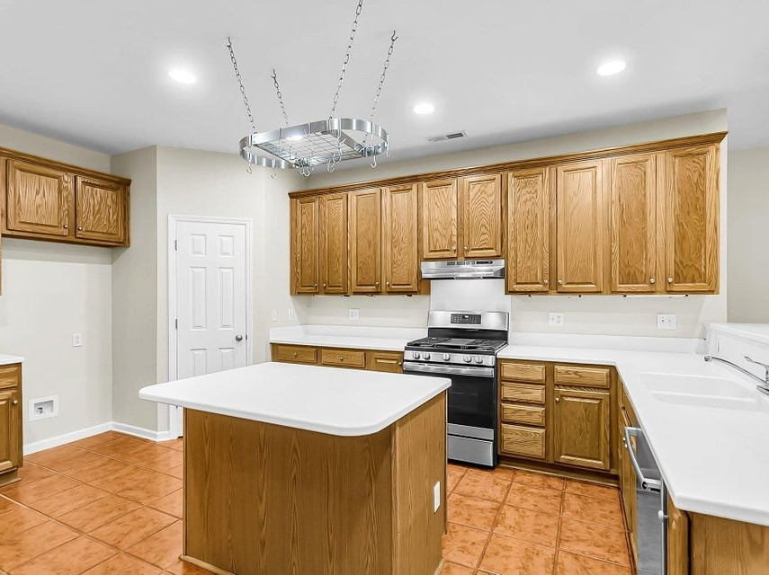
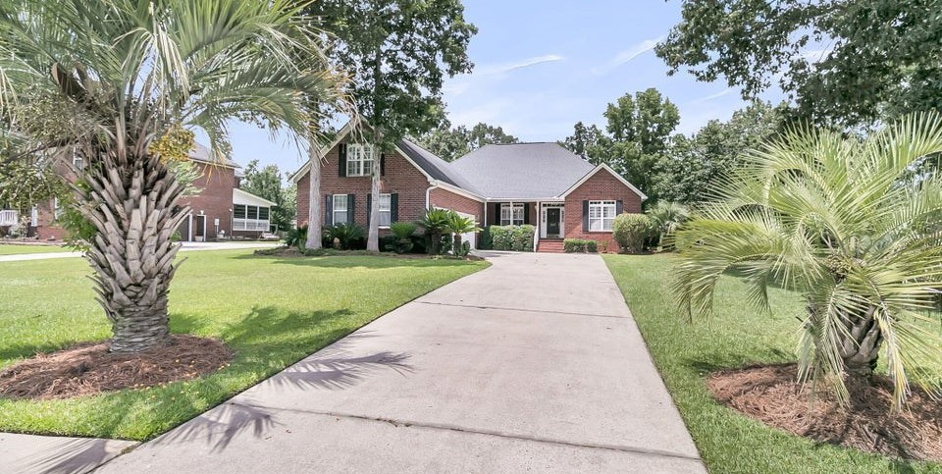
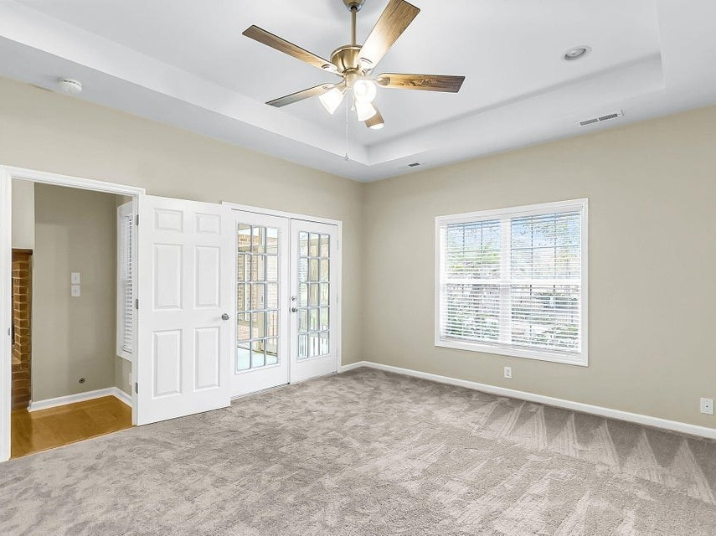
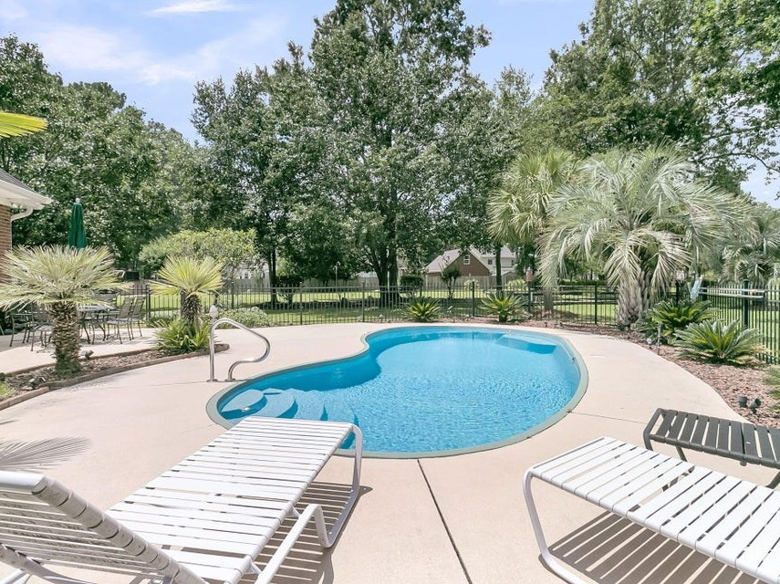
697 Hamlet Circle
Crowfield Plantation | Goose Creek, SC 29445
4 Bedrooms | 2 Bathrooms
2,894 Square Feet
MLS# 25019892
Now Offering at $650,000
Welcome to your perfect sanctuary! This one is a rare find. A one owner 3-bedroom and frog can be 4 bedroom, all-brick one story home with oversized frog and three car garage. As you enter this beautiful home the gleaming hardwood floors will catch your eyes and then you will see the open concept.
You will also notice the new professionally painted walls with modern neutral colors and all trim and doors paint with fresh coat of with white trim. New light fixtures, new door knobs, and new ceiling fans throughout this great home. The tour is just getting started imagine waking up to relaxing view of your new in ground pool, lush greenery, enjoying the serene views of the 4th fairway of Crowfield golf course.
We can go one and on about what a great home it is but might be best if you come see for yourself.

