Slide 1
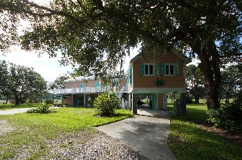
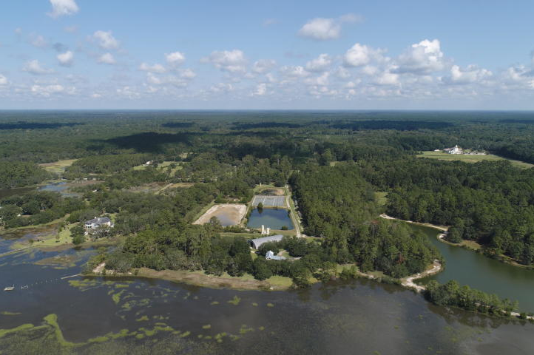
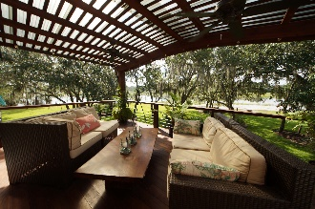
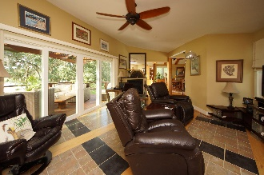
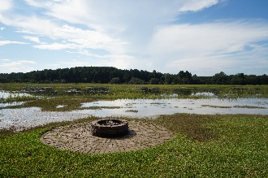
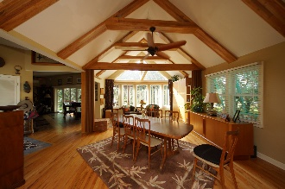
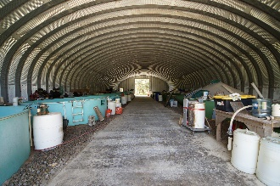
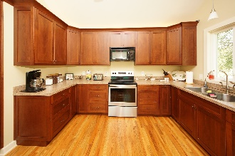
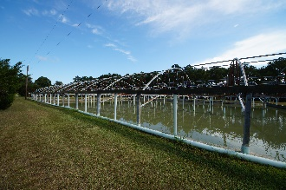
SO MANY OPTIONS: WORKING FISH FARM, HOBBY FISHING/SHRIMPING, OR JUST ENJOY THE 10.2 ACRES ON THE TOOGOODOO RIVER!
6989 Toogoodoo Road
Hollywood, SC 29449 | MLS# 18025883 | $900,000
OCRM phone conv says no problem getting dock! The ultimate sustainable getaway with stocked ponds and ''hurricane safe'' house. Electric hurricane shutters, high impact windows, Bahama shutters, reinforced concrete piers with DOUBLE Hurricane straps. STORAGE: 1.) 5000 sq.ft steel master airplane hanger with high bay door for boats, RV's...anything, 2.) 1080 sq.ft steel master hanger, 3.) 360 sq.ft steel garage, 4.) 72 sq.ft generator shed. WELL: 600ft deep 70 gallons a MINUTE! 21,000 ft green house super structure, can be used to raise fish or emptied and used as greenhouse or storage. 8, 50ft long aerated raceways for fish or greenhouses. 5 PONDS...all can be filled.
Johnny Crosby
jcrosby@propertyadvisorsinc.com | 843-270-9407 | www.charlestonhomeproviders.com
Brand Name Real Estate | 4 Carriage Lane, Suite 106 | Charleston, SC 29407

