Slide 1
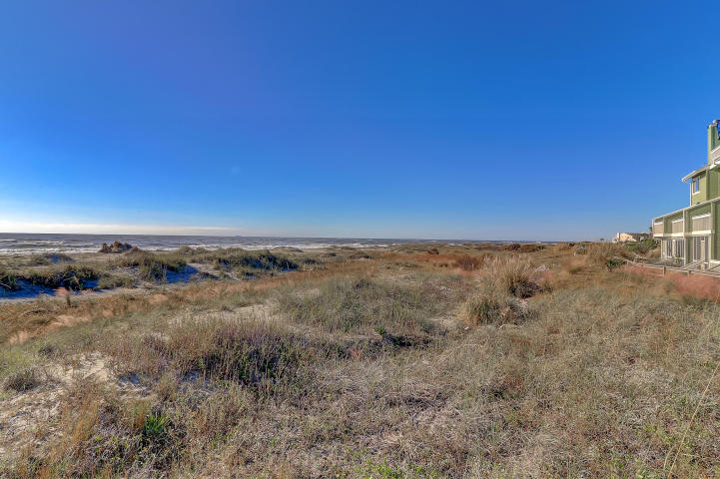
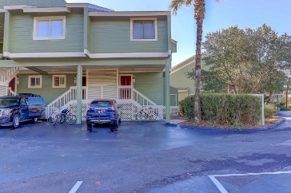
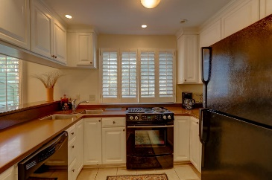
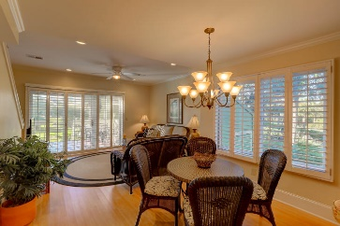
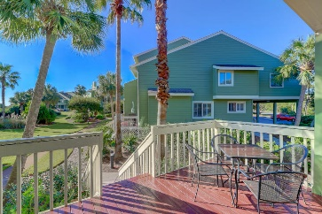
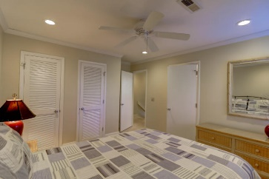
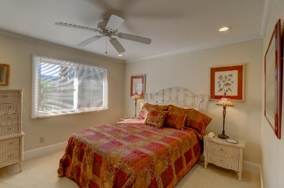
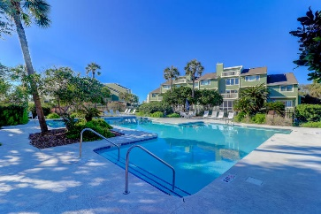
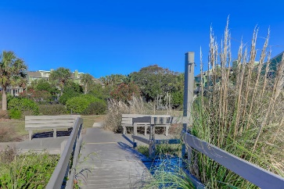


6A Mariners Walk Drive
Wild Dunes
Isle of Palms, SC 29451
MLS# 17028685
$525,000
Oceanfront Mariners Walk
Move Right In
Updated w/Great Rental Potential
Great location in an Oceanfront Mariners Walk community of Wild Dunes. This turn key end unit 2bd/2ba sells fully furnished with tons of streaming light throughout, beautiful plantation shutters and laminate floors. The deck space off the open living space offers some ocean views and just steps to the beach and pool. Excellent rental potential, a great 2nd home or primary residence. This is a well maintained condo with smooth ceilings, hard service counter tops, tons of recessed lighting, crown molding and a great kitchen. Walk in with your suitcase and be at home to rest or entertain!
Darlene Smith
Office - (843) 886-8110
Mobile - (843) 696-7824
darlenesmith@carolinaone.com
DarleneSmithTeam.com
Carolina One Real Estate
1503 Palm Blvd Ste
Isle of Palms, SC 29451

