Slide 1
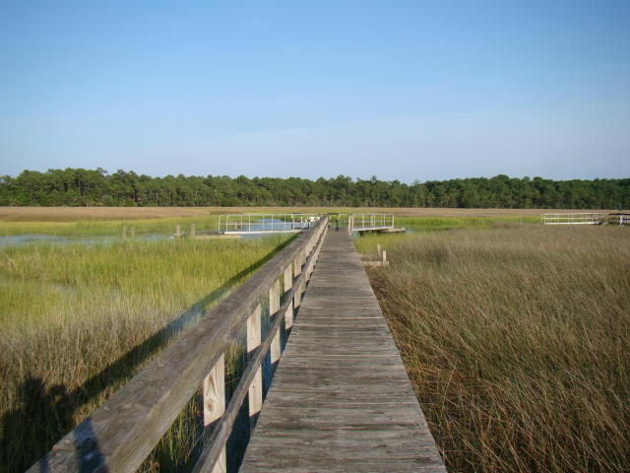
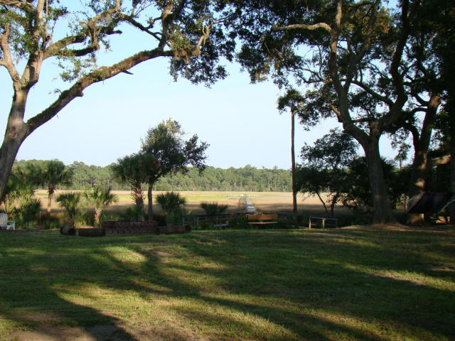
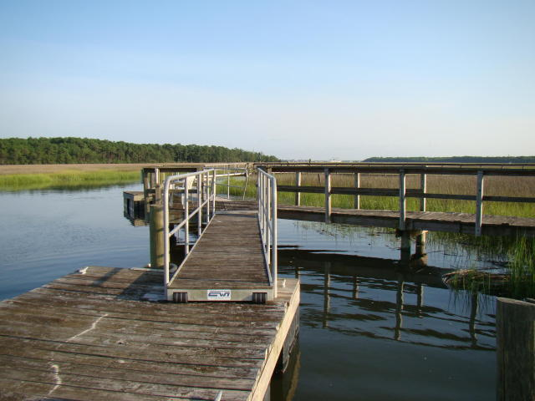
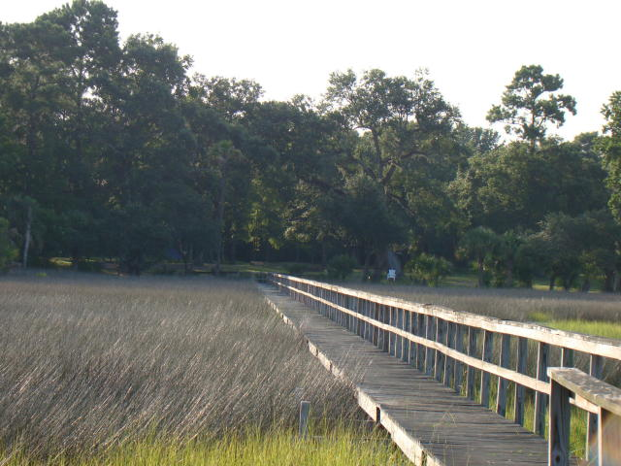
6 B Pinefield Dr
Pinefield ~ Charleston
MLS# 15018633
$455,000
Easy Access to Cooper River
Beautiful waterfront lot on Clouter Creek tributary with shared dock in place. Permit to construct onsite Wastewater system (septic) in hand. Minutes from Remley's Point and Cooper River. Ideal site for the boat lover or fisherman! Come build your dream home on a dream lot.
Michelle Riser & Zachary Glover
843-860-1229 (Michelle) | 843-810-9891 (Zachary)
mriser@ccim.net | mrcrealestate1@gmail.com
Matthew Ryan Company, 104 Berkeley Square, PMB 59, Goose Creek, 29445

