Slide 1
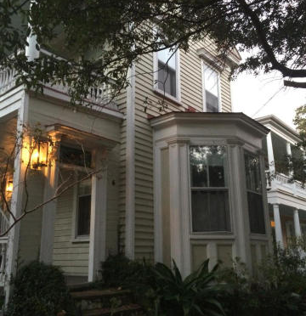
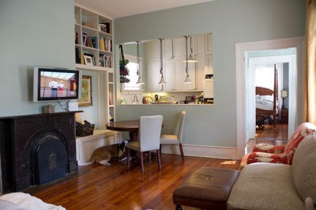
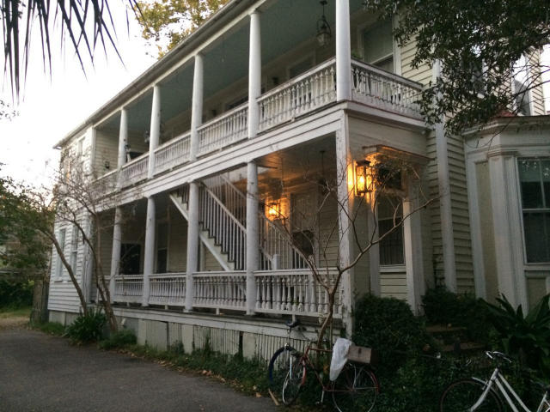
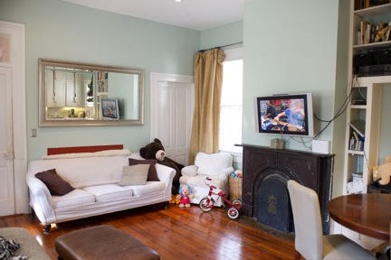
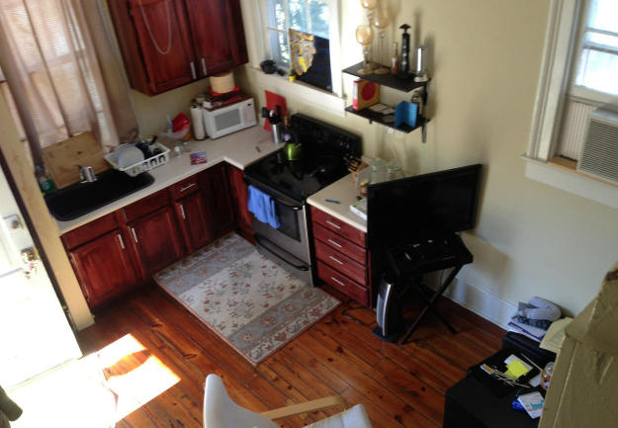
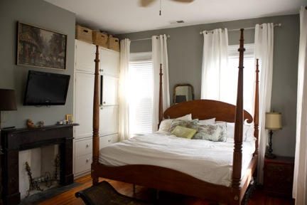
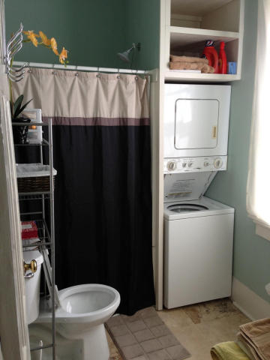
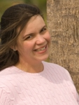

6 Bee Street
Charleston ~ MLS# 14028147 ~ $1,100,000
Close to MUSC
This home is a great investment! There are 3 units total which include 2 2 bedroom 1 bath units and a third one bedroom one bath unit. It is steps from MUSC and in great shape. There is off street parking on the property and much of the property has been updated. The one bedroom is rented $1000, the two bedroom is $1875 and $2200 on the other two bedroom. Don't miss this opportunity! Call today for a showing.
Carey Nikonchuk
(843) 276-1701 M
cnikonchuk@gmail.com
www.palmettoproperty.net

