Slide 1

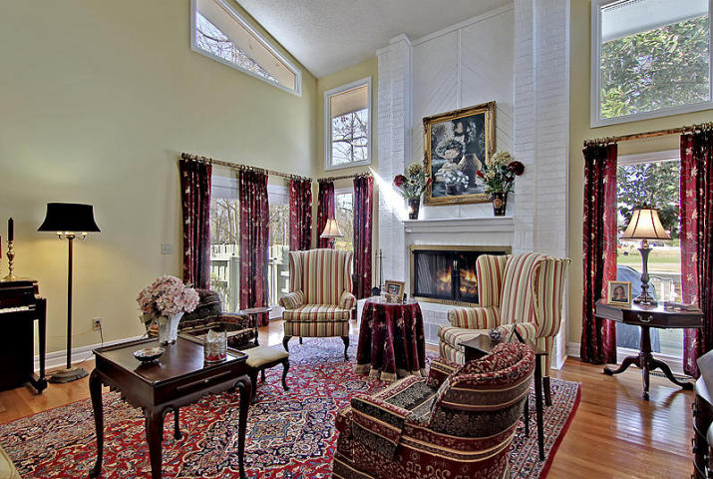
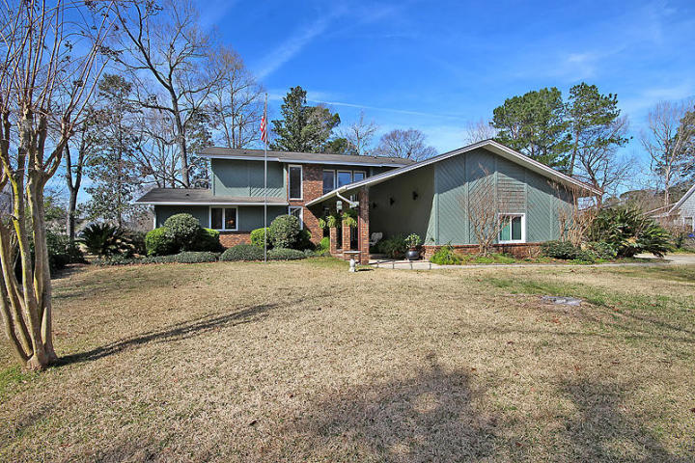
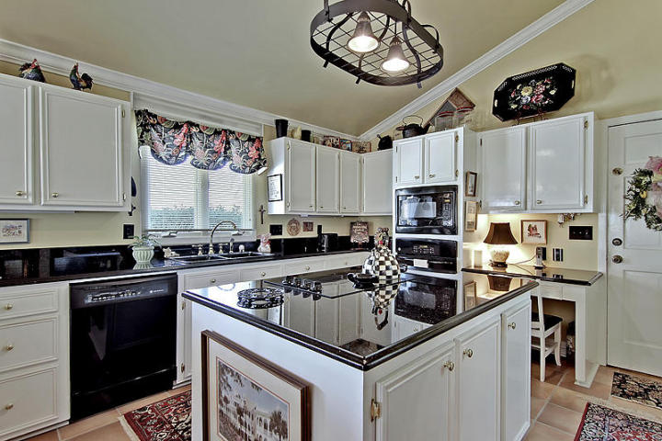
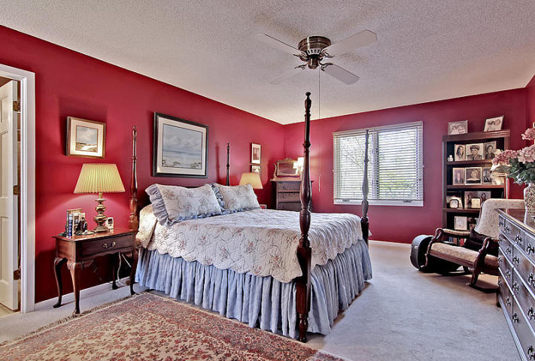
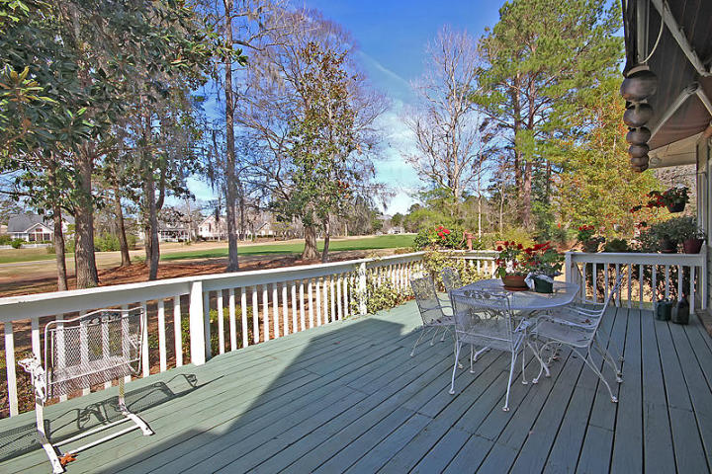
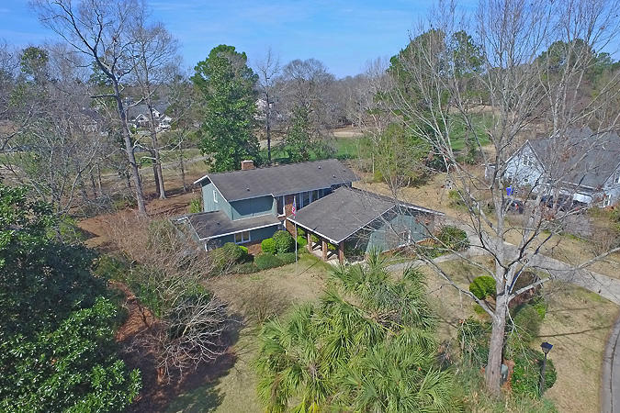
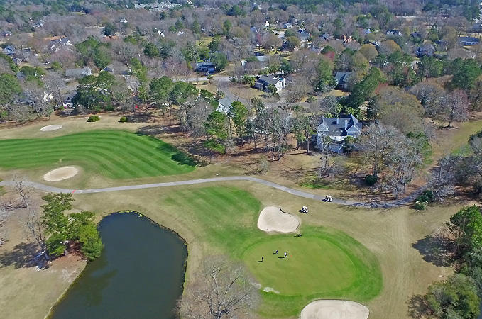

Luxury Golf Course Home Bargain Price!
6 Cutchin Court MLS# 17004557 ~ $399,900
4 Bedrooms ~ 3½ Bathrooms
Words can't describe the beautiful golf-course views and privacy afforded by this spectacular home so please see the photos. If Donald Trump were playing golf in West Ashley instead of Mar-a-lago he may just walk from the back deck of this home right onto the second green of the golf course. After golf, the back deck view of a perfect sunset is matched by the ethereal view of the full moon from the front porch. Inside, the elegance of formal living and dining rooms is offset by a bright country kitchen with black appliances and dark granite balanced by white cabinets and an adjoining sunroom - all set to the tune of sunlight. Won't last long. Please submit a squeaky clean full-priced offer to save your buyer the fun of a full-priced counter offer.
Chip Walsh
843-822-4663
chipwalsh@gmail.com
The Boulevard Company, LLC 35 Broad Street Charleston, SC 29401
www.TeamWalshRealEstate.com

