Slide 1
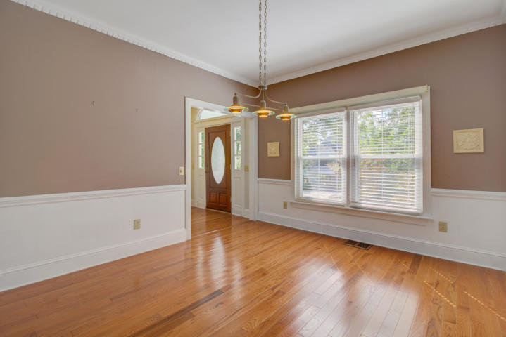
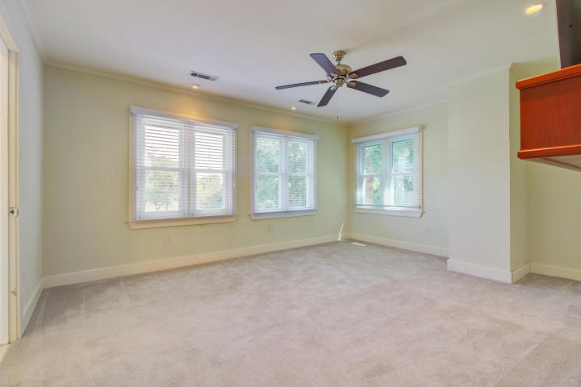
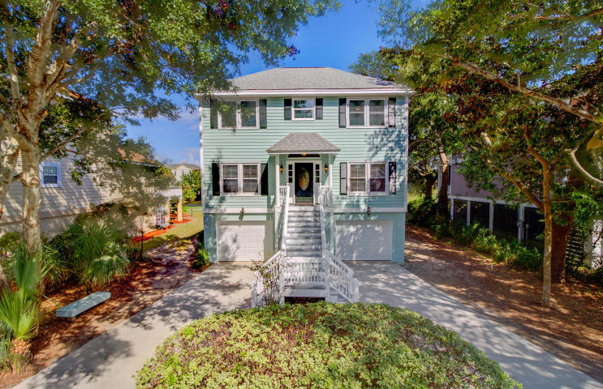
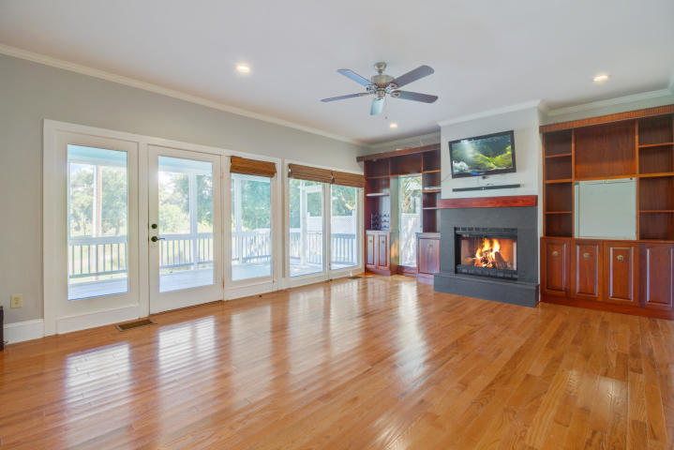
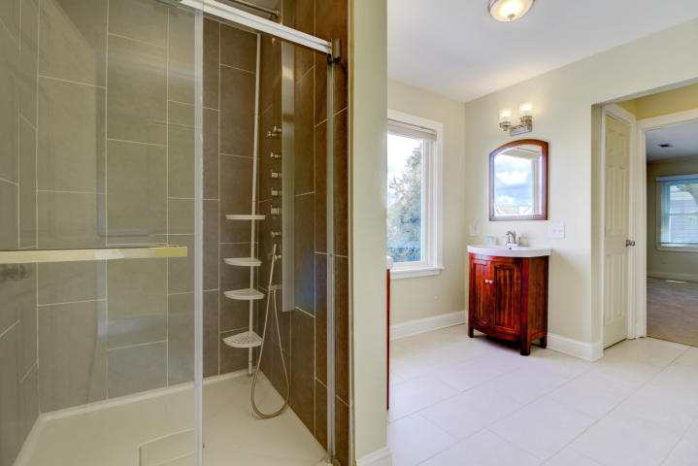
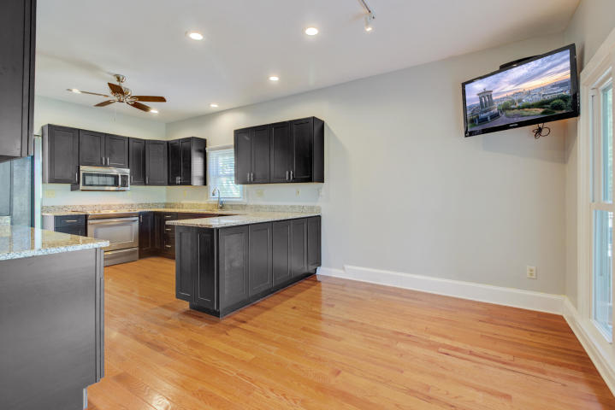
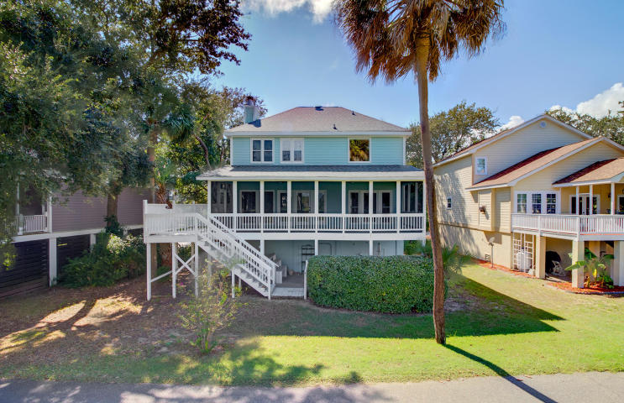
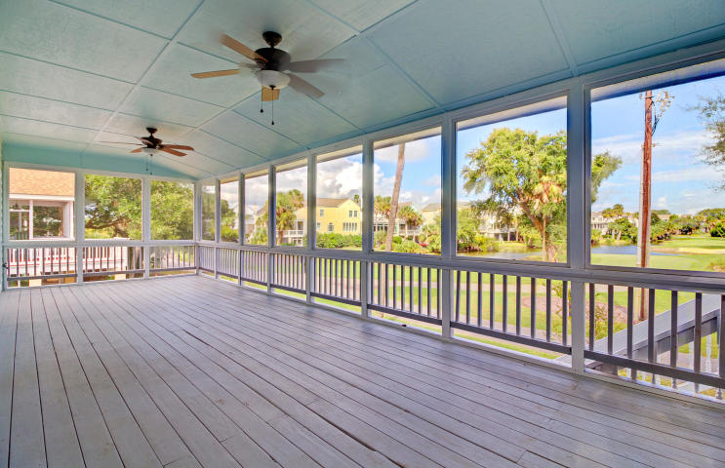
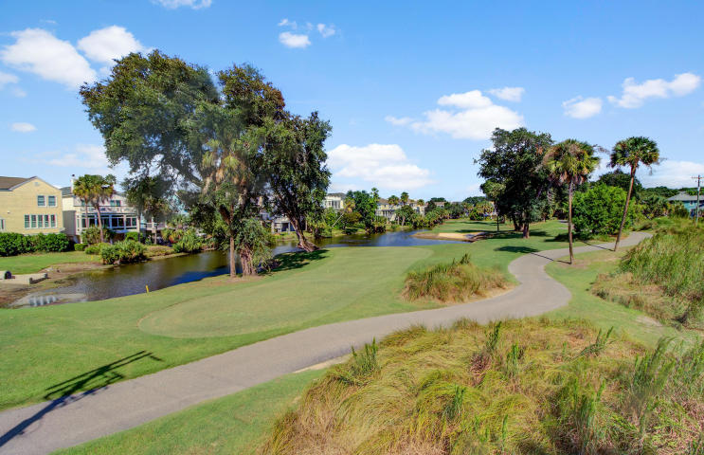


Just Listed On The Isle of Palms
6 Frank Sottile Lane
Isle of Palms, SC 29451
MLS# 18027415
$780,000
Perfect location on the Isle of Palms! Tucked away on a quiet street one block from the marina and two blocks from the beach with incredible golf course views, Welcome to 6 Frank Sottile Lane! Whether you are looking to live in this beautiful raised home full time or enjoy as a fantastic family retreat, you will LOVE all that this home has to offer! (If you can resist the temptation of living in this home yourself, please note it has a healthy rental history and would make a wonderful vacation rental property, too.) The raised home has plenty of room for two cars, a golf cart and tons of storage under the home. When it comes to ideal floor plans, this is it! This four bedroom home has three full baths! One bedroom with its own full bath is found on the main level. A huge kitchen is perfect for preparing meals for the family or a large group of visitors, and you will have plenty of visitors living in this ideal location! There are an abundance of cabinets in the kitchen where the granite counters and stainless steel appliances make this kitchen not only functional but very attractive as well! The eat-in kitchen opens to a large family room, both of which overlook the stunning golf course behind the home. There is a fireplace with built-ins on either side. The home is flooded with natural light. The extra deep screened porch spans the entire width of the home! Enjoy the fresh air and beautiful views year round on this spectacular porch with an open area perfect for your grill. Under the screened porch is a large open-air porch/patio where you will find the convenient outdoor shower. As you venture upstairs you will appreciate that the master suite spans the entire rear of the home so the owners can take advantage of the pretty views of the golf course. The master bath is very large with dual vanities, an oversized tile shower and two closets. Bedrooms 3 and 4 share a jack and jill style bathroom in this smartly designed floor plan. For added convenience, the laundry room is also located on the upper level. The Isle of Palms is a golf cart friendly community- whether you wish to walk or take the golf cart, the beach and marina, including the popular Morgan Creek Grill, are literally up the street. Memberships to the Wild Dunes Resort with its beautiful amenities (golf and tennis) as well as golf memberships are available. There are no restrictive covenants in this neighborhood, and NO HOA Fees! In addition, the current flood policy is only $513.00 per year- very affordable for IOP properties! Check out the fantastic 3D Walk through tour of this home then make your appointment to see it in person while it is still available. This home truly has it all!
3D Walk thru tour: https://my.matterport.com/show/?m=YNkh1KUhK61
Ellen O'Neil
Broker/Owner, ABR, e-PRO, CNE
Charleston Realtor of Distinction
(843) 300-8530
www.EllenONeilProperties.com

