Slide 1
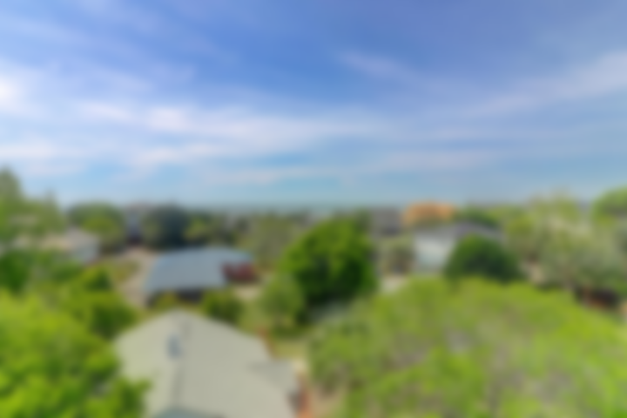
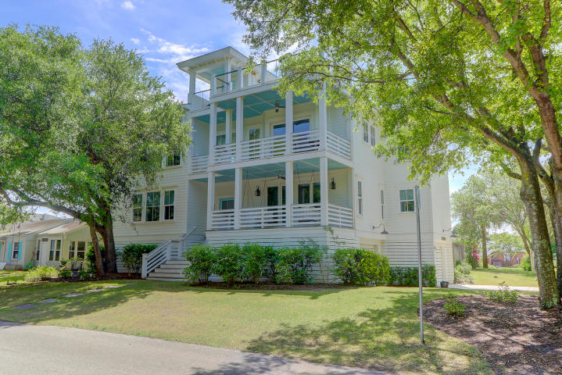
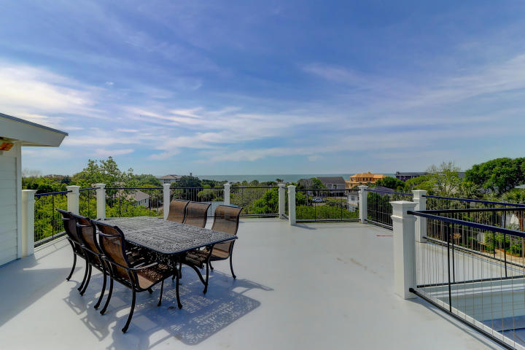
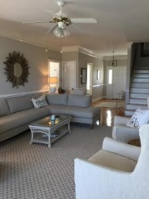
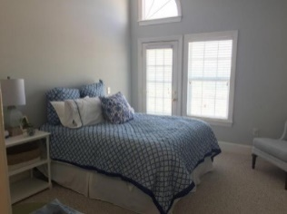
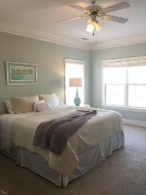
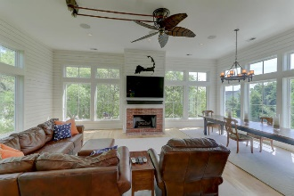
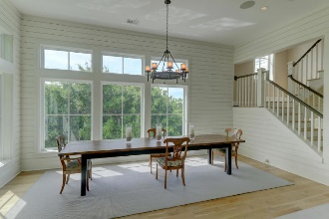
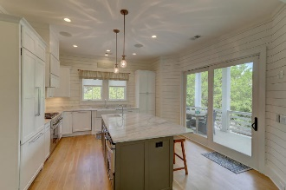
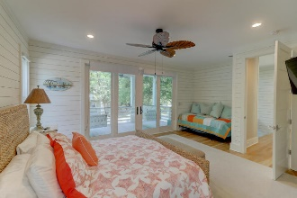
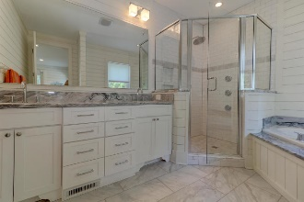
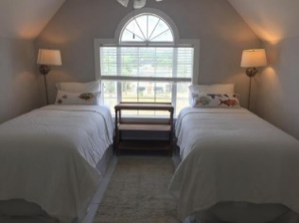
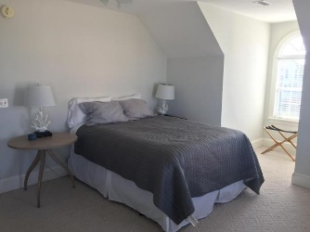
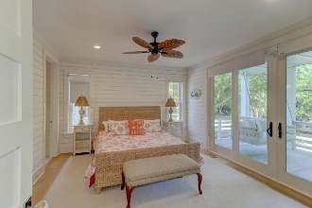
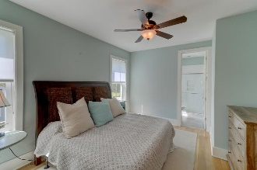
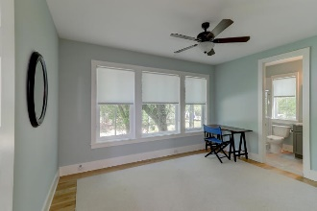
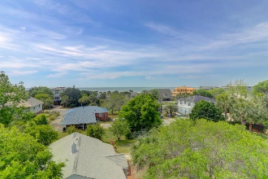
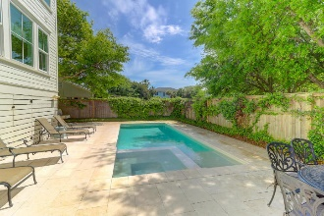
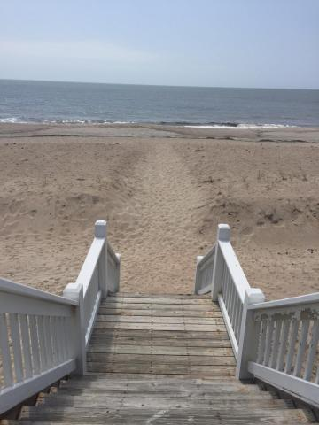

Like New High Quality Construction At The Beach
6 32nd Avenue
Isle of Palms, SC 29451 | MLS# 19012618 | $2,199,000
Welcome to this 2015 custom built home with top of the line finishes and a functional reverse floor plan that flows well. This home has been a primary home for the sellers, and it also has a profitable rental projection included in the listing. On the first floor is access to the pool with built in hot tub and 4 bedrooms (including a downstairs master), each with their own private bathrooms and a hallway half bath for other guests. The downstairs master has a beautiful porch furnished with two custom made porch swings. Up the stairs is saturated with natural light as you enter the great room and kitchen with another master and a porch off the kitchen area. Every attention to detail was put into this ''like new'' home. The Chef's kitchen includes Thermador appliances including a gas pro 6 burner range, built in French door refrigerator with ice maker. On the 3rd floor you will find another half bath, wet bar with sink and built in beverage center and the most amazing roof top fiberglass deck large enough to hold 50 people with unobstructed views of the ocean, TV hook up and built in surround sound. Some other amazing features of this home include; Shiplap throughout, elevator, 5 inch white oak, hardwood floors, metal roof, spray foam insulation, 2 Rinnai tank less hot water heaters, 2 car garage underneath, custom mahogany front door, granite in kitchen, wet bar and all bathrooms, custom tiled showers with seamless glass doors, 9 foot Solid shaker pine interior doors, hurricane rated windows and doors, built in gas fireplace, Sono sound system throughout. 6 32nd is set apart from most beach house investments in that it is exquisitely built with all the functionality and more and a quick walk to the beach! Come see this one soon. It is move in ready and can close quickly with no current tenants or vacation renters.
Curry Smoak
O (843) 619-7816
M (843) 729-5691
currysmoak@gmail.com
The Boulevard Company, LLC
806 Johnnie Dodds Blvd Ste 100
Mt Pleasant, SC 29464

