Slide 1
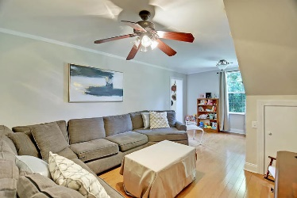
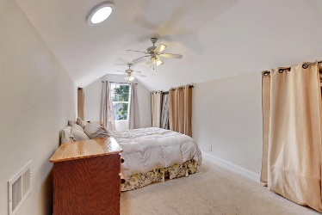
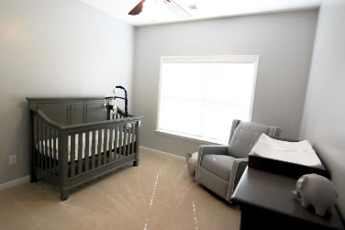
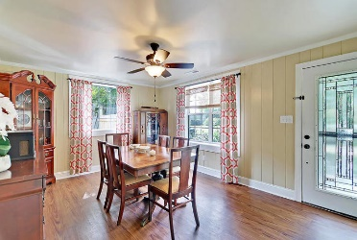
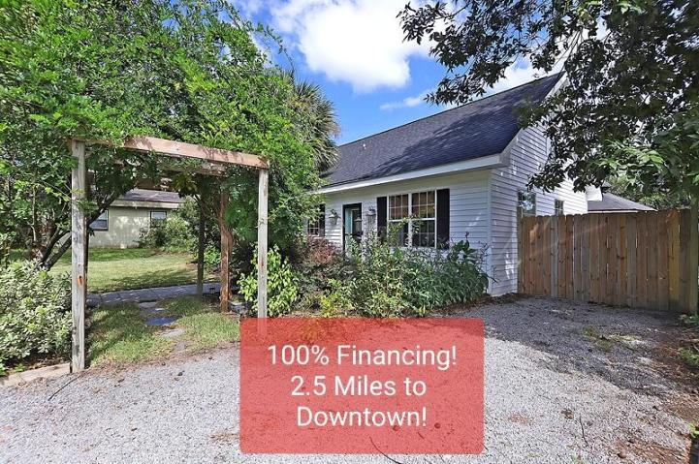
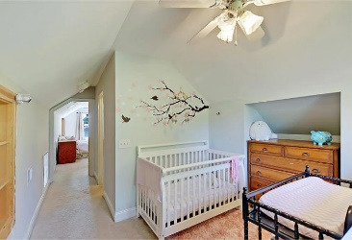
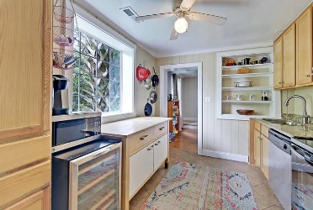
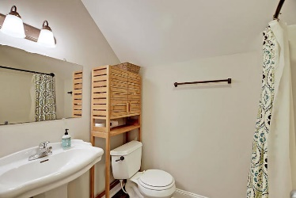
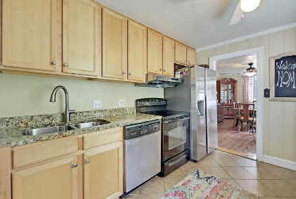
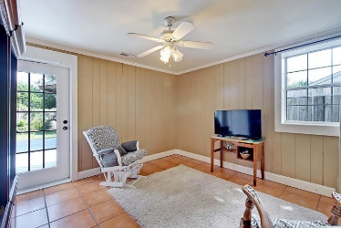
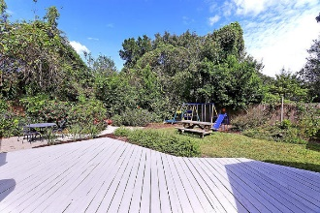
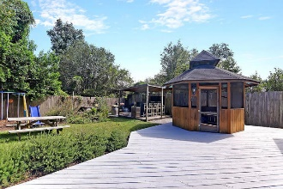
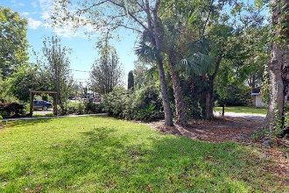
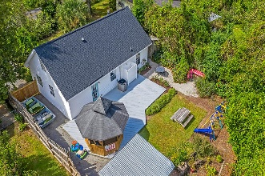
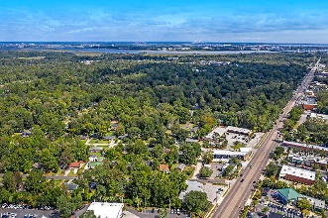



6 Briarcliff Drive West Oak Forest Charleston, SC 29407 MLS# 19028568 | $345,000
$1,748/mo to OWN in West Ashley
100% Financing
Open House
Saturday 3-5pm
* No Money Down * No Mortgage Insurance *
* No Income Limits on the Borrower *
P&I Payment of $1,748 @ 4.5%, 4.77% APR (1% Discount)
Borrower Must Qualify * Min 620 score, Max 45% DTI * Primary residence only
Equal Housing Lender. This information is for illustration purposes only; interest rates, closing costs, loan
program, lending guidelines, are all subject to change. This is not an offer to enter into an interest rate lockin
agreement. This is not a commitment to lend. Individual programs may be discontinued by lender without
further notice. Monthly Taxes and Insurance are estimates only. Interest rates are as of 2/5/2020 and are
subject to change on approval of credit. *APRs subject to change. Information is subject to change without notice. This is not an offer for extension of credit or a commitment to lend. Pinnacle Financial Partners is not affiliated with the U.S. government, HUD, FHA, VA or any other government agencies. For additional information about Pinnacle, visit the NMLS Consumer Access page at www.nmlsconsumeraccess.org. This Flyer and Rates were created on February 05, 2020.
Robert Bobo
Mortgage Advisor / Sr. Vice President
NMLS #1424660
Pinnacle Financial Partners
(843) 209-3343 M
(843) 209-3343 W
Robert.Bobo@pnfp.com
Meg H. Kandik
M (843) 814-5137 | O (843) 603-4659
Meg@HolyCityRE.com | www.holycityre.com
Bennett Construction & Realty | 792 Folly Rd | Charleston, SC 29412

