Slide 1
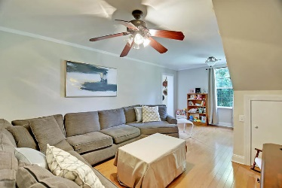
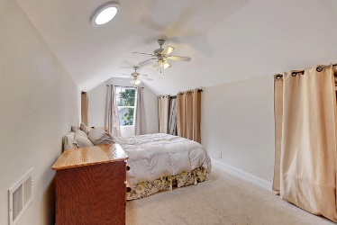
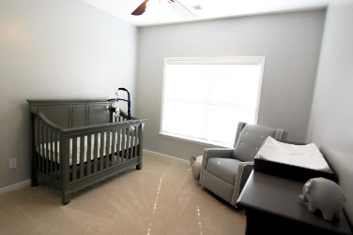
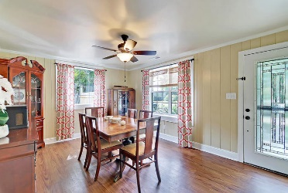
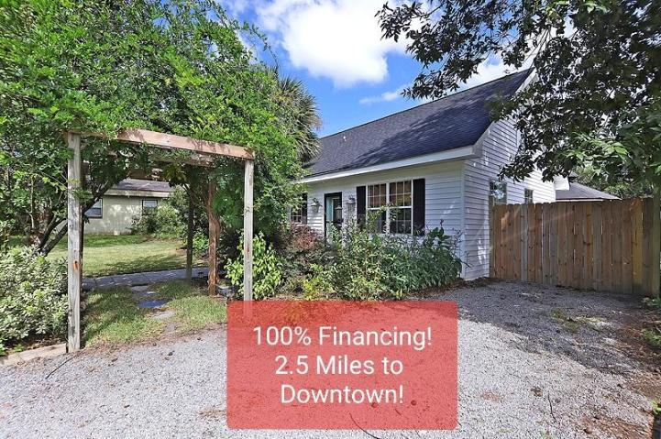
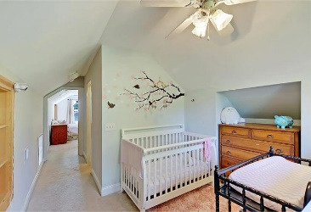
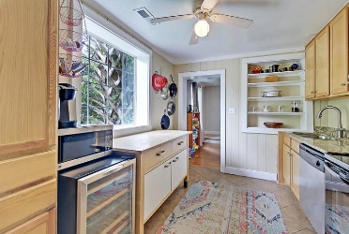
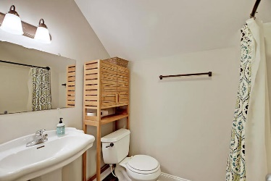
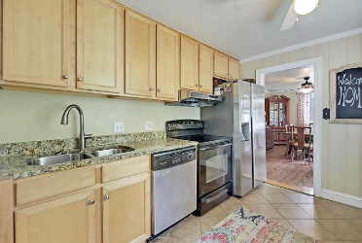
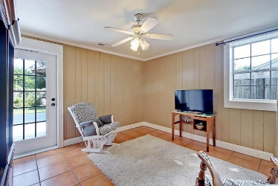
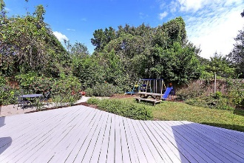
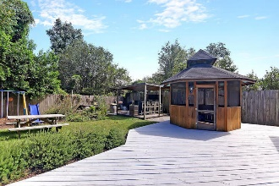
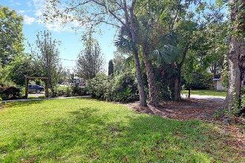
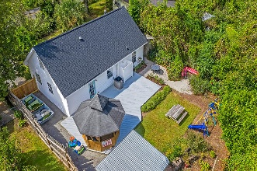
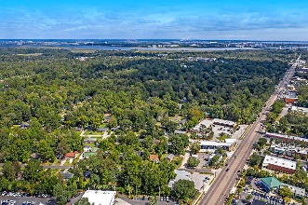



6 Briarcliff Drive
West Oak Forest
Charleston, SC 29407
MLS# 19028568 | $347,500
West Ashley
Near Avondale
Just Listed!
Under $280,000
100% Financing Available and only 2.5 miles from Downtown Charleston, 1.8 miles to I-526 and 4.2 miles to I-26 and walkable to Krispy Kreme, convenience store, multiple shops, endless restaurants, Starbucks and more! This home has been updated and includes a newer roof (2016) and 18 seer HVAC (2017), granite counter tops, stainless appliances, new LVT in the master bath, fresh paint, huge deck, screened gazebo and mature landscaping with a fenced yard! The rooms are all great size and the master suite offers an extra space that's perfect for a nursery, office, sitting area etc. You'll absolutely love all of the pocket doors downstairs, as this home has so much character! Schedule your appointment to tour 6 Briarcliff Drive today! X flood zone so flood insurance is not mandatory.
100% Financing Available for Qualified Buyers!
Outdoor Shower
Screened Gazebo with Electricity
Covered Outdoor Bar with Sink
Huge Shed + Boat Storage
Awesome West Ashley Location
Just down from St. Andrews Parks & Recreation (Tennis Courts, Ball Fields, Playground, Indoor Pool etc)
Walk to Whole Foods, Starbucks, Krispy Kreme, Glass Onion, Swig & Swine, Jimmy John's, Zoe's and MORE
Just down from Avondale!
Beth Moore
M (843) 532-4892
bmoore@carolinaone.com
Meg H. Kandik
M (843) 814-5137 | O (843) 603-4659
Meg@HolyCityRE.com | www.holycityre.com
Bennett Construction & Realty | 792 Folly Rd | Charleston, SC 29412

