Slide 1
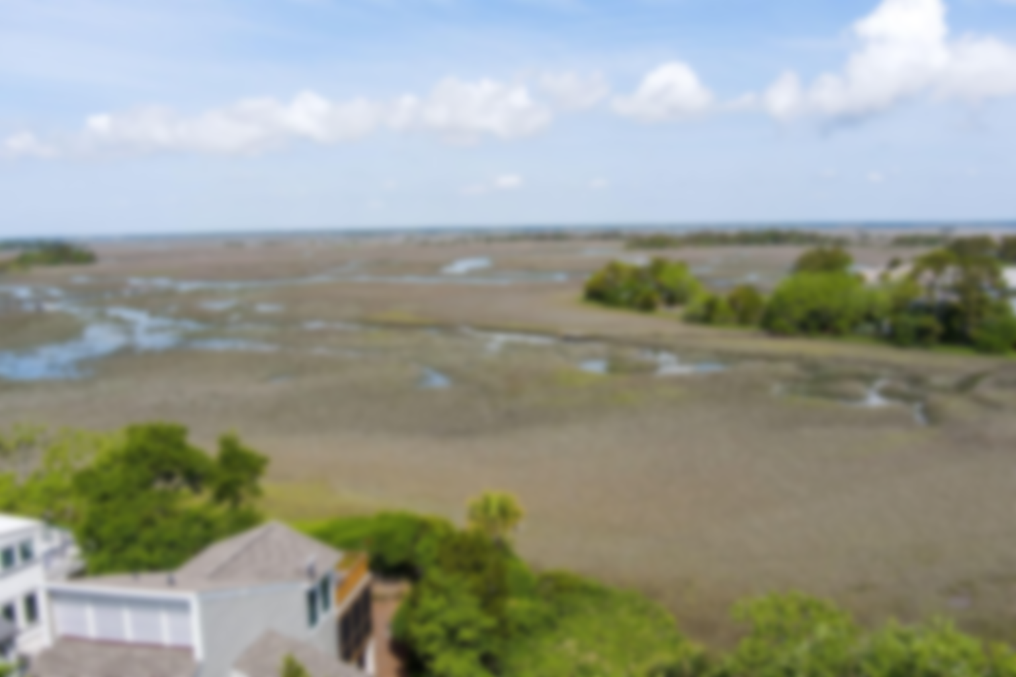
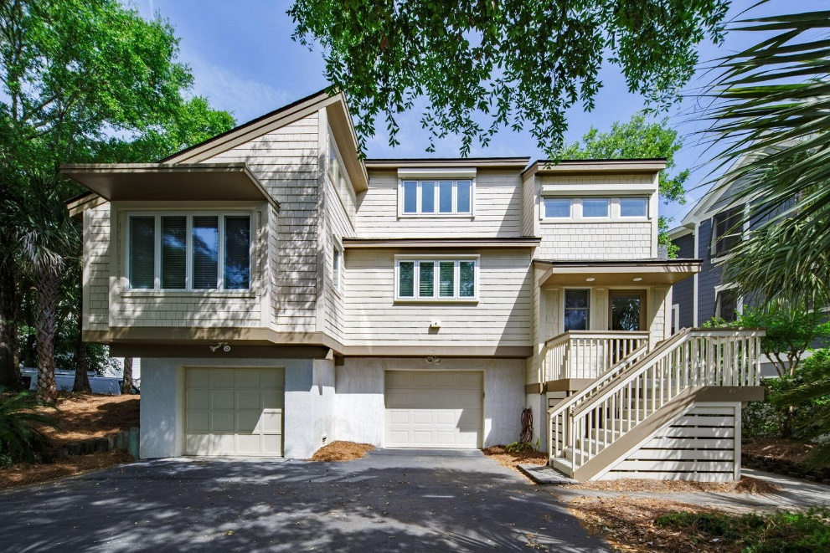
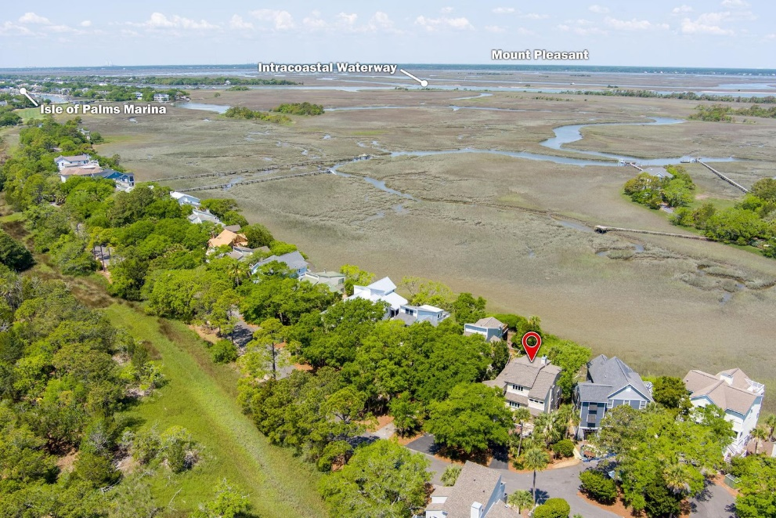
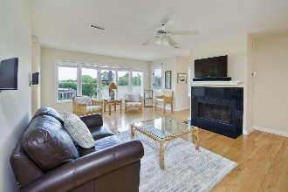
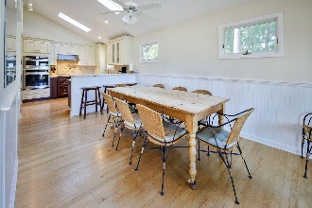
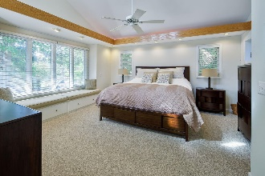
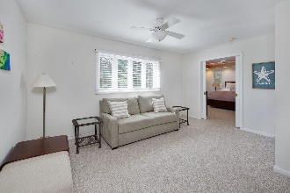
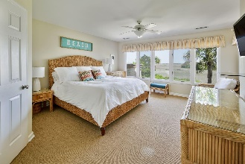
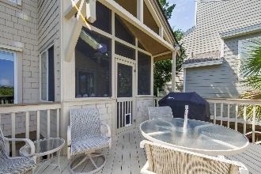
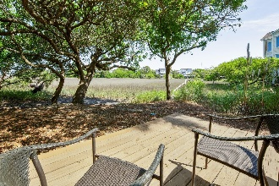
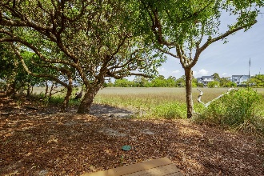
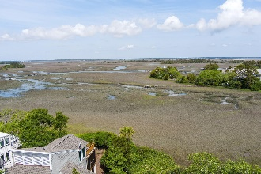
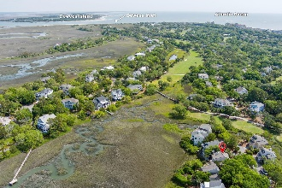


JUST LISTED IN WILD DUNES!
6 Marsh Island Lane
Isle of Palms, SC 29451 | MLS# 22011142 | $1,850,000
Welcome to your next tranquil beach retreat, 6 Marsh Island Lane! This stunning marsh front home is located in Charleston's gated beach resort community, Wild Dunes, and is on a quiet street ending in a cul-de-sac with no thru-traffic. Walk or ride your bike or golf-cart to the Wild Dunes amenities and beach! NEW ROOF AND HVAC 2020, NEW WASHER 2020, NEW FRONT PELLA WINDOWS 2021, NEW VELUX SKYLIGHTS AND SHADES WITH CONTROLS 2020! This fully furnished, upgraded home boasts some of the best marsh front views in Wild Dunes and includes four bedrooms, three full bathrooms, and plenty of entertaining space! Notice the circular driveway that provides plenty of parking for guests, a one car garage with plenty of storage, and a smaller garage for a golf-cart.
Wild Dunes is just 25 minutes to Historic Downtown Charleston. The resort offers 1,600 acres of world-class golf, top-ranked tennis, miles walking and biking trails, club membership to pools, award-winning restaurants, and 2 miles of pristine beach on the Isle of Palms, South Carolina. For the ninth year in a row, the readers of Travel + Leisure ranked Charleston the No. 1 City in the U.S. In addition, readers ranked Charleston as the only U.S. destination among the Top 15 Cities in the World. Don't miss this opportunity to experience the Wild Dunes lifestyle!
Virginia Landon
803-493-9202
virginialandon@kw.com
virginialandon.kwrealty.com
Keller Williams Realty
496 Bramson Ct Ste 200
Mt. Pleasant, SC 29464

