Slide 1
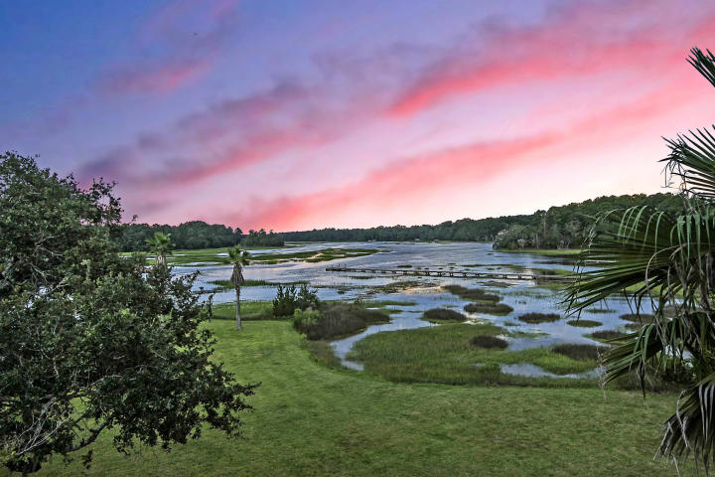

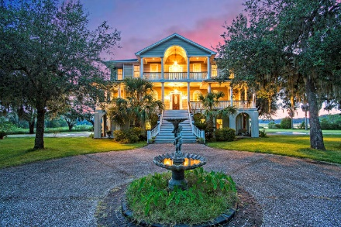
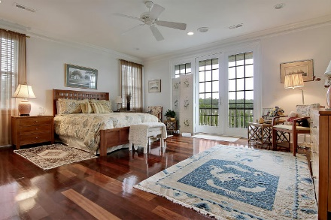
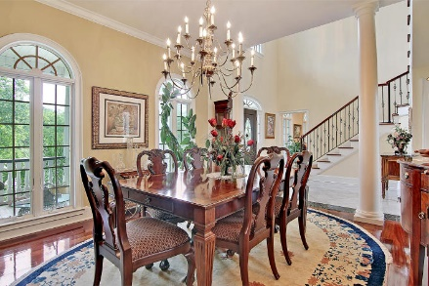
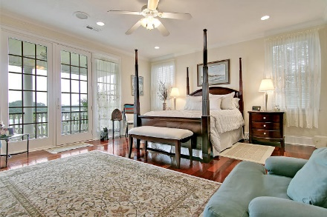
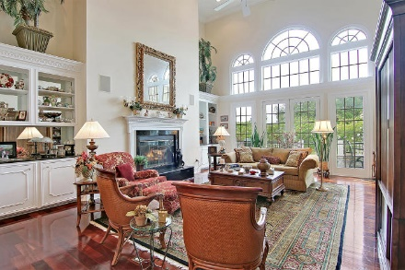
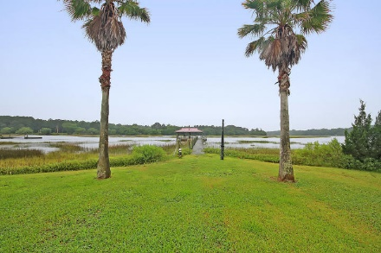
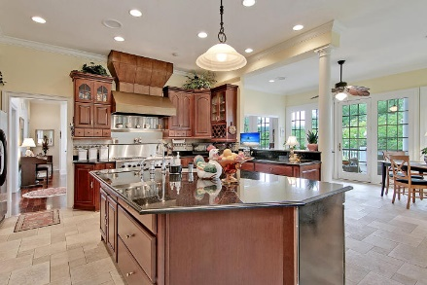
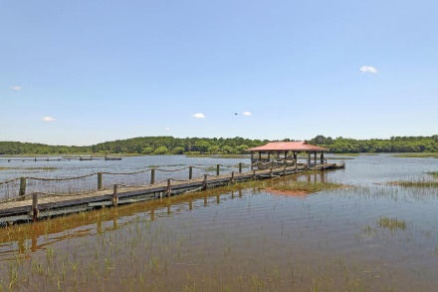
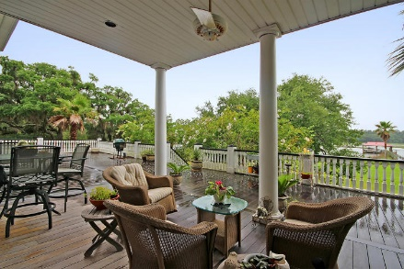
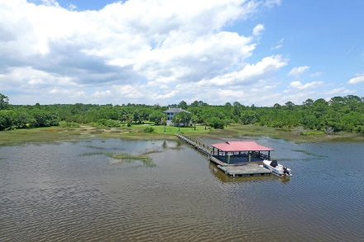

Parkshore Marshfront
Luxury Lowcountry Escape
7001 Toogoodoo Road
Chisolm ~ Meggett, SC 29449 ~ MLS# 17033045 ~ $1,349,999
Looking for a private, serene, incredible waterfront estate with plenty of acreage? Well, look no further! This gated 5 bed, 4 bath home with a dock on Toogoodoo Creek is exactly what you’ve been seeking. Enjoy expansive water views throughout this property including a lovely pond on 7.6 acres. You’ll find great attention to luxurious details including dentil crown molding, decorative columns, marble flooring, Brazilian cherry hardwood floors, Palladian windows, tall ceilings, & a wrought iron staircase. The chef’s kitchen features granite counters, a gas range, a center island, & an eat-in area with water views. 6-8 feet at high tide. The dock includes electric, a sink, & a floating dock. An additional studio with kitchen, laundry, & full bath is perfect for a mother-in-law suite.
Additional features include:
The kitchen features granite counters, a center island, breakfast bar, eat-in area with views of the water, a wet bar area and gas range
Marble flooring in the two story foyer
6-8 Feet at high tide
Dental crown molding
Palladian windows
Decorative columns in the dining room
Master bedroom has fireplace and access to the deck
Master bath has dual vanity, jacuzzi tub, walk-in tile shower
Jack-n-jill bath on the top level also has dual
Studio apartment is complete with kitchen, laundry and full bath
Dock has electric, a sink and a drive up floating dock
Home is steel framed
Foundation is engineered with 65 foot long concrete pilings
Home has reverse osmosis water filter system
Just a short drive to restaurants and shopping in West Ashley and downtown Charleston
Book your viewing today!
Missy Reid Missy@MattOneillTeam.com (864) 934-5447

