Slide 1
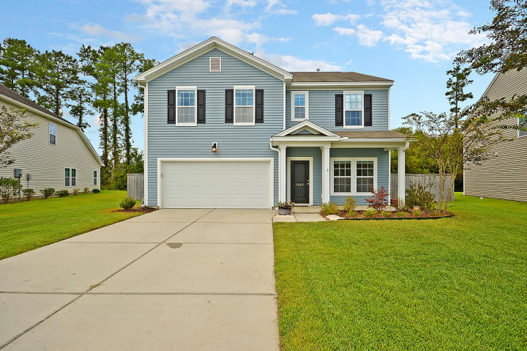
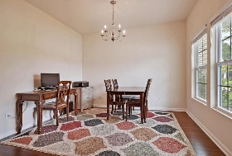
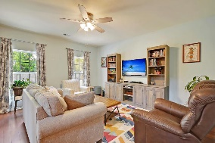
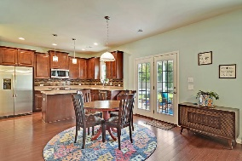
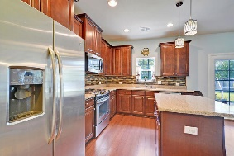
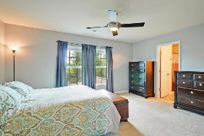
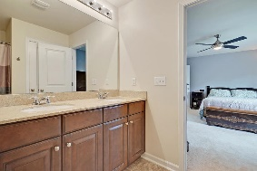
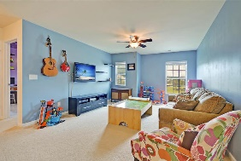
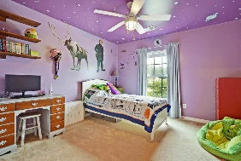
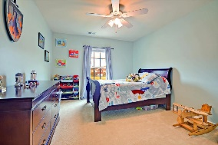
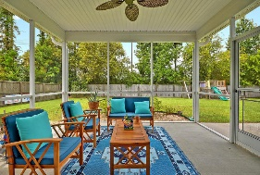
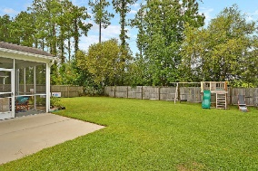
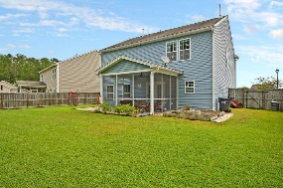
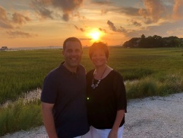

Why Wait For New Construction In Summerville?
7002 Kingsley Vale Court
Victoria Pointe
Summerville, SC 29485
MLS# 20023402
$259,000
3 Bedrooms | 2½ Baths | 2,150 sf
Welcome home to 7002 Kingsley Vale Ct! This sidewalk lined neighborhood is located right next to Summers Corner, with Rollins School of the Arts and Sand Hill Elementary in walking distance! This adorable home greets you with a welcoming porch and great curb appeal. Upon entering, you'll immediately notice the lovely wood flooring and bright foyer. To your right, is a large dining room that could also be used as an office. The living room is a great size and offers tons of natural light. The kitchen overlooks the living room providing a nice open floor plan. The kitchen has plenty of cabinets, an island, a gas cooktop, a pantry and a large eat in area. Head upstairs and you'll find a very large master bedroom. Off the master is the master bath, offering dual vanities, large shower/tub combination and a huge walk in closet. Upstairs you'll also find two more bedrooms, both with great size closets. A full bath, the laundry room and the large loft finish off the second floor. The loft space can be used many ways, media room, exercise room, office...you name it! Head back downstairs and out to the screened in porch which overlooks the large fenced in yard offering tons of privacy and a large patio for grilling. This home has been well maintained. Why wait for new construction?!? Come live in your dream home now! This home is located in Dorchester District 2 and a new Publix shopping center will be built in walk distance! Come see this home today, it won't last!
Larry & Kathy Mazalatis
Larry Cell 843-693-0529
Kathy Cell 843-693-0159
Office 843-871-9133
AGENTOWNED PREMIERE GROUP | 1800 TROLLEY RD | SUMMERVILLE, SC 29485

