Slide 1
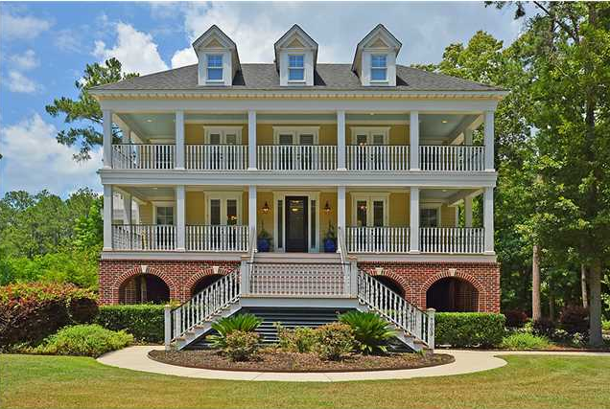
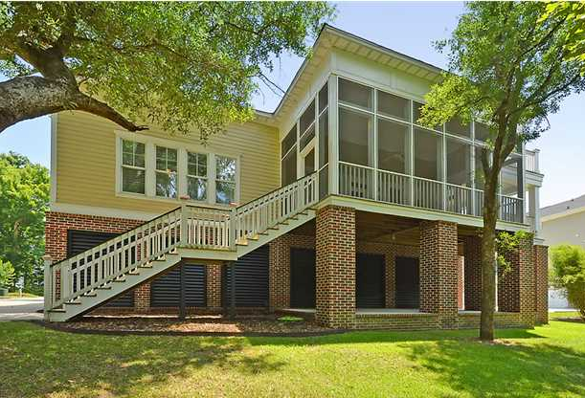
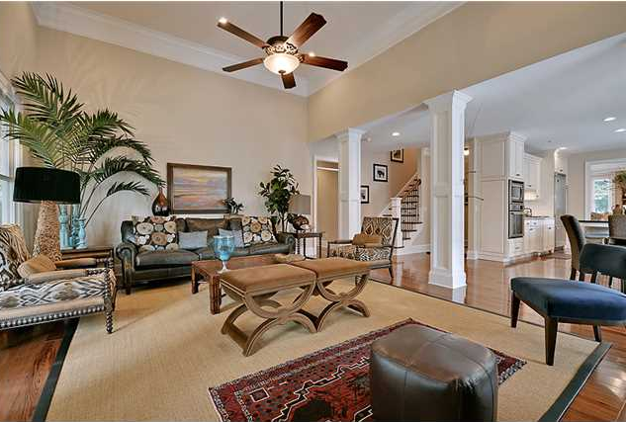
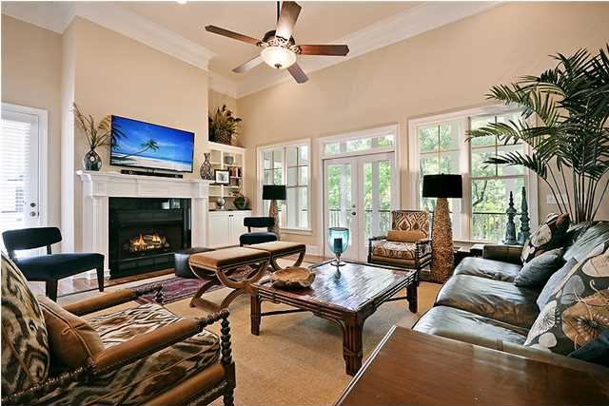
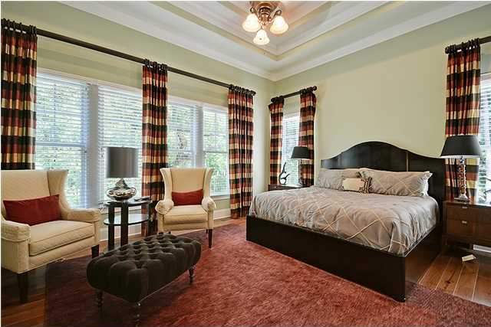
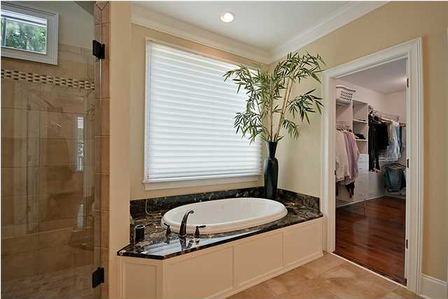
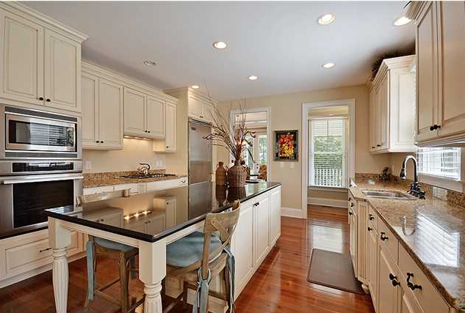
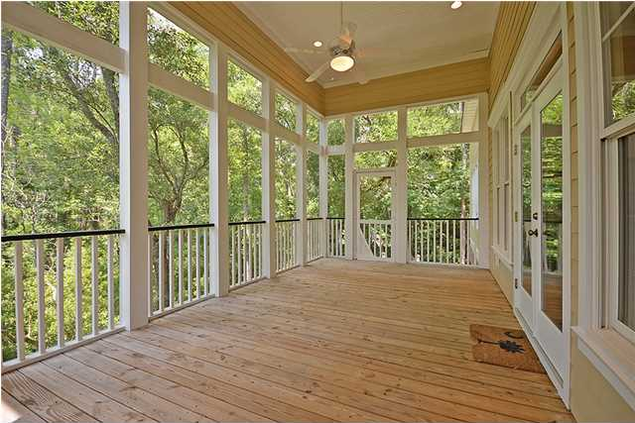
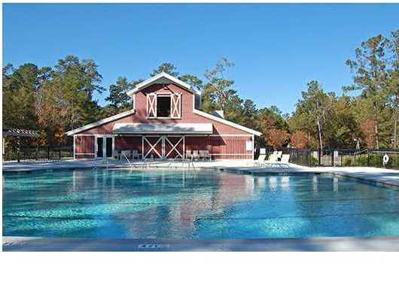
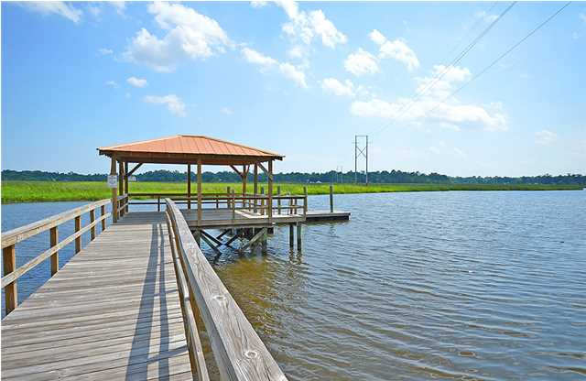


Happy Hour Open House Thursday, July 10th, 4-6:30pm 7003 Old Landing Dr - Tanner Plantation – Hanahan
You will be absolutely blown away by this incredible custom built elevated construction 3 story 4 BR/3.5 Bath home in Tanner hall. Enjoy views of the creek off the double porches in the front or side of the house and relax in the shade on the screened porch in the back. Utilize the huge 3 car garage for extra storage or a workout room. The elevator shaft will provide for easy transportation of heavy items. You’ll admire the beautiful hard wood floors that you’ll see throughout the entire house. The kitchen is decked out with granite countertops, an island, and top of line appliances. It’s connected to the spacious well-lit family room that has a fireplace. Sleep comfortably in the master bedroom, which is on the first floor and has a fireplace and a spacious bathroom with a walk in closet. The other three bedrooms as well as another large family/play room are upstairs. You can also delight in the neighborhood amenities such as the pool, tennis courts, play park, and a beautiful dock overlooking the marsh. This is only a small glance at all this property has to offer as there is so much to enjoy about this beautiful home!
Phone: 843-568-7475 Fax: 843-725-0183 Info@coastlineps.com www.findhomesincharlestonsc.com

