Slide 1
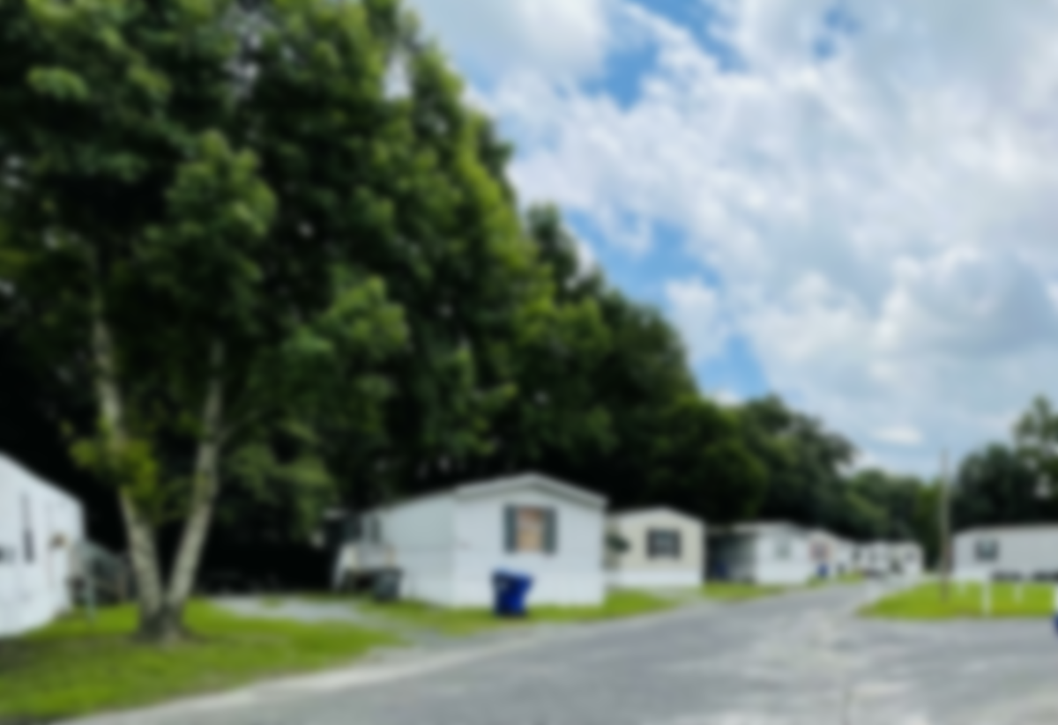
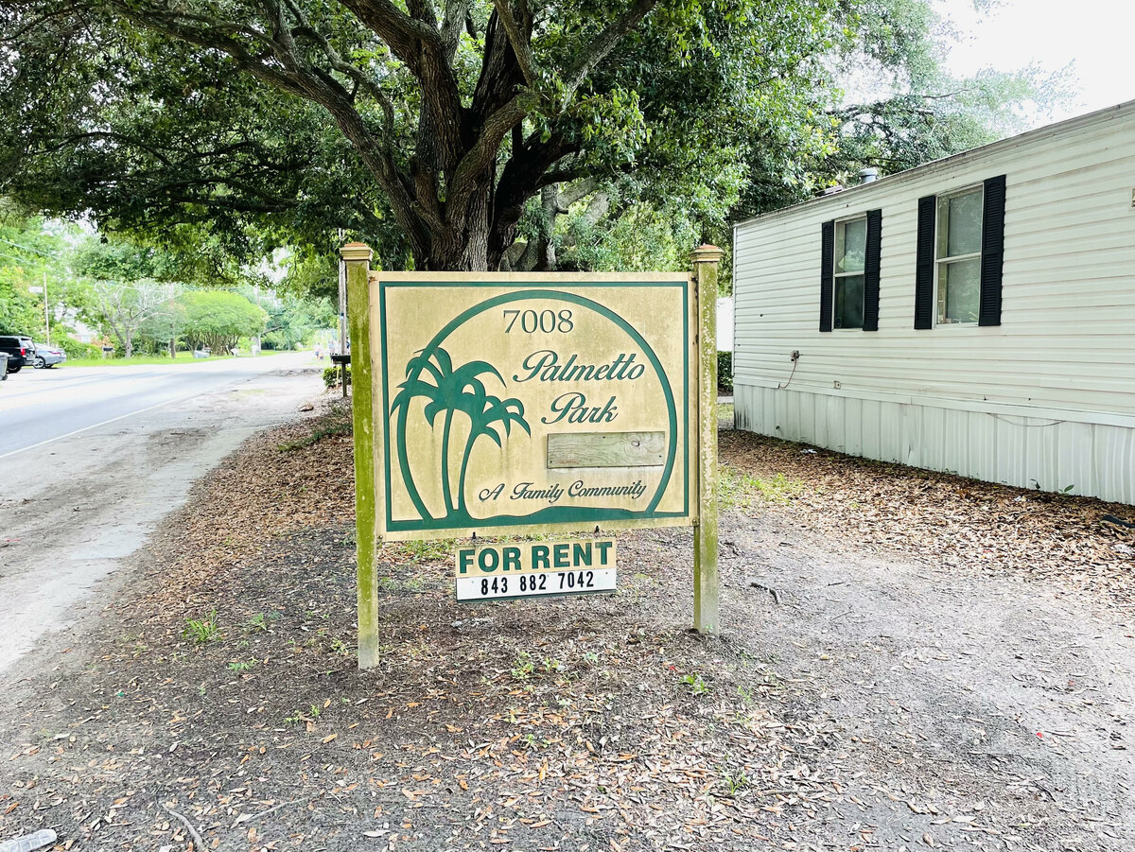
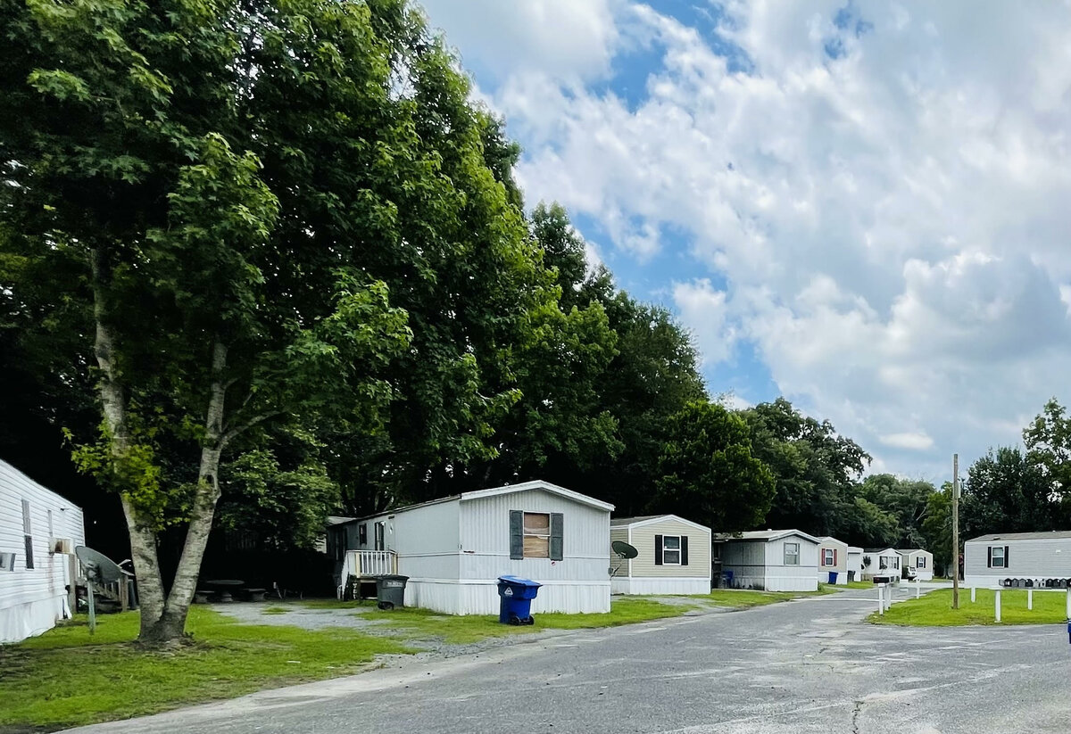
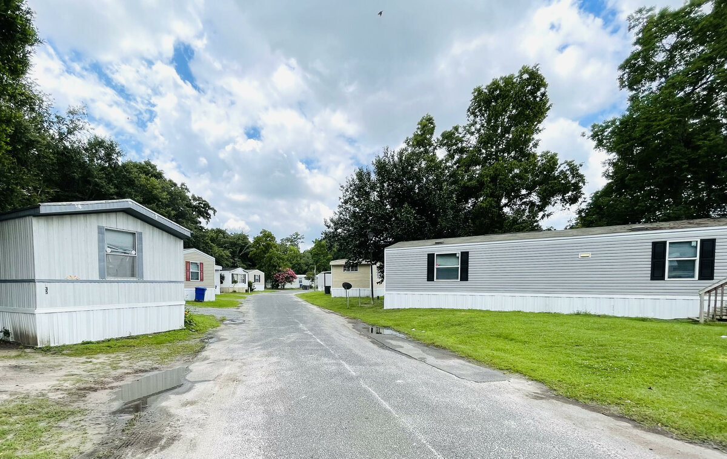
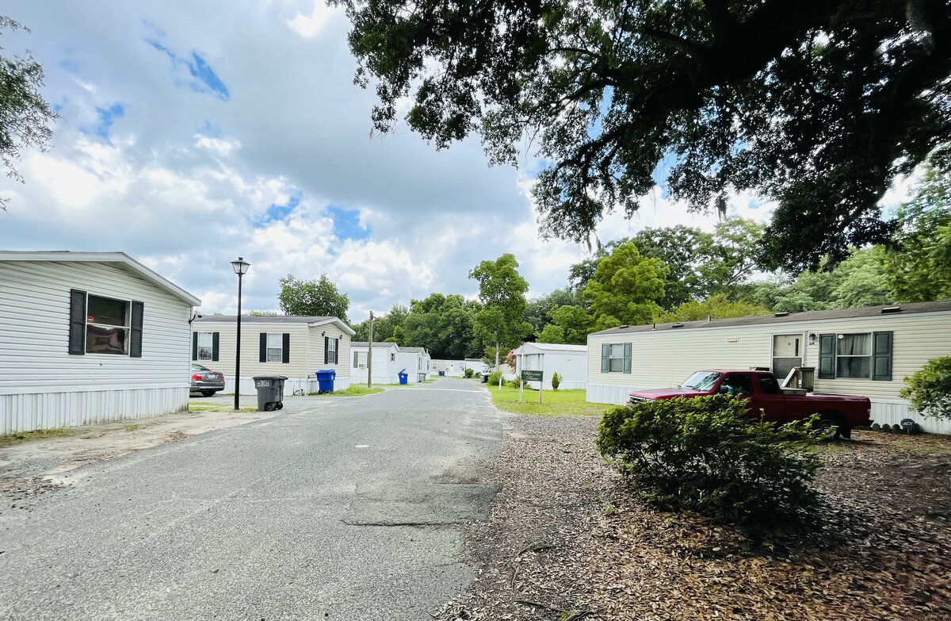
3 Mobile Home Parks
7004 Stall Rd
North Charleston, SC 29406 | CMLS# #30740510 | $12,000,000
This listing includes 3 separate mobile home parks - #1 - Palmetto Park, 42 pads and 2 single family homes, 7004-7008 Stall Road -Average monthly rental is a little above $1000 - All of these are owned by the Seller and most have been replaced in the last 10 years - #2 - Central Park Estates, 24 pads, 942 Orangeburg Road - TMS# 136-09-00-002 - Located across from Walgreens - On the corner of Orangeburg Road and Central Avenues - Average rental is above $1130 - #3 - Creekside Estates, 18 pads - 111 Garwood Road - 252-06-00-051 - Average rental is $775 - The Seller owns 81 units. The financials are based on current rents but the management is in the process of renewing all 1 year leases by about $250 per month, per unit. This will offer a buyer a better cap rate. These three parks have "grandfathered" features that are beneficial to the Owner. These mobile home parks are well maintained. The rental history is very good. The land on which these parks sit is zoned multi-family and the will be an appreciation in that land value over time. Currently you are looking at a 6% CAP rate but that will improve with the rents going forward
Fudgy Brabham
(843) 568-1241
fudgy@hbrtwn.com
www.hbrtwn.com
Harbourtowne Real Estate
672 Marina Drive, Ste 110
Daniel Island, SC 29492
Harbourtowne Real Estate | 672 Marina Drive, Ste 110 | Daniel Island, SC 29492

