Slide 1
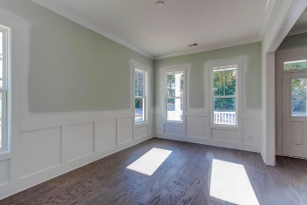
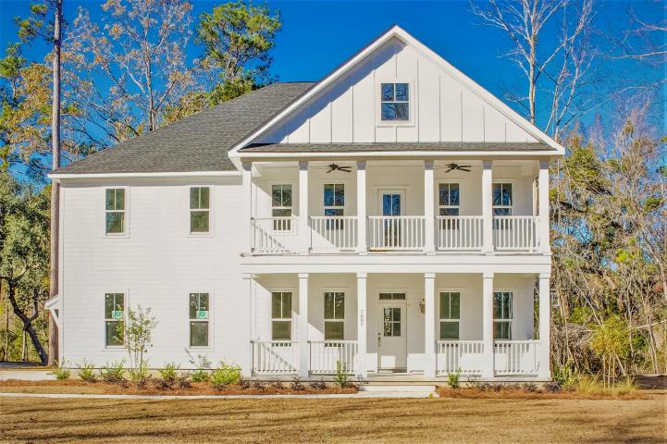
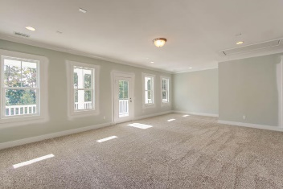
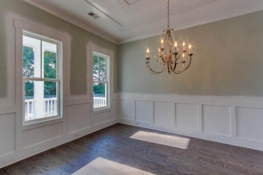
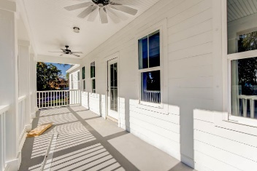
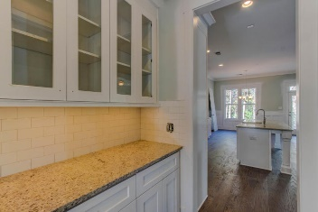
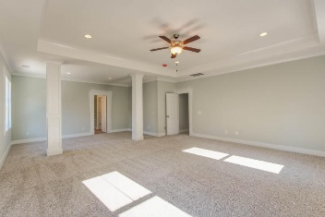
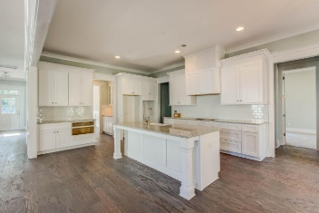
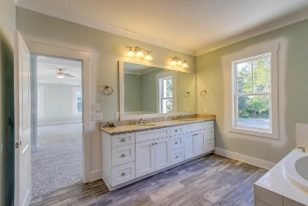
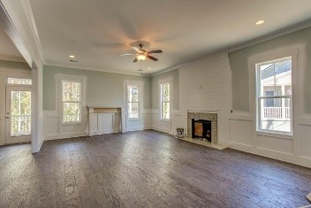
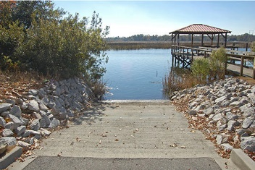

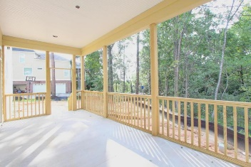
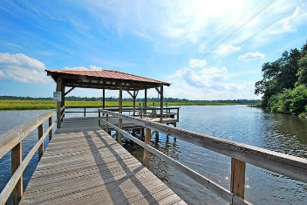
7005 Old Landing Drive Tanner Plantation :: Hanahan, SC 29410 :: MLS# 17004870 :: $635,000
Back on the Market!
LAST CHANCE TO OWN NEW CONSTRUCTION IN TANNER HALL
Yes, it’s true this is the Last Available New Construction Home in Tanner Hall by this Local Builder. Welcome to this beautiful, pristine Lowcountry home located in the custom waterfront community. This home features a great, private lot with lots across from the Community Dock and Boat Landing! Approaching the front door, you are greeted by double front porches and gas lanterns. As you enter, you will quickly notice the quality craftsmanship that only a local custom builder can provide. The floor plan consists of a wide entry foyer, cased openings, smooth ceilings, crown molding, and hardwood flooring throughout the main living area, Dining Room, Formal Living Room, Family Room, and Kitchen. The gourmet kitchen opens to the living area, and features 42" custom cabinetry, under cabinet lighting, subway tiled backsplash, granite countertops, and huge center island for everyone to gather around. Also in the Kitchen is a Butler's pantry AND a large walk-in pantry with Built-in Wood Shelving. You can relax by the Family Place in the Family Room or out on the Screened Porch overlooking wetlands at the rear of the backyard. The Upstairs includes a Loft Area with access to the Upper Balcony, 3 Additional Guest Bedrooms, and a Massive Executive Style Owner's Suite with a sitting room. The Owner's Suite Closet is what dreams are made of, with Plenty of Custom Built-in Shelving and easy access to the oversize Owner's Suite Bathroom. Don't forget the exclusive amenities to Tanner Hall, which include a private boat landing and dock, tennis courts, swimming pool, play park and Community Club House. Tanner Hall is close to Boeing, the Airport, Interstate, Shopping and Restaurant. Only minutes from Downtown as well.
Chris Eller
EPRO, GRN, SFR, REALTOR, CRS
(843) 343-3359
Chris@GallowayFamilyHomes.com
GFH Realty, LLC
498 Wando Park Blvd Suite 1125
Mt. Pleasant, SC 29464
www.gallowayfamilyhomes.com

