Slide 1
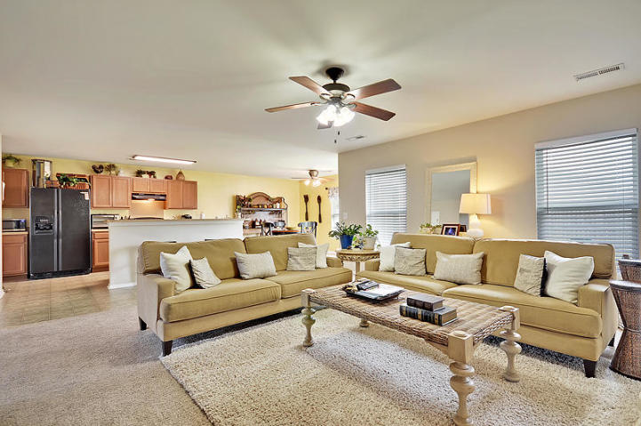
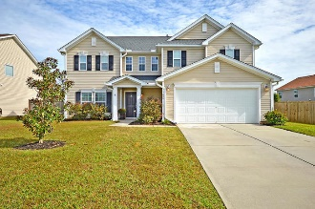
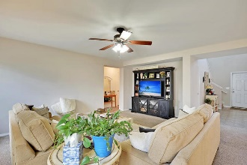
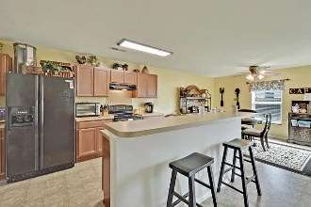
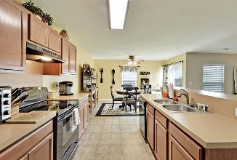
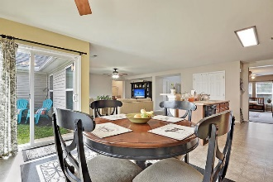
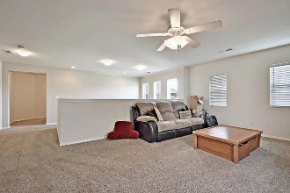
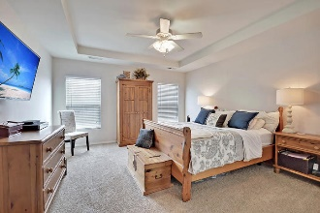

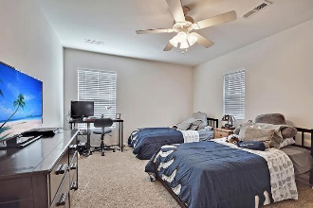
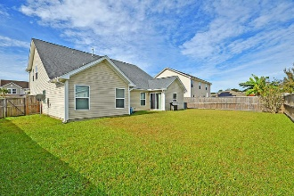


Open Floor Plan Move-In Ready New Price!
7006 Bellflower Lane
Tanner Plantation
Hanahan, SC 29410
MLS# 18029507
$324,900
Starbucks card to first 10 agents
Exquisite home in Tanner Plantation that is truly move-in ready! Featuring a very desirable bright, open, spacious floor plan, three large bedrooms with the master on the main and other bedrooms upstairs along with an upstairs loft or 2nd living room / play room area. The large master bedroom has a recessed tray ceiling, double windows, ceiling fan, garden tub, and stand alone shower. The kitchen offers excellent cabinet storage, bar seating, eat-in kitchen breakfast area, all of which overlooks the large living room, and a wall of windows provides abundant natural sunlight throughout this entire area. There is a separate dining room at the front of the house, which could also be used as an extra office or playroom. Upstairs are large bedrooms and the additional loft living room area, perfect for all the extra 'toys'! The backyard is completely fenced in and has double gates on the right side for easy access. All appliances and washer/dryer convey. No flood insurance required. Enjoy the convenient neighborhood schools, restaurants and grocery shopping without leaving Tanner Plantation. Easy access to I-526, Rivers Avenue, Boeing, SPAWAR, Naval Weapons Station, Park Circle, Mt. Pleasant, Downtown Charleston, and Beaches.
Jerod Coulter, ABR, REALTOR
(843) 513-3741
jerod@realtor.com | www.HomesOfMountPleasant.com
The Boulevard Company, LLC | 35 Broad Street | Charleston, SC 29401

