Slide 1
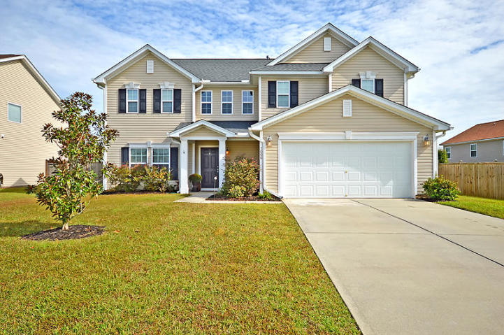
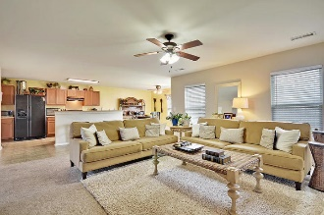
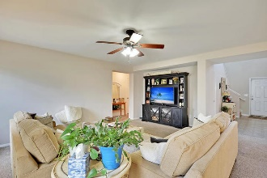
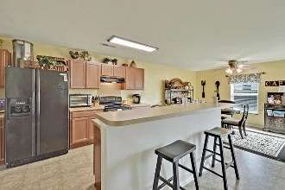
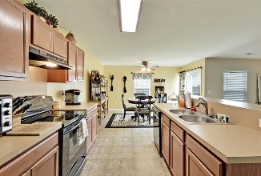
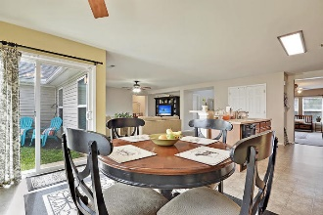
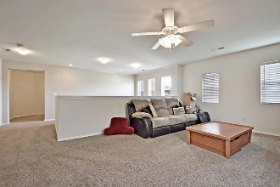
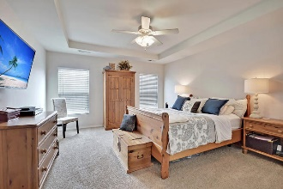
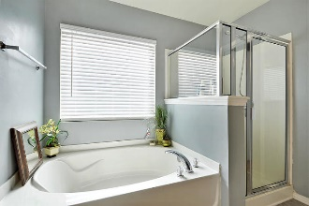
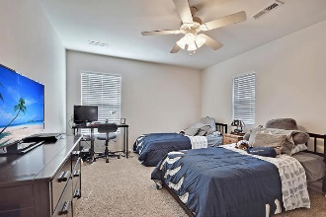
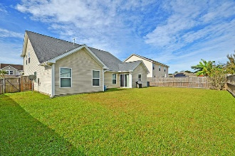


$30,000 Price Reduction
Move-in Ready
Easy To Show
7006 Bellflower Lane
Tanner Plantation
Hanahan, SC 29410
MLS# 18029507
$308,900
Starbucks card to first 10 agents
This beautiful home features a very bright, open, spacious floor plan, three large bedrooms with the master on the main and other bedrooms upstairs as well as an upstairs loft or 2nd living room / play room area. The upstairs loft area is set up so it can be enclosed and become a large 4th bedroom if desired. The tall two story foyer provides abundant natural sunlight upstairs and down. The foyer flows nicely into the living room, which is open to the entire kitchen. The kitchen has excellent cabinet storage, bar seating, eat-in breakfast area, all of which overlooks the large living room, and a wall of windows that provides sunlight throughout this entire area. There is a separate dining room at the front of the house, which could also be used as an extra office or playroom. The large master bedroom has a recessed tray ceiling, double windows, ceiling fan, garden tub, and stand alone shower. Upstairs are large bedrooms and the additional loft living room area, perfect for all the extra 'toys' or enclose it for the 4th bedroom. The backyard is completely fenced in and has double gates on the right side for easy access. All appliances and washer/dryer convey. No flood insurance required. Enjoy the convenient neighborhood schools, restaurants and grocery shopping without leaving Tanner Plantation. Easy access to I-526, Rivers Avenue, Boeing, SPAWAR, Naval Weapons Station, Park Circle, Mt. Pleasant, Downtown Charleston, and Beaches. Move-in ready in highly desirable Tanner Plantation!
Jerod Coulter, ABR, REALTOR
(843) 513-3741
jerod@realtor.com | www.HomesOfMountPleasant.com
The Boulevard Company, LLC | 35 Broad Street | Charleston, SC 29401

