Slide 1
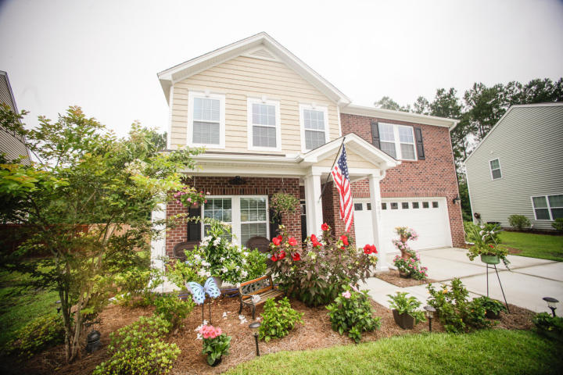
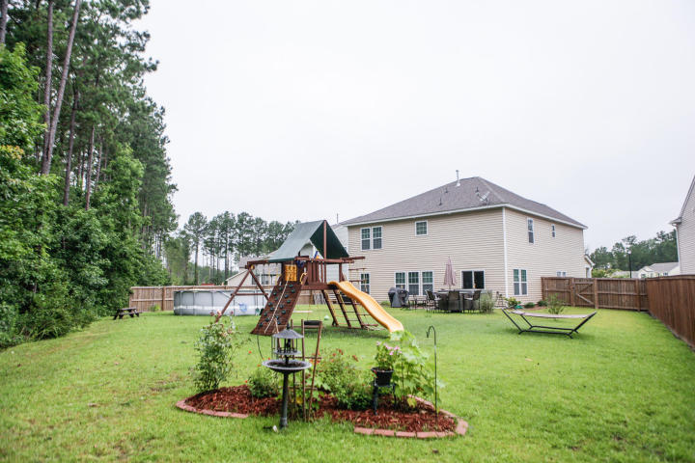
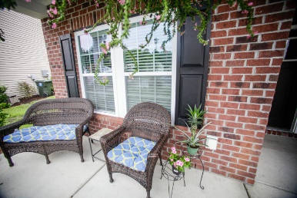
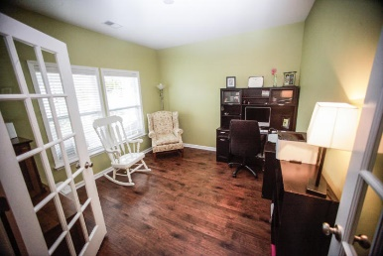
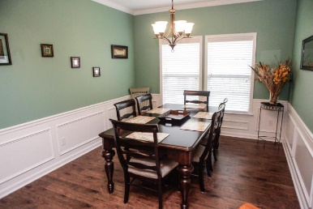
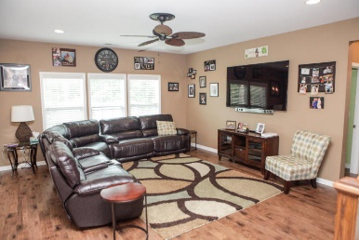
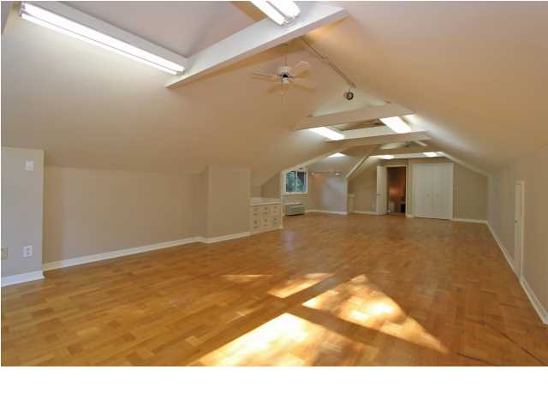
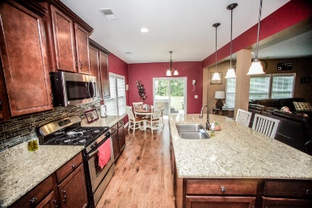
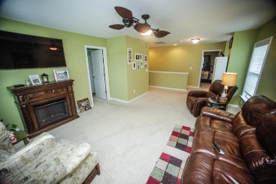
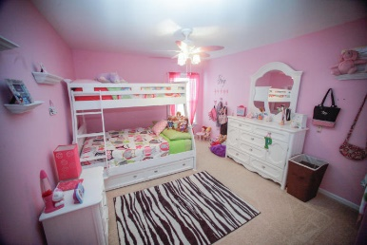
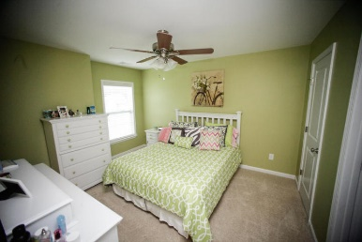
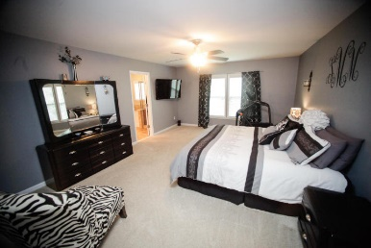
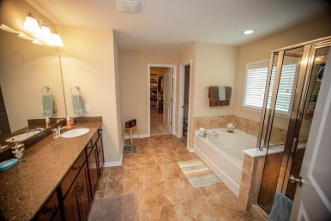
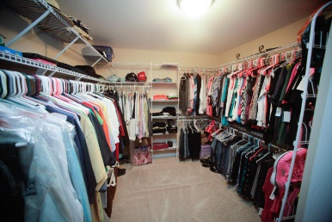
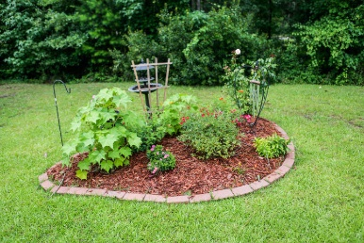


7007 Kingsley Vale Court
Victoria Pointe ~ Summerville ~ MLS# 15017229 ~ $300,000
Fresh on The Market ~ 3100 sqft Dorchester Dist 2
Incredible home! Beautiful wood floors, granite counters, oversized granite island, gas stove, tankless, endless hot water. Custom paint, upgrades, upgrades and attention to detail, right down to a vented pantry with timed light! This is a must see home. On a cul-de-sac. Desirable Dorchester 2 schools.
Christopher McCormick
Office - 843-974-6200
Cell - 843-224-3204
cjmccormick@carolinaone.com
Carolina One Real Estate
900 N Main St
Summerville, SC 29483

