Slide 1
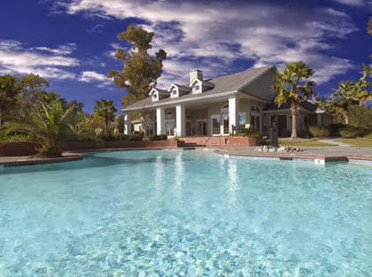
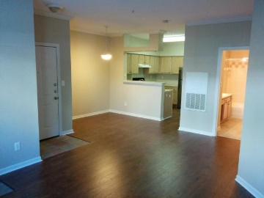
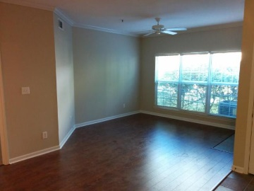
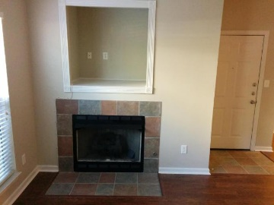
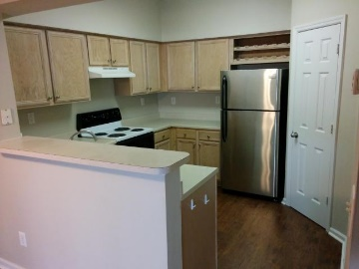
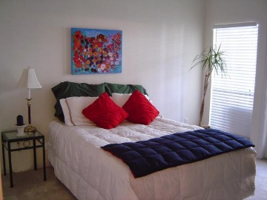
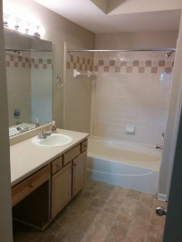
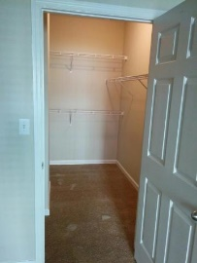
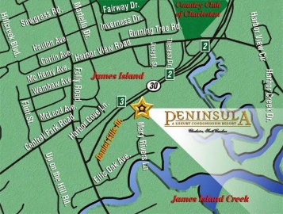


700 Daniel Ellis Drive #12106 ~ Peninsula New hardwoods…new carpet…new stainless fridge…new paint!
New wood flooring installed 9/15/15 in Kitchen and Living Room, Freshly Painted, New Carpet in BR and walk-in closet, New Stainless Steel Refrigerator, and more. Excellent location and value for the condition! Enjoy the resort style Marshfront Peninsula Development that is only 5 min from downtown and 10 min to Folly Beach! Check out this large garden-view ground floor unit of the Peninsula! Gorgeously renovated development with new roofs, siding, porches, pool/clubhouse renovations, tennis courts, neighborhood jogging/walking trail, and much more! The gas fireplace accents the cozy living room, and the functional open floor plan is great for entertaining space. The easy in and easy out nature of the first floor units make a huge difference. (No elevators on property).
MLS# 15015966
$128,900
Haynes Johnson
Mobile - (843) 864-8159
haynes.charlestonproperties@gmail.com
The Boulevard Company, LLC | 35 Broad Street | Charleston, SC 29401 | haynes.charlestonrealestate.properties

