Slide 1
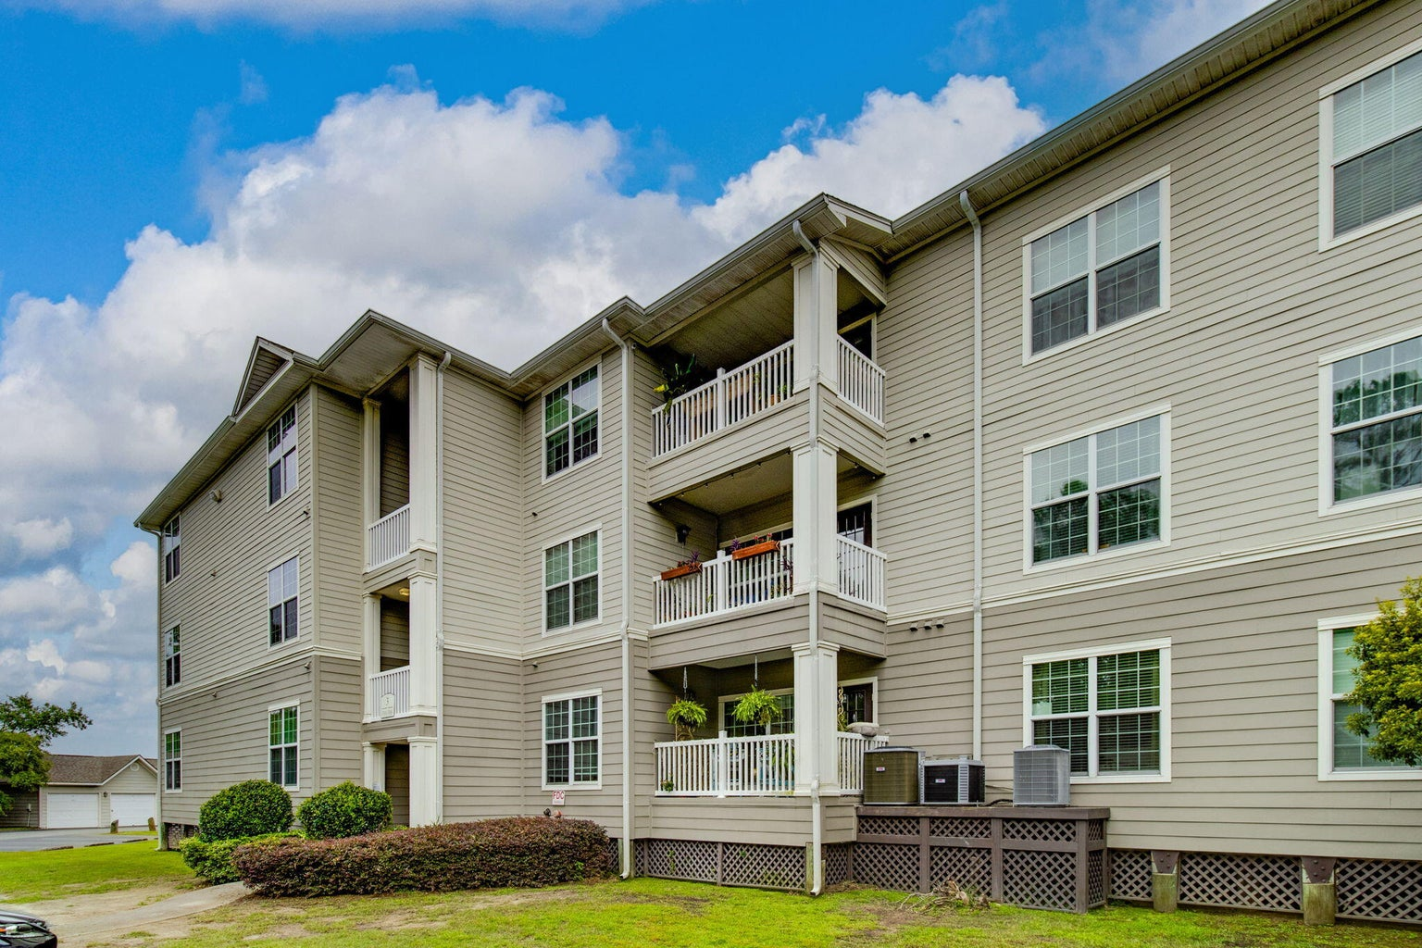
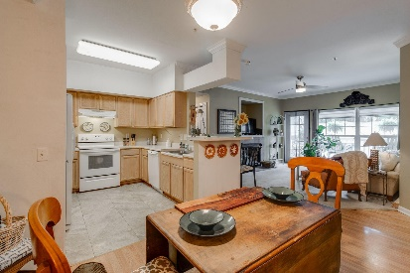
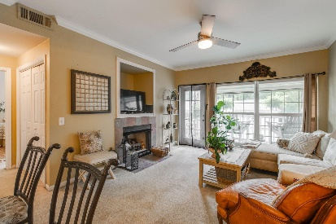
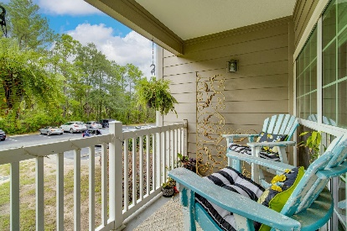
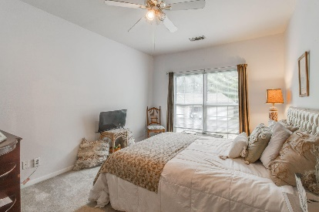
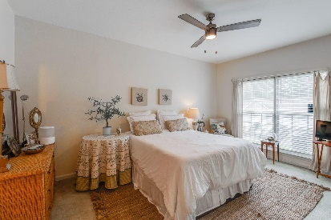
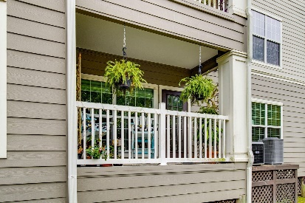
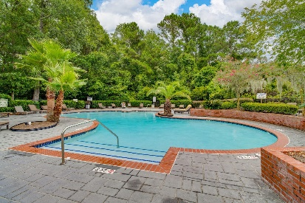


700 Daniel Ellis 3103
The Peninsula Condominiums | Charleston | MLS# 23017722 | $259,999
NEW PRICE! SELLER MOTIVATED!
Charming coveted first floor condo on beautiful James Island. Whether you're looking for a serene escape or a vibrant home base near all of the action, this condo offers the best of both worlds. This spacious 2BR/2BA home offers the perfect blend of comfort and convenience. Key features include new HVAC(10/22), large bedrooms with ample walk-in closet space, remodeled Owner's Suite bathroom with new tile shower/floor and a handicap toilet, fresh paint in both bedrooms, new zebra blinds in Great Room, new ceiling fans(Hunter) in Great Room and Owner's Suite, new Washing machine, abundant natural light throughout, open-concept dining and living area, perfect for entertaining, Patio off of Great Room is perfect for relaxing and savoring your morning coffee or watching evening sunsets. Handicap accessible. Easy access to pool, recreation area, tennis and walking paths. 5 minutes to downtown Charleston, MUSC and College of Charleston, 15 minutes to Folly Beach. Shopping and Dining minutes away.
Take a virtual walkthrough!
Beth Mandell
M 803-463-7734 | O 843-871-2121
bmandell@century21properties.com
www.bestcarolinahomedeals.com
Century 21 Properties Plus of Summerville | 118 W Richardson Ave | Summerville, SC 29483

