Slide 1

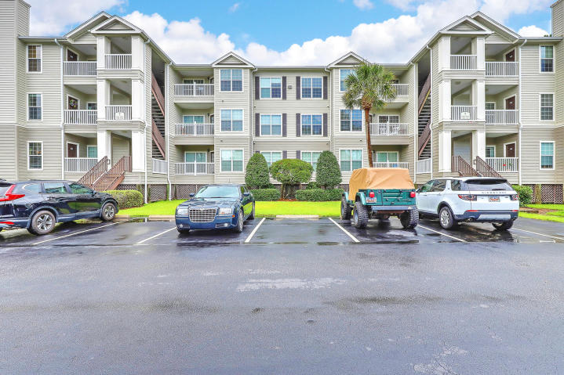
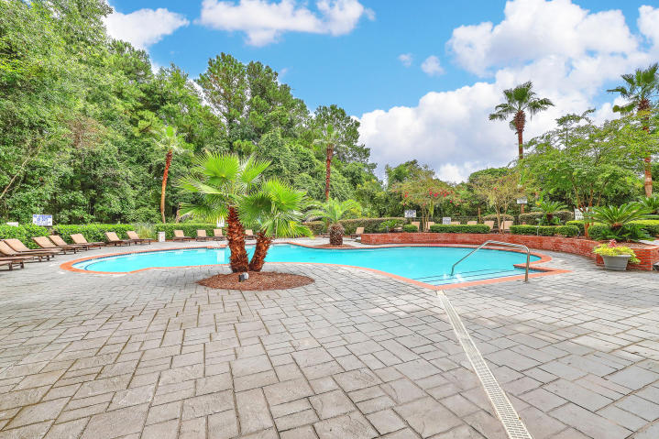
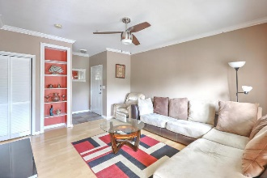
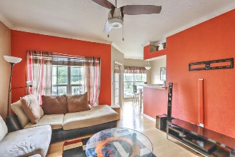
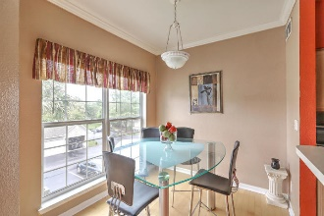
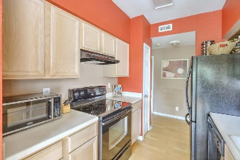
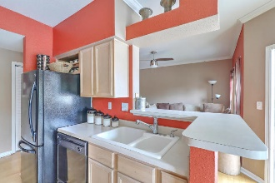
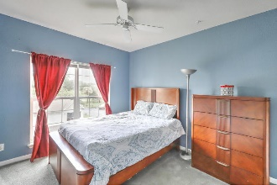
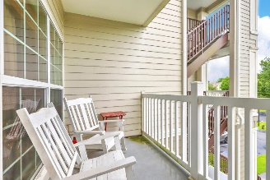
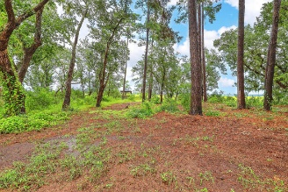
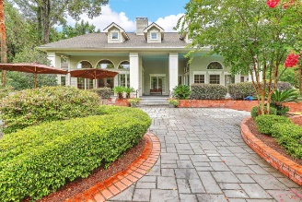
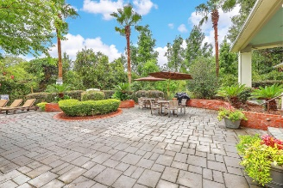

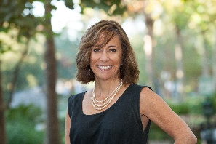
Furnished Condo Minutes to MUSC/Downtown Open House Saturday 12-3pm
700 Daniel Ellis Drive #7205
The Peninsula Condominiums | Charleston | MLS# 18022403 | $128,775
LOCATION, LOCATION, LOCATION!!
Awesome 2nd floor unit in marshfront building, which can be sold furnished. Features include nicely sized bedroom with large walk-in closet**Porch off the living room and dining room to enjoy**Smooth 9 ft. ceilings with crown moldings and built-in bookshelf in living room. This is such a great location - just minutes to downtown & Folly Beach! Grocery stores and restaurants all within walking distance. Great community -- pool, clubhouse w/workout facilities and media room, tennis and basketball court, car care center. The monthly regime covers flood, hazard, grounds, outside maintenance, water & sewer. This unit, with good rental history, would make a great investment property, weekend getaway home or perfect for your college student!
Desiree Maurer Office - (843) 416-2000
Mobile - (843) 327-9010 desiree.maurer1@gmail.com
www.yourcharlestonhousesearch.com
Keller Williams Realty 496 Bramson Ct Ste 200 Mt. Pleasant, SC 29464

