Slide 1
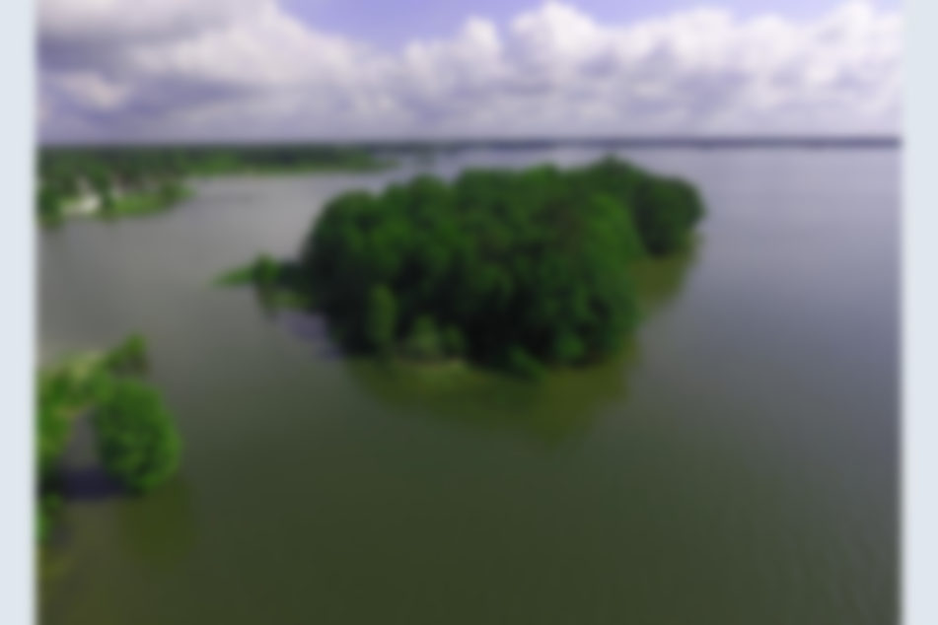
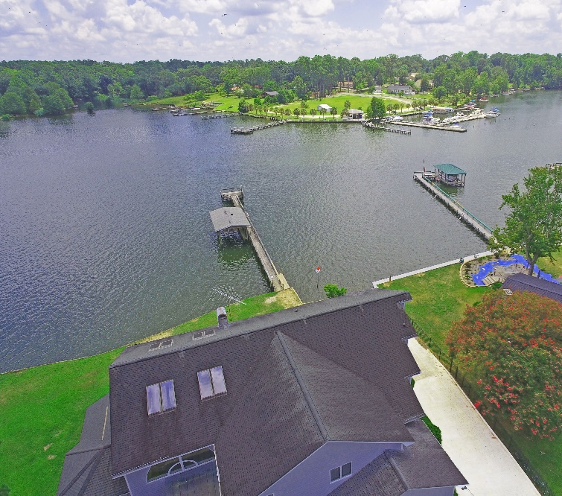
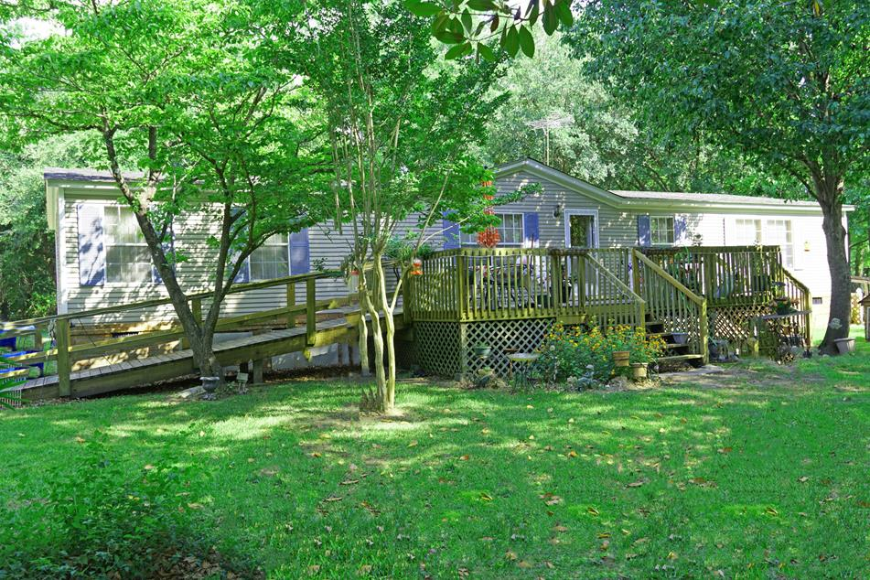
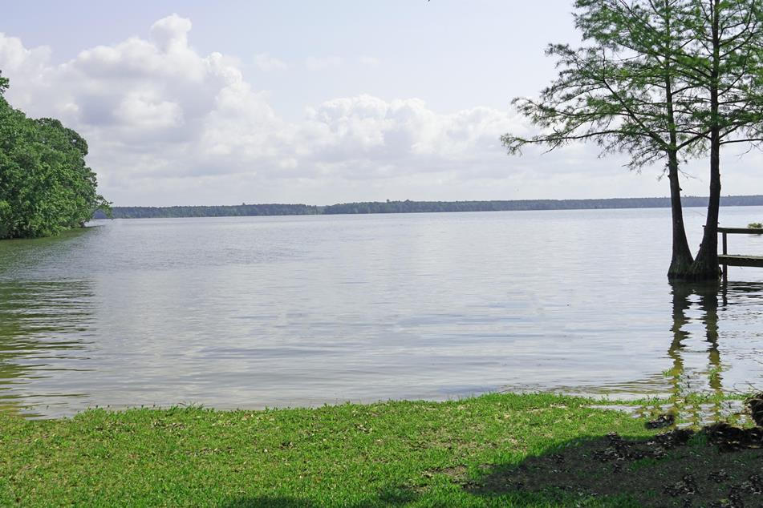
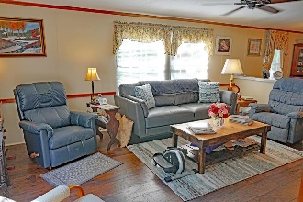
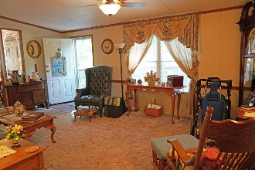
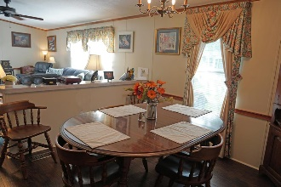
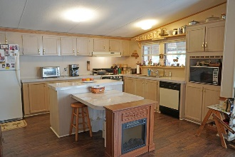
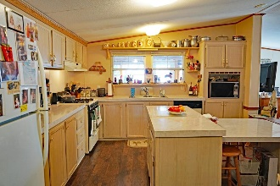
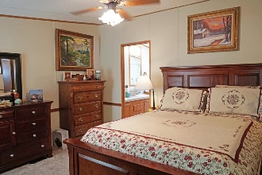
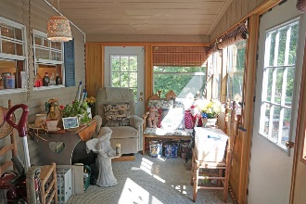
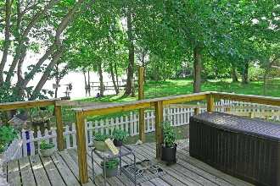
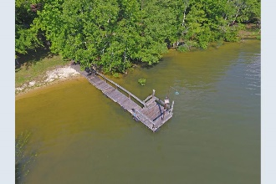
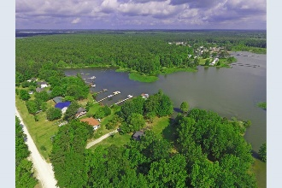

Buyers Loss Is Your Gain!
Back on the Market!!
Lake Moultrie Under 200k
702 Short St
Pineville, SC 29468 ~ MLS# 19016263 ~ $189,000
Waterfront Lake Moultrie Sitting with a Big Water view tucked into Halls sub-division. Sitting on your porch you can enjoy the best the Lake can offer. Just around the bend from Angels Landing. Neighborhood boat ramp for easy access to boat launch. This is a Leased lot on the lake. 3 bedrooms with a large Kitchen, formal living room, Den and heated sun porch. Front and side porches to catch the Lake breeze at all angles. Make this the Summer/weekend home or the Full time retirement home.
Lake Homes Realty, LLC
Elloree, SC 29047
www.SCLakeLife.com
Kristie Anderson
(803) 387-9459
kristie@sclakelife.com

