Slide 1
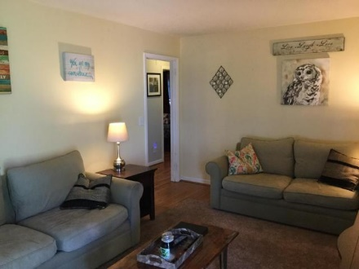
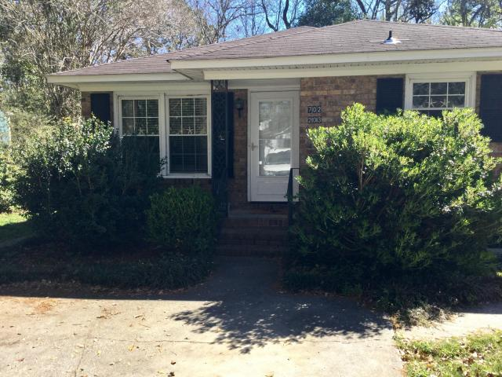
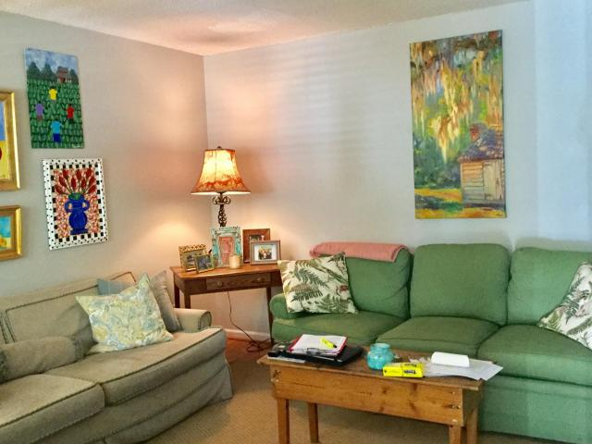

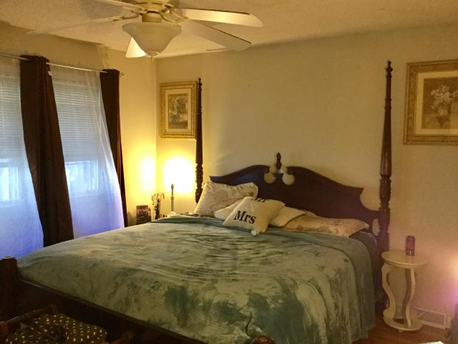
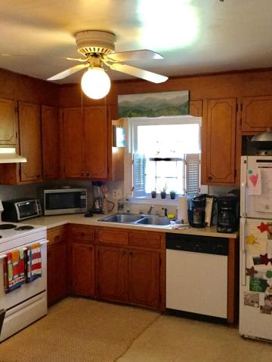
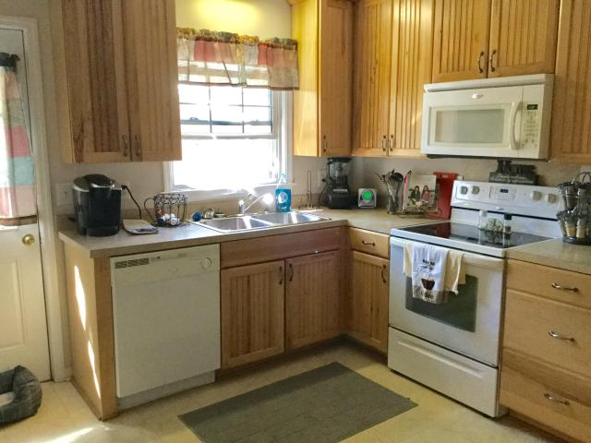
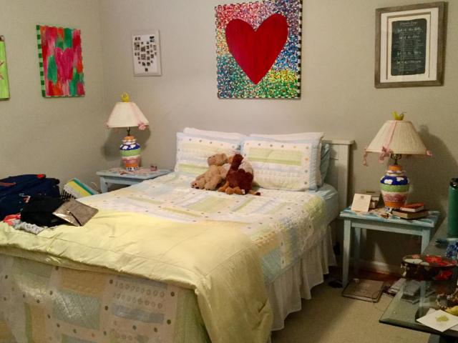
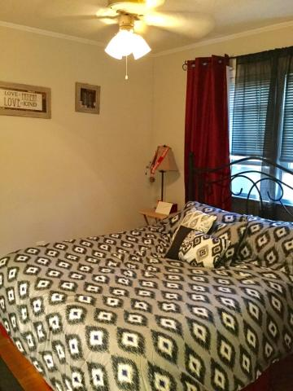
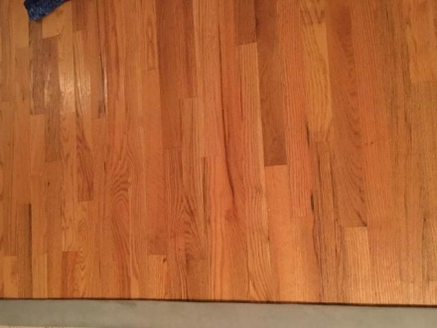
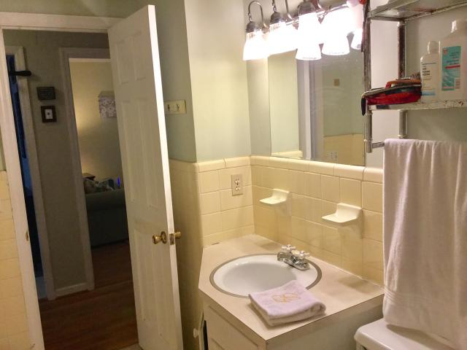
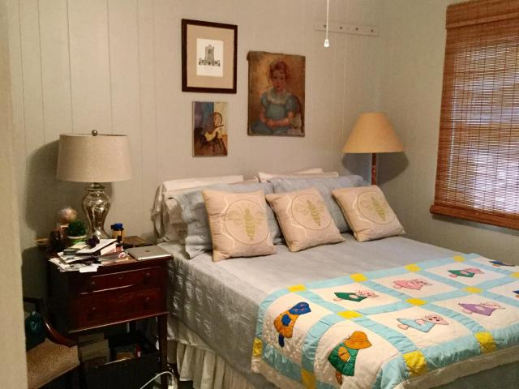

Parkshore Marshfront
Craftsman Cottage on
Daniel Island
702 Tall Oak Avenue A & B ~ Ashley Forest ~ Charleston, SC 29407
MLS# 17007789 ~ $390,000
Well maintained duplex with fantastic rental history. This duplex is within walking distance to all the restaurants and shops in the highly desirable Avondale area and 5 minutes from downtown. Both units have 2 good sized bedrooms, 1 bath with tiled tub /shower, a large eat in kitchen with an exterior door and a nice sized living room. Hardwood floors in living room, hallway and bedrooms. Each unit has its own laundry /storage room in the back of the building. Nice backyard sitting area . Both units are rented and leases end May 31, 2017. Seller has a January 6, 2017 appraisal for $390,000.
Coastalina Realty of Charleston
916 Palm Blvd
Ste 101
Isle Of Palms, SC 29451
Dar Venable, Realtor
Mobile - (843) 330-2424
dvislander@bellsouth.net
coastalinarealtyofcharleston.com

