Slide 1
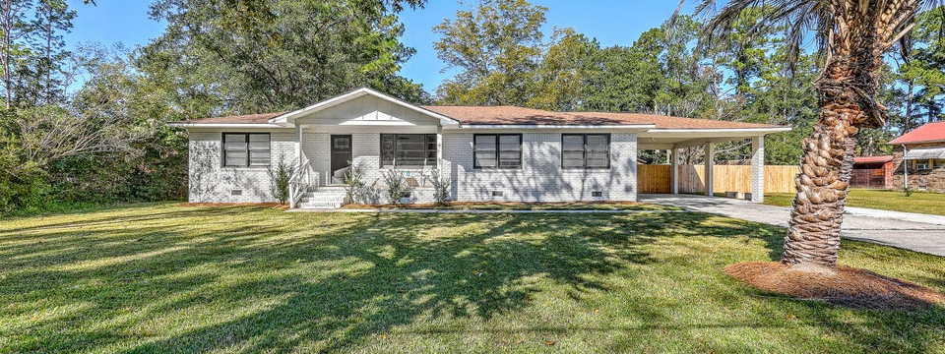
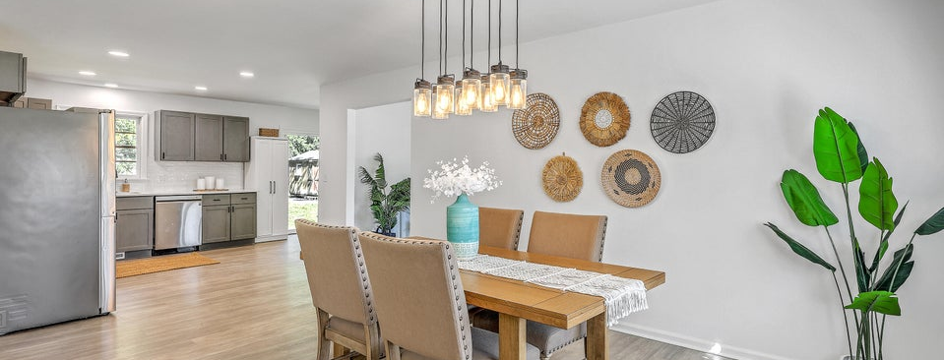
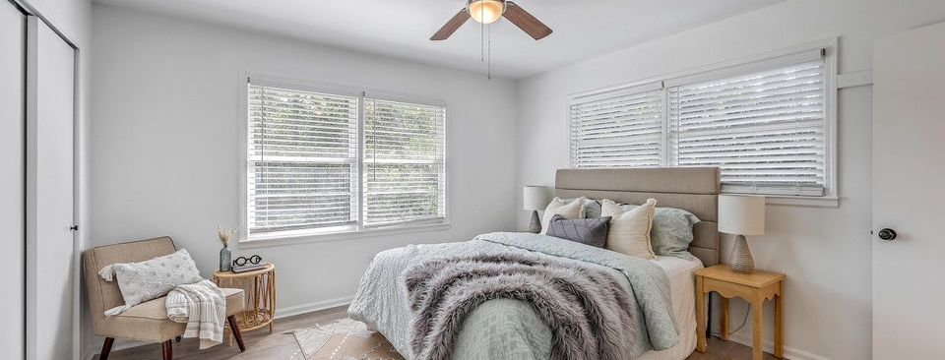
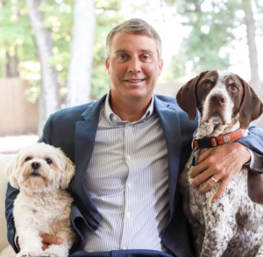
JUS
9714 ROSEBERRY STREE
MOTIVATED SELLER!
/
7
1/
ii
Fully Renovated + Priced to Sell
Open House on Sunday, November 2nd from 11am-1pm
702 N Palmetto Street | Summerville, SC 29483 | MLS# 25028702
TAKE A VIDEO TOUR!
�
$475,000
3 BED
2 BATH
1,800 SQ_FT
0.6 ACRES
Priced to sell and move-in ready! This beautifully renovated brick ranch in the heart of downtown Summerville offers an unbeatable blend of charm, modern luxury, and value. Set on a huge 0.65-acre lot, this home delivers space, upgrades, and flexibility that are rarely found this close to downtown- and it won't last long! With 3 spacious bedrooms, 2 full baths, and 1800 SF of well-designed space, this home provides a great opportunity for any buyer. Step inside to an open, flowing layout featuring new LVP flooring throughout, fresh paint, and two bright living areas perfect for entertaining or relaxing. The secondary den gives an extra space for an office, kids room, family room, and more. The fully updated kitchen impresses with new cabinetry, sleek counters, tile backsplash, and stainless-steel appliances with gas range, opening seamlessly to the dining and living spaces. Both bathrooms have been elegantly renovated with designer tile showers and modern fixtures, creating a crisp, updated feel from top to bottom.
Other recent upgrades include a new tankless water heater and a fully encapsulated crawlspace with Wi-Fi monitoring system- offering year-round comfort and efficiency.
Outside, enjoy the massive backyard with room for a pool and/or an additional dwelling or accessory structure, or potentially subdivide the lot. A powered, air-conditioned workshop/studio, garden shed, and covered carport add incredible function and value.
All of this with no HOA, just minutes from Doty Park, Summerville's historic downtown shops, restaurants, schools, and parks. This one checks every box- space, style, upgrades, and location- all at a price designed to move.
Schedule your showing today before it's gone!
Scott Baskin
THE SCOTT BASKIN TEAM
843-324-4139
scott@explorecharlestonrealestate.com
SCOTT BASKIN TEAM

