Slide 1
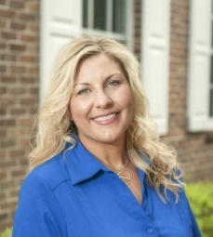
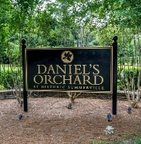
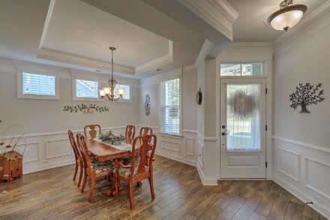
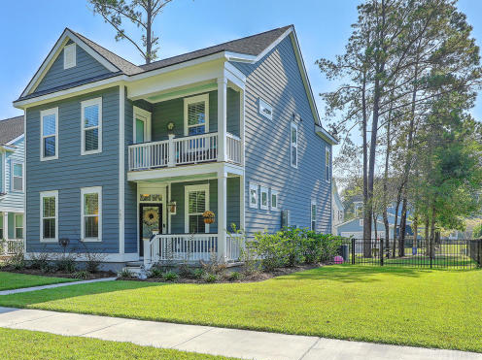
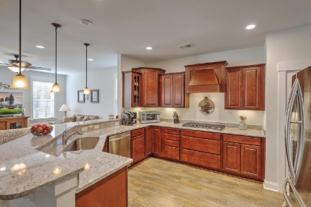
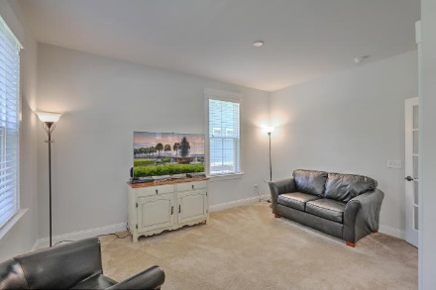
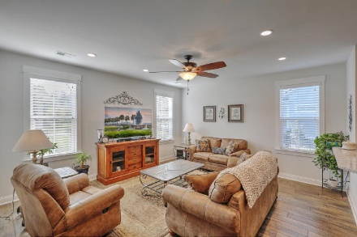
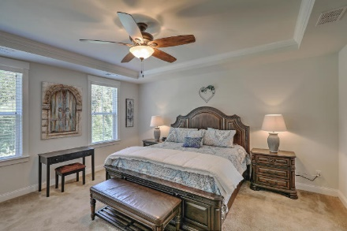
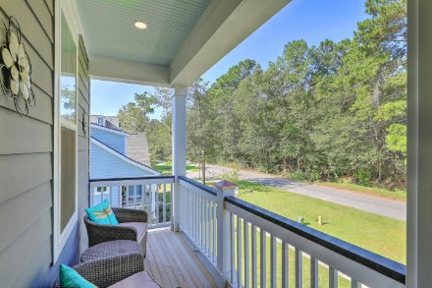
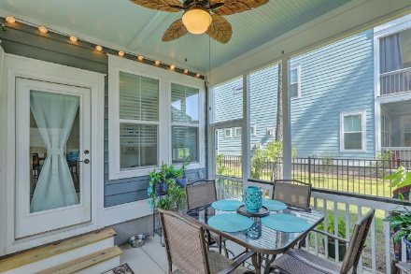
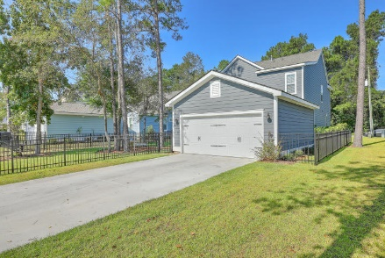

Daniels Orchard
Open House
Sunday 1pm-4pm
Reba Cole
M (843) 819-7322
rcole@century21properties.com www.century21properties.com
703 N Hickory Street | Summerville| MLS# 17026653 | $347,000
Sellers are contributing $5000 toward Buyer's Closing Costs with a full price offer!!! Schedule a showing of this awesome home in the boutique neighborhood of Daniel's Orchard in beautiful Summerville, SC! Daniel's Orchard is a unique community with only 48 homes! You will love the ponds, gazebo, park and being within walking distance of Downtown Summerville. This wonderful home is less than a year old and is better than new. The current owners made wonderful choices and designed an upgraded beauty. The gourmet kitchen features a Gas Range and Stainless Appliances. There is a room on the first floor that can be used as a bedroom with a bath right across the hall. Many of the rooms can be used for what best suites the new owners with tons of flexibility and opportunity, The outside space is perfect for entertaining or just relaxing on the porches. This home is situated on one of the larger lots in Daniel's Orchard and features an extra long driveway that can accommodate 4 vehicles. This beautiful home is ready for new owners to love and make it their home. You must see it to believe the value!
Century 21 Properties Plus | 3301 Salterbeck St Suite 100 | Mt. Pleasant, SC 29466

