Slide 1
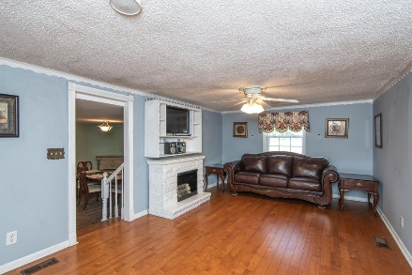
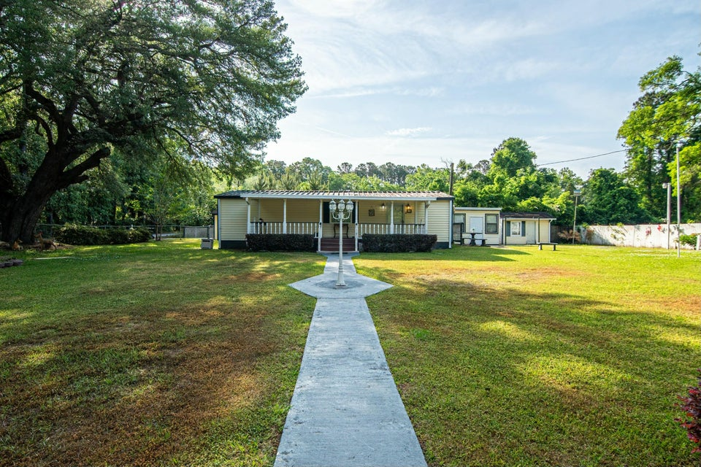
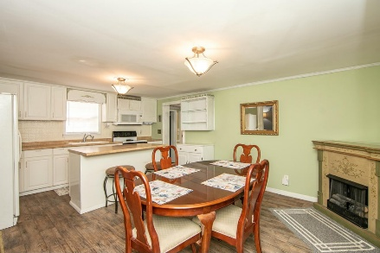
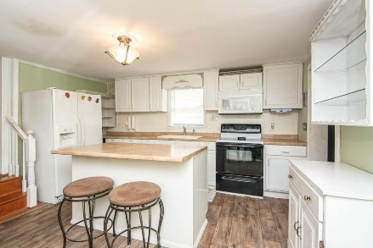

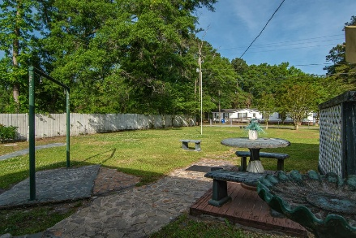
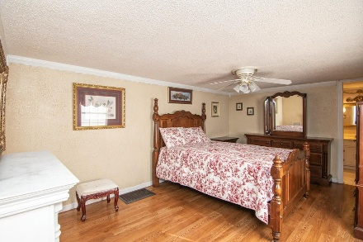
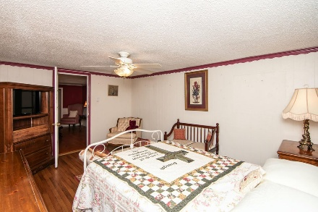
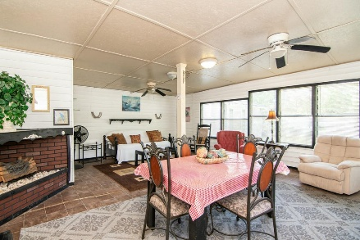

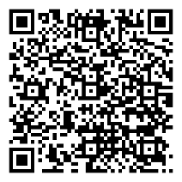
Price Reduced!
703 E Cain Street
Summerville, SC 29485 | MLS# 25010791 | $225,000
CAN ALSO BE COMMERCIAL (ZONED BUSINESSES) ZONED RESIDENTIAL AND COMMERCIAL
NO HOA - HUGE CORNER LOT – GARAGE - SUNROOM.
IN TOWN & JUST REDUCED TO $225K
Spectacular home on a huge corner lot! This home is very affordable and has been well maintained as pride of ownership shows! Formal living and dining rooms are great for holidays. The kitchen is wonderful for entertaining guests with beautiful cabinets and center island in the kitchen.. Family room features a cozy electric burning fireplace. This is a split floorplan so master is away from the other two bedrooms. Spacious main bedroom with a main bath boasting a Jacuzzi tub and separate shower. Fully gated yard has natural tree barriers adding privacy from neighbors. One car garage offers plenty of space and a storage unit to hold lawn equipment. This a must see! PARTIALLY FURNISHED
Laura McLain
843-509-7647
laura@lauramclainrealty.com
www.lauramclainrealty.com
The Boulevard Company, LLC | 806 Johnnie Dodds Blvd Ste 100 | Mt Pleasant, SC 29464

