Slide 1
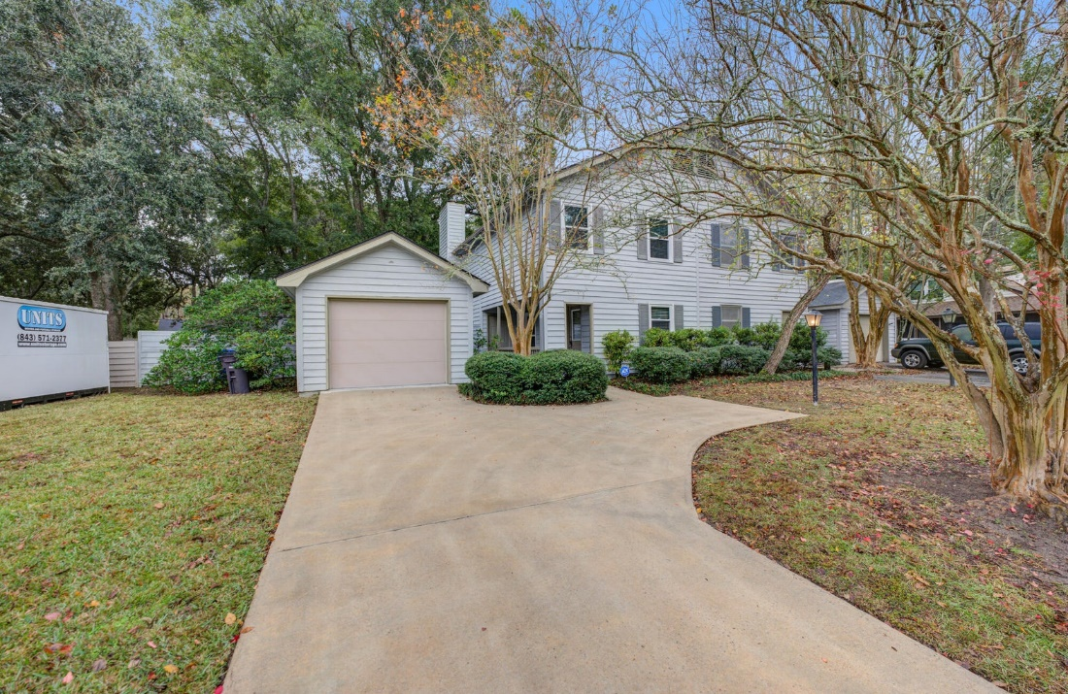
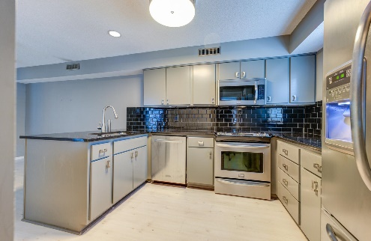
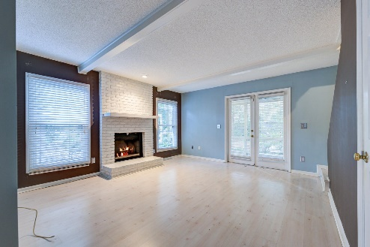
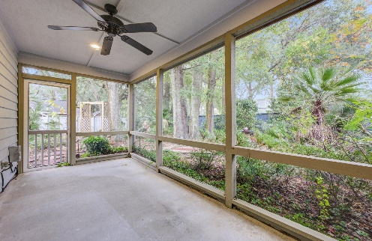
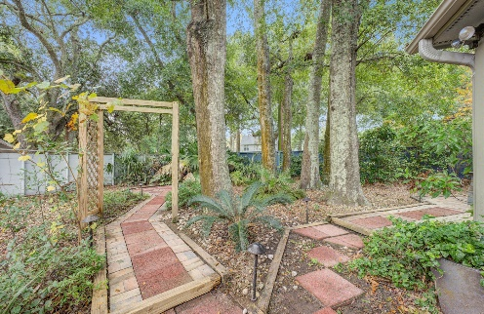


Just Reduced!
REDUCED
704 Fox Pond Drive
Fox Pond · Mount Pleasant, SC 29464
MLS# 23026415 · $690,000
Michael Dew
O 843-769-5100
M 843-870-7000
michaeledew@gmail.com
www.michaeldewrealestate.com
Fabulous Location!!!! 2 bed 2.5 bath home in the heart of Old Village. Laminate flooring through out. Eat in kitchen with stainless steel appliances, granite counter tops, and tiled backsplash. Family room with brick fireplace. Large fenced in yard. 1 car detached garage. Easy walking or biking distance to the harbor(enjoy the park at Alhambra) or the shops and restaurants on Coleman. Also convenient to Mt Pleasant Academy, Moultrie Middle, and historic Pitt St. Just minutes away from downtown Charleston and the beaches.
AgentOwned Charleston Group
902 Savannah Hwy
Charleston, SC 29407
Real Estate ● Mortgage Insurance ● Business Brokerage

