Slide 1
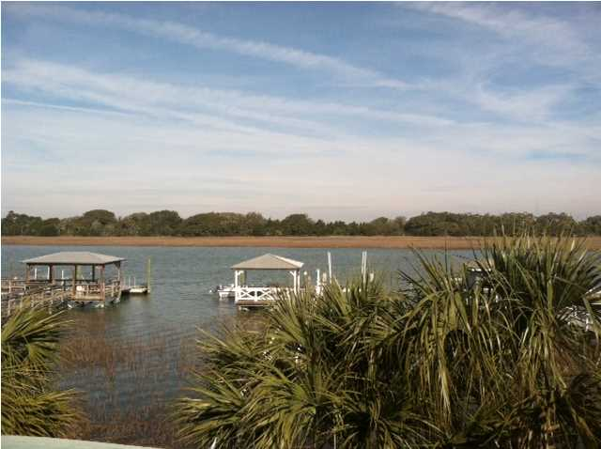
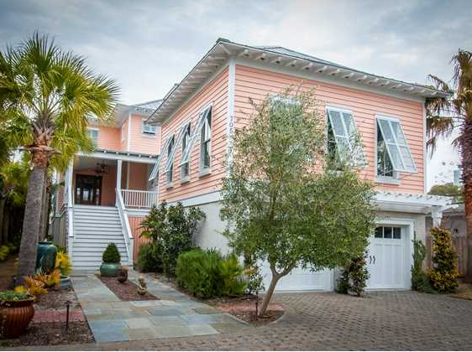
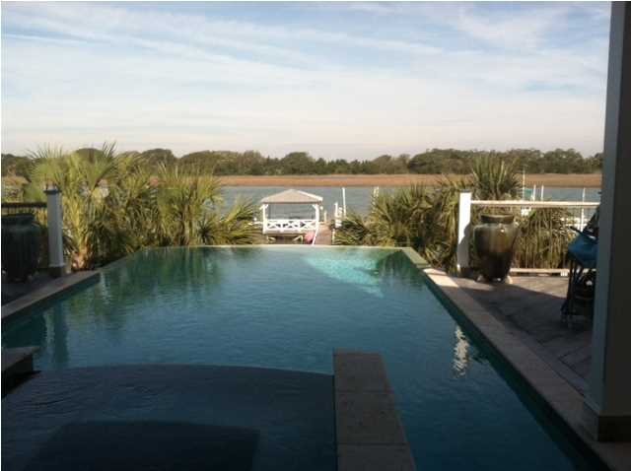
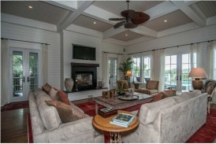
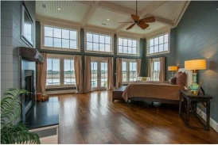
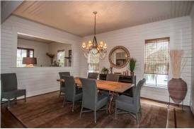
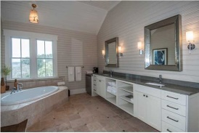
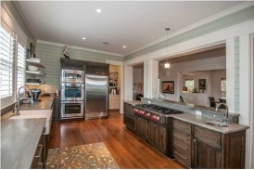
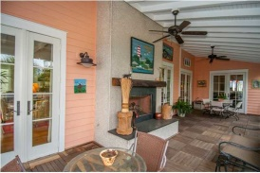

705 Palm Blvd Isle of Palms, SC ~ MLS# 1405538 ~ $3,499,000
Wine & Cheese
Agent Open House
Thursday 4-6
Truly a Spectacular Deepwater Estate! As soon as the beautifully handcrafted electric gates open, you know Paradise is found! This Home has top of the line everything inside and out. The Landscaping alone makes you feel like you are in the Tropics. The decks are all Ipe and The screened in porch has a beautiful Fireplace along with the Ipe Tiles making it a perfect outdoor Living space with fabulous views of Hamlin Creek. The sunset views from this home are a must see! The back deck views are unbelievable from the gunite swimming pool with infinity waterfall and infinity hot tub waterfall all looking over Hamlin Creek. As you enter 705 Palm, you are greeted with an impressive entry/ foyer, separate dining room, extremely large open gourmet kitchen complete with custom cabinets and hardware, two sub zero refrigerators, a large Wolf gas range, granite countertops and all the other bells and whistles you could possibly imagine in a dream kitchen! The kitchen is open to a fabulous great room complete with all toung and groove wood walls and 12 foot ceilings all with fabulous views of the water! The first floor also boasts a large media room, nice size guest bedroom/full bath and two nice storage rooms for an office or wine cellar. The elevator goes to all floors. On your way up the beautiful staircase to the second floor you will be impressed by the barrel ceiling detail and wood inlay. The second floor has two more guest suites and the large laundry room with lots of storage. The Master Suite is located on this floor as well and is truly a masterpiece! This Master Suite comes complete with two large walk in closets with custom built cabinetry, fireplace, 15' ceilings with much detail, a master bath complete with a jacuzzi tub overlooking the water, 16' vanity with a refrigerator and custom shower. The Master suite also boasts a 700 sq ft deck overlooking Hamlin Creek! The entire house has 8 foot paneled doors and heavy oil rubbed bronze hardware, all floors are 1/4 sawn oak, 3 fireplaces with gas logs, Anderson windows and french doors, irrigation with well. interior and exterior lighting systems, invisible fence, stereo and alarm system, generator, elevator, closed cell foam construction, plus, plus, plus!!!A short Ipe decked walkway leads to the dock which features a 12,000 lb lift. The 40' floating dock is perfect for fishing or catching those blue and stone crabs! The dock also has a 20x20 pier head that is covered with a "Galvalume" commercial metal roof which matches the home. Two dock boxes, fish cleaning station, shower and ceiling fan are also included. Last but not least, this home has a fully enclosed space underneath about 3800 sq ft with lots of possibilities! If you are looking for an amazing Deepwater Estate, look no more, it's 705 Palm Boulevard!!
Holly Covington
Office - 843-971-1312 Mobile - 843-442-4560
hcovington@thebeachcompany.com

