Slide 1
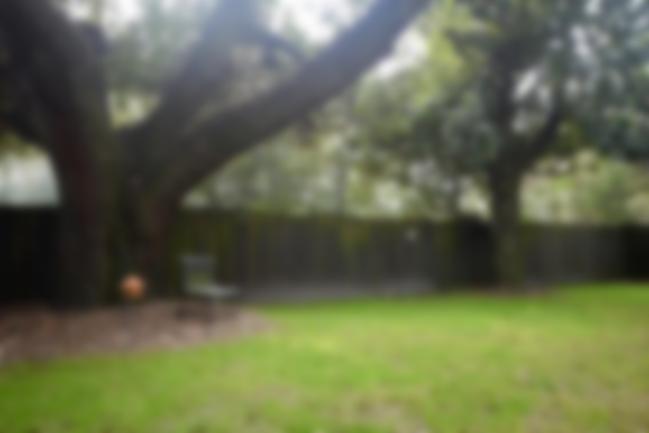
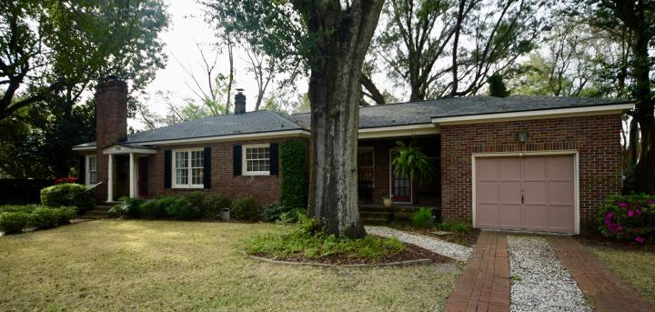
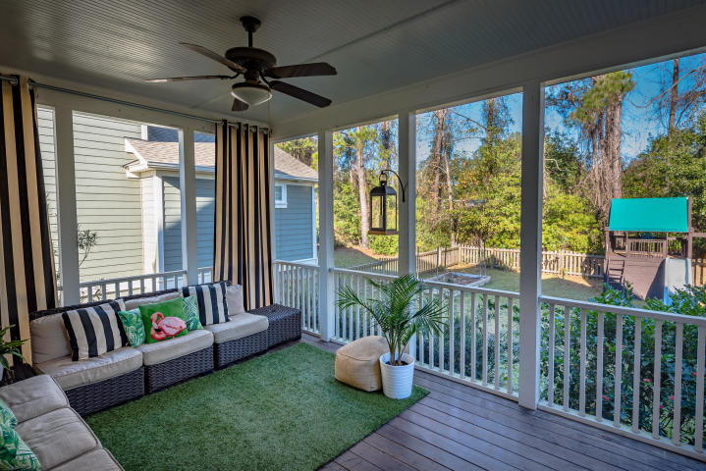
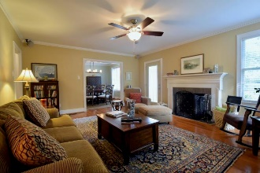
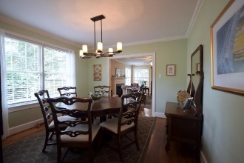
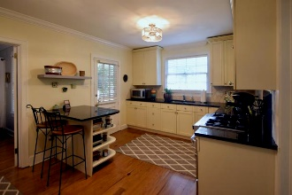
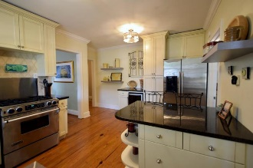
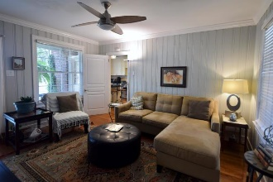
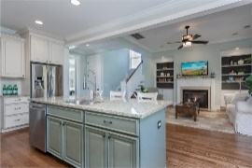
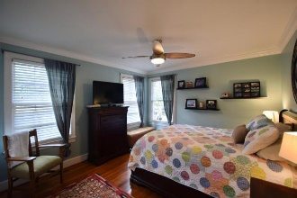
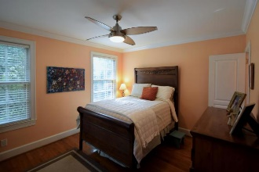
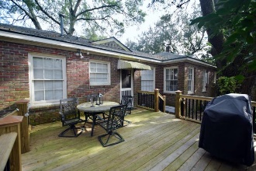
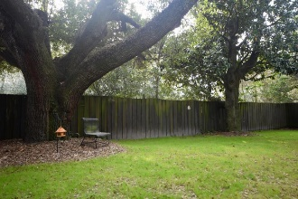
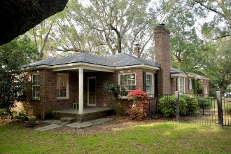


Great Home! Amazing Location! New Price!
705 W Harrison Road
Moreland | Charleston, SC 29407 | MLS# 19006249 | $419,000
You would be hard pressed to find a more adorable home located this close to downtown and ideally situated for an easy commute anywhere. Charming Moreland brick cottage lovingly cared for with a great floor plan that makes for an easy flow. The kitchen is outfitted with beautiful cabinets, stainless appliances, gas range and a wine frig. Running behind the dining room and living room is the hallway that leads to 3 bedrooms. The smaller middle bedroom's closet contains the washer/dryer that was relocated from the garage. Off of the kitchen is a room that is currently being used as a den but could easily be used as a 4th bedroom with its own full bath and entrance! HVAC and roof new in 2016. The crawl space was encapsulated in 2018 with a dehumidifier added, duct work was also replaced. No water problems with the past events in the last couple of years. The owner does not have flood insurance as it's not required.
Gary Raymond (843) 729-3688 | gary.raymond@agentownedrealty.com
AgentOwned Preferred Group | 1400-G Palm Blvd. | Isle Of Palms, SC 29451

